Slide 1
Effective Mentoring for Students Brian D. Saunders, MD, FACS Associate Professor of Surgery and Medicine Director of Undergraduate Surgical Education Penn State College of Medicine Trouble Shooting Your Clerkship 105 April 22, 2015

Slide 2
Disclosures
None

Slide 3
Objectives
To describe the mentoring process and its central role in professional development
To identify the risks and benefits for all parties in a mentoring relationship
To dispel some common myths about mentoring

Slide 4
What do you do all day?
Endocrine surgeon
Teacher
Investigator
Administrator
Mentor
Mentee

Slide 5
Why?

Slide 6
“No man is an island”
“Meditation XVII,” John Donne

Slide 7
Definition
men·tor
noun \ˈmen-ˌtȯr, -tər\ : someone who teaches or gives help and advice to a less experienced and often younger person

Slide 8
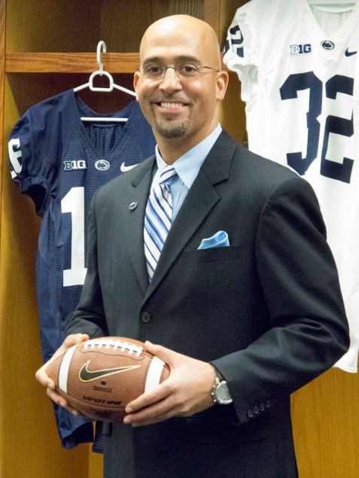
Synonyms
Coach | Guru
Trainer | Tutor
Advisor | Teacher
Counsellor | Instructor
Guide | Parent

Slide 9
The goal of a mentoring relationship
To build capacity and self reliance in the mentee

Slide 10
It is not …
Making clones
Dealing with underperforming individuals
Dealing with personal issues
Therapy
Allowing people to moan/whine/vent …..
except, maybe sometimes

Slide 11
Mentors
Vs.
Role Models
Sought for 1:1 consultation
Know their mentees
Interactive
Observed and imitated
May not know audience
Passive

Slide 12
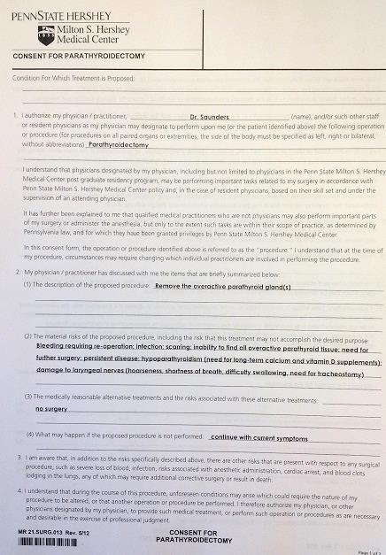
The process of mentoring

Slide 13
Stages of mentoring
Initiation
Cultivation
Separation
Redefinition

Slide 14
Critical elements
Respect
Trust
Listening skills

Slide 15
Types of mentoring functions
Career
Help the mentee learn the ropes and prepare for career advancement
Psychosocial
Help the mentee develop a sense of competence and clarity of identity

Slide 16
Hidden curriculum
Model the behavior you are asking of others
The mentee unconsciously adopts aspects of the mentor’s thinking, behaviors, and/or style

Slide 17
Qualities of a mentor
Positive:
Sincere desire to help
Sound judgment
Independent thinking
A tendency to think divergently
Good humor
Trustworthy and ensures confidentiality

Slide 18
Qualities of a mentor
Negative:
Attempts to undermine or compete with mentee
Dominates the relationship
Seeks a clone
Does the work for the mentee
Manages the mentee as a supervisor would
Know-it-all

Slide 20
Qualities of a mentee
Positive:
Takes initiative (to begin and drive the relationship)
Goal oriented
Seeks, accepts, and acts on feedback
Listens
Takes an active role in their own learning
Self-aware
Allocates time and energy for the relationship
Responsible for commitments

Slide 21
Qualities of a mentee
Negative:
Know-it-all
Unwilling to expend the time
Avoids decisions and relies exclusively on the mentor
Submissive
Acquiesces to or over-idealizes the mentor

Slide 22
Advantages of mentoring
Mentor:
Career enhancement
“Passing the torch to a new generation”
Learning (new technologies, new developments)
Share their expertise with another
Prove themselves as valuable leaders
Obtain a fresh perspective on the development process
Invest in the career of others
Recognition

Slide 24
Advantages of mentoring
Mentee:
Career advancement
Professional identity
Experienced guidance and support
Increased self-awareness and self-discipline
An expanded personal and professional network
A sounding board for testing ideas and plans
Constructive feedback on personal and professional development areas
Doors opened
Different perspective

Slide 25
Risks of mentoring
Mentor:
Time and energy commitment to mentee
Mentee dependence on mentor
Negative halo from mentee who fails

Slide 26
Risks of mentoring
Mentee:
Overdependence on mentor
Micro-management of mentor
Negative halo from mentor who fails

Slide 27
Myths of mentoring
Mentoring is monogamous (can be teams)
It only happens on a long-term, face-to-face, basis
Mentors needs to be older and more experienced
Only the mentee gains benefits
Taking the time to mentor decreases productivity

Slide 28
Advice to potential mentors
Recognize that mentee may be uncomfortable with asking for help – break the ice by sharing some of your career experiences
Stay in your zone of expertise/experience
Extend the mentee’s network – suggest additional mentors to address unique needs
Be clear that the mentee sets the pace
Advise, do not manage

Slide 29
What does the research reveal?
With mentoring in academic medicine …
Mentees rate overall well-being as higher
Mentees have an increased sense of security, hope about the future, and motivation
Mentoring was deemed an important influence on:
Personal development
Career guidance
Research productivity (publications, grant success)
Development of professional competence
Establishing professional network
Allowed students to identify themselves more as doctors

Slide 30
Additional conclusions
Most surveyed say lack of mentoring is the #1 or #2 most important factor hindering career progress in academic medicine
Women perceive more difficulty finding mentors
Same gender or same race matches are not essential
Maintaining clear boundaries is essential for an effective relationship

Slide 31
Truly complete mentor
Serves as an advisor/guide, developer of talent/coach, opener of doors/advocate, role model, interpreter of organizational or professional rules, protector, rule setter/boss, and carries on all of these functions of a long- term basis.
W. Silen, MD
Dean for Faculty Development and Diversity,
Harvard Medical School, 1998
Notes:
…

Slide 32
Thank you
bsaunders@hmc.psu.edu

