Slide 1
Integrating simulation in Orientation decreases apprehension and increases satisfaction of Surgery Clerks Elizabeth Even, RN, MSN Nurse Educator – Feinberg School of Medicine Northwestern University, Chicago, IL

Slide 2
Challenge
Patient
Care
Gowning/Gloving
Prepping/Draping
Tubes/
Drains
Patient transfer
Suturing
Notes:
Students spent 1-2 weeks “getting comfortable”
Felt unsure of how to get involved on day 1
Learned several tasks independently
High anxiety level walking into OR

Slide 3
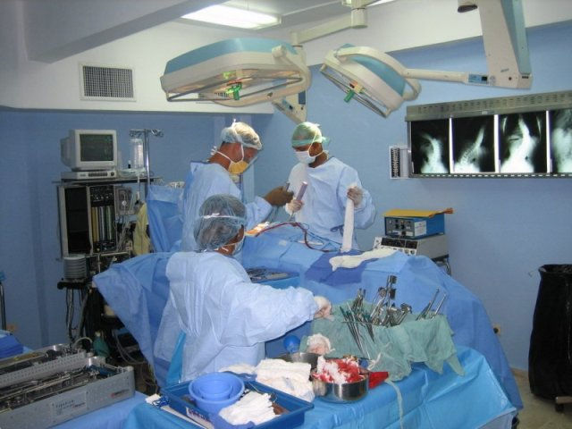
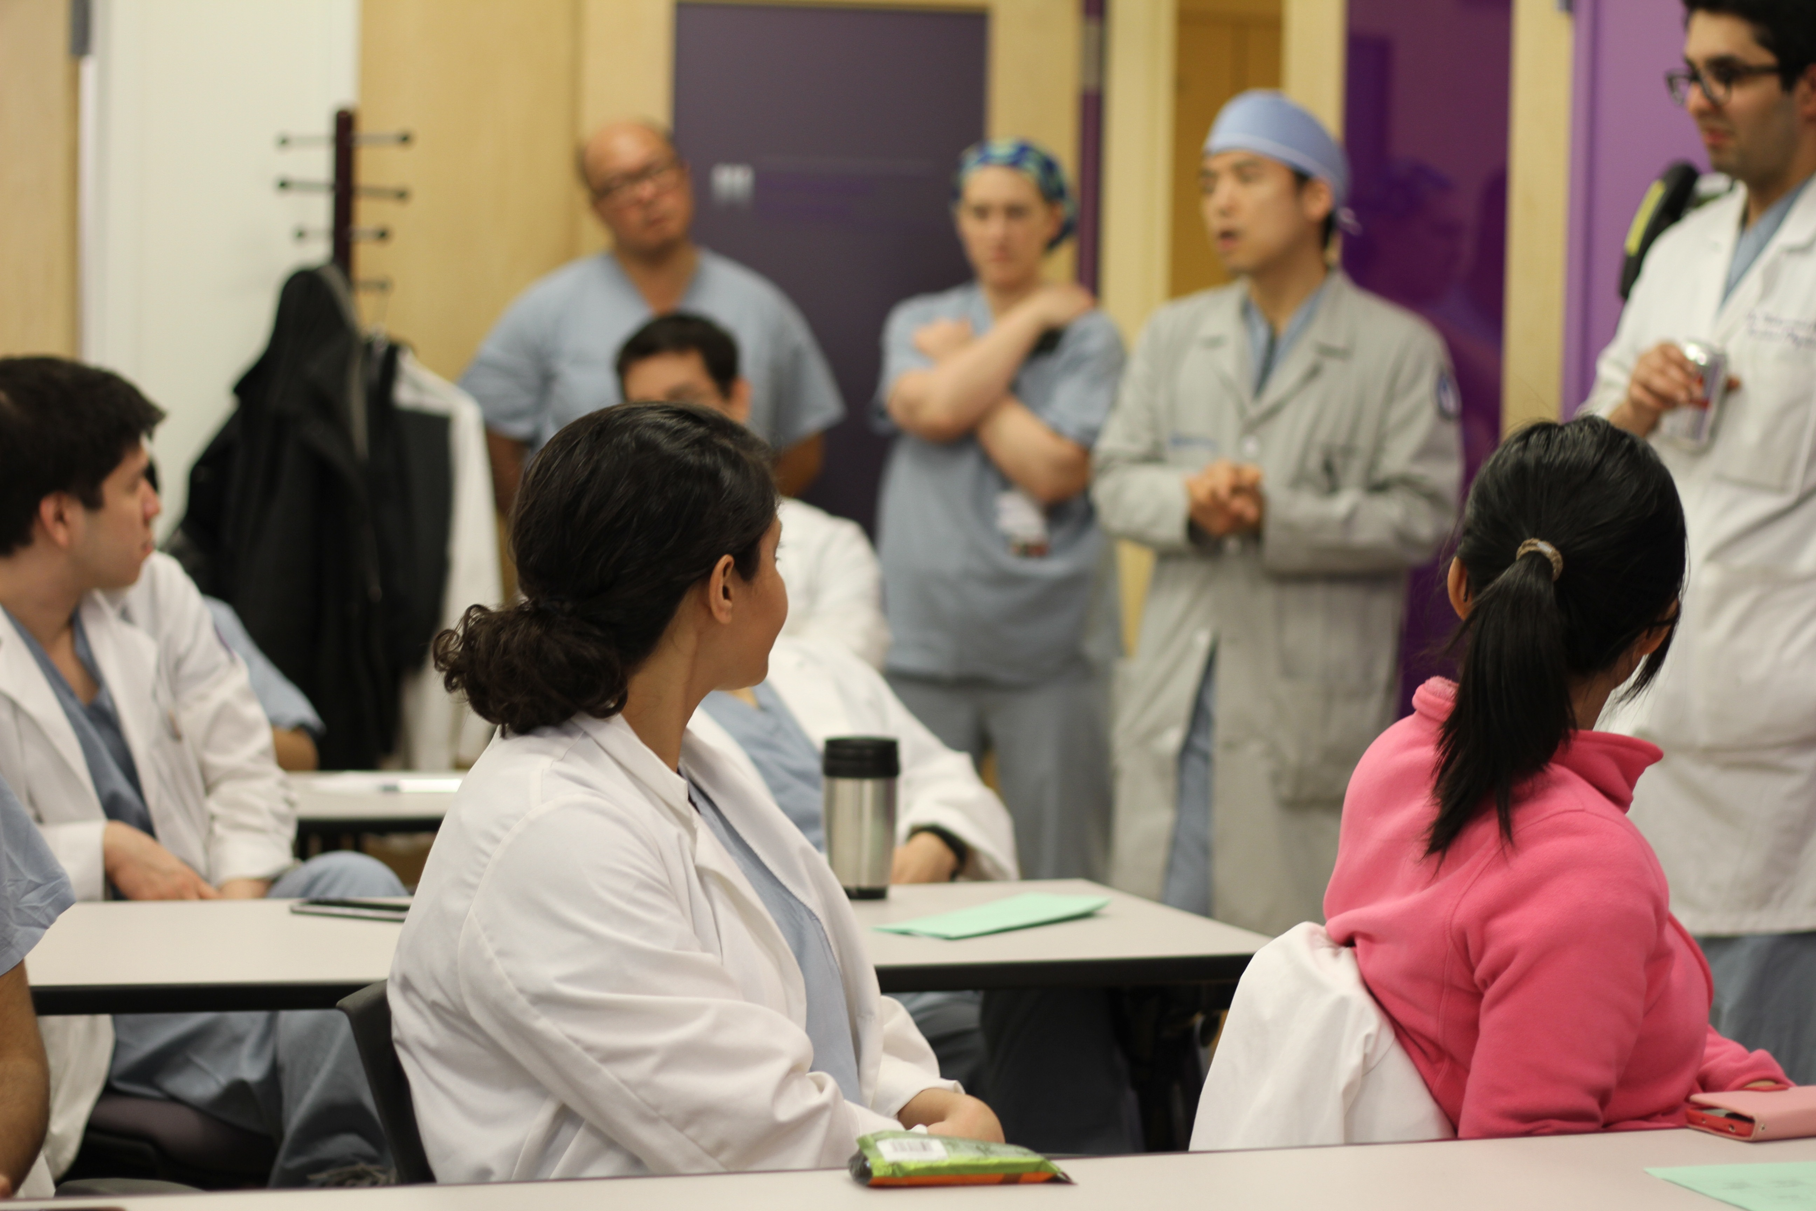
A “Simulated” Welcome
N=30
Notes:
Students broken into small groups
Multi-disciplinary mock case
Students are given “safe tasks” to complete
Case runs up to initial incision

Slide 4
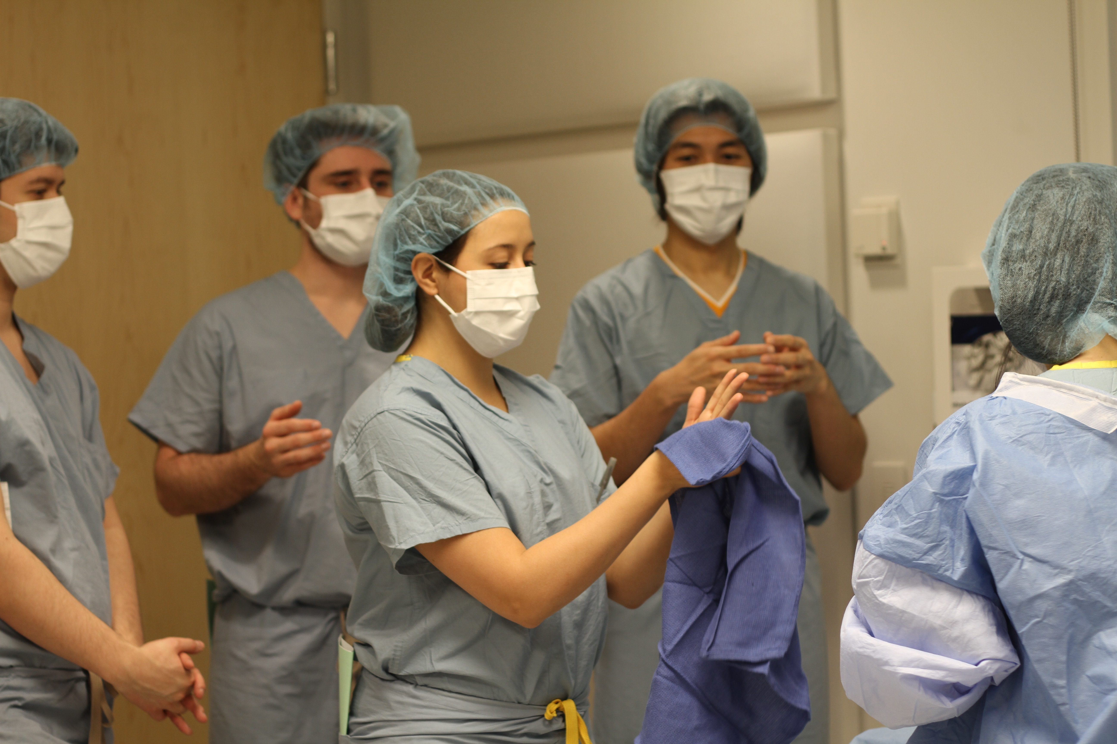
Method
Pre-op
Intro
Non-sterile
SCDs
Sterile
Gown/ glove
Prep/ drape
Verify
Transfer
Foley
Debrief
Feedback
Tips/ Pearls
Scrub
Transfer
Q & A
Notes:
Well of course there was food!

Slide 5
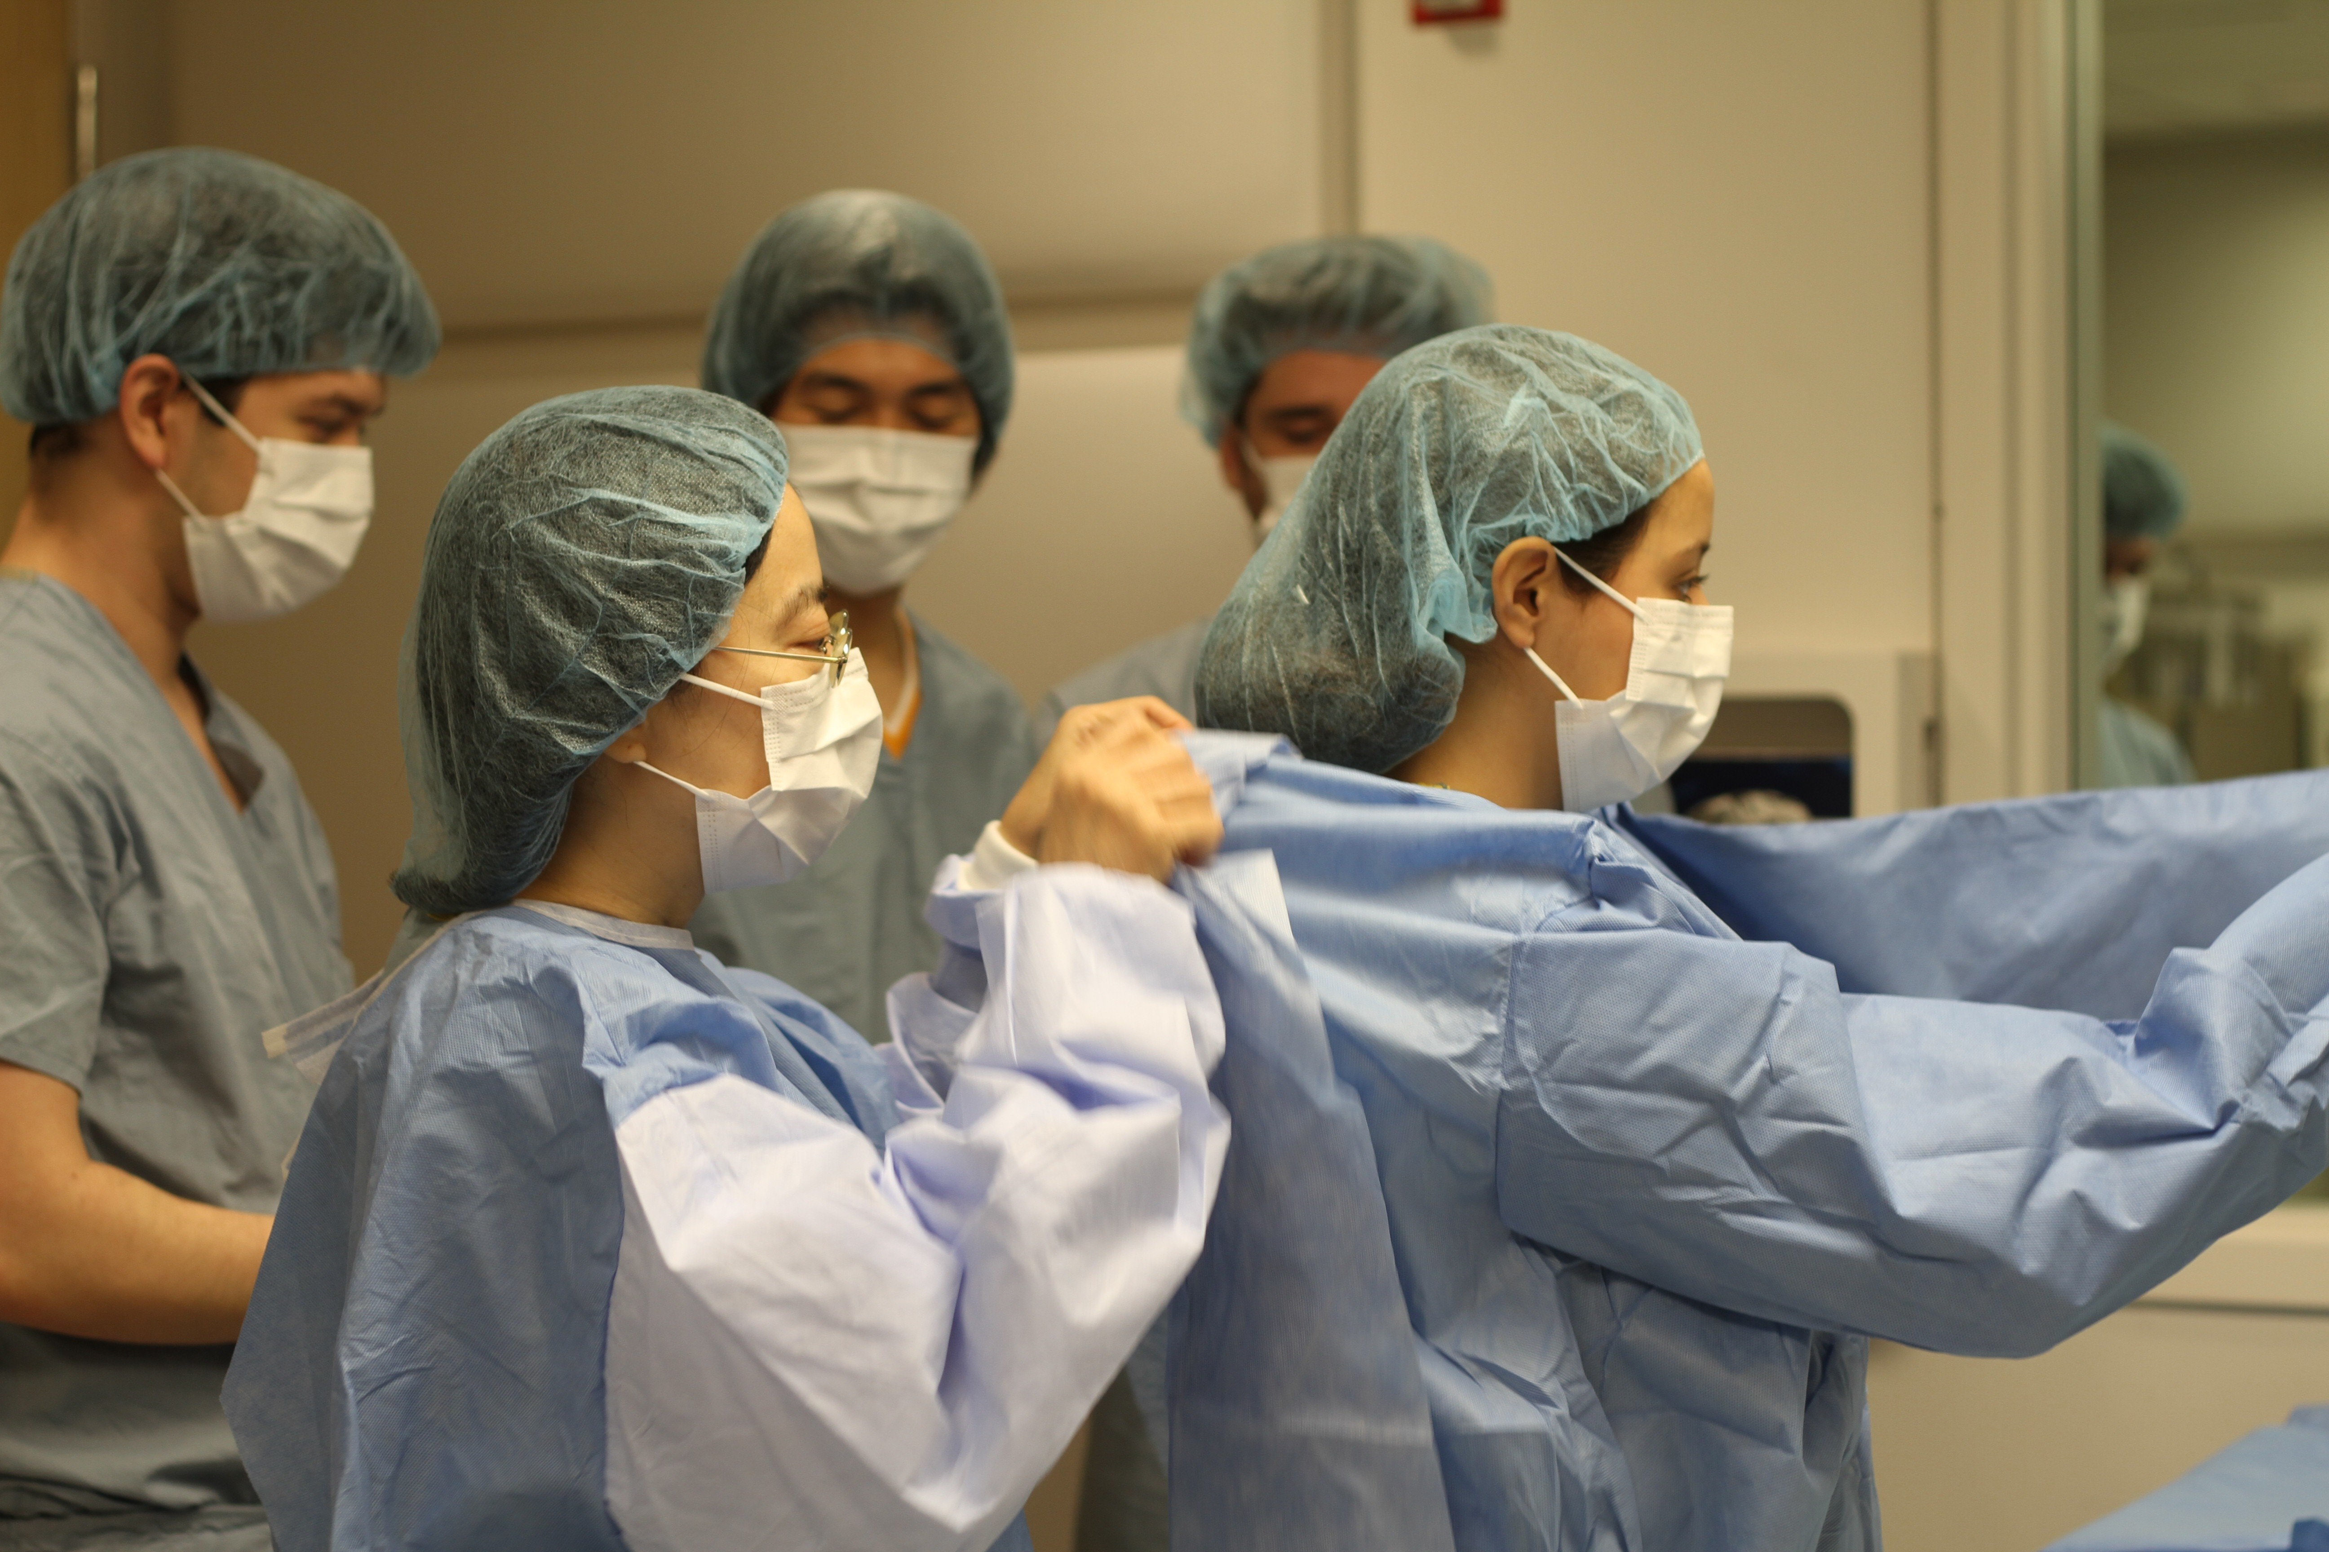
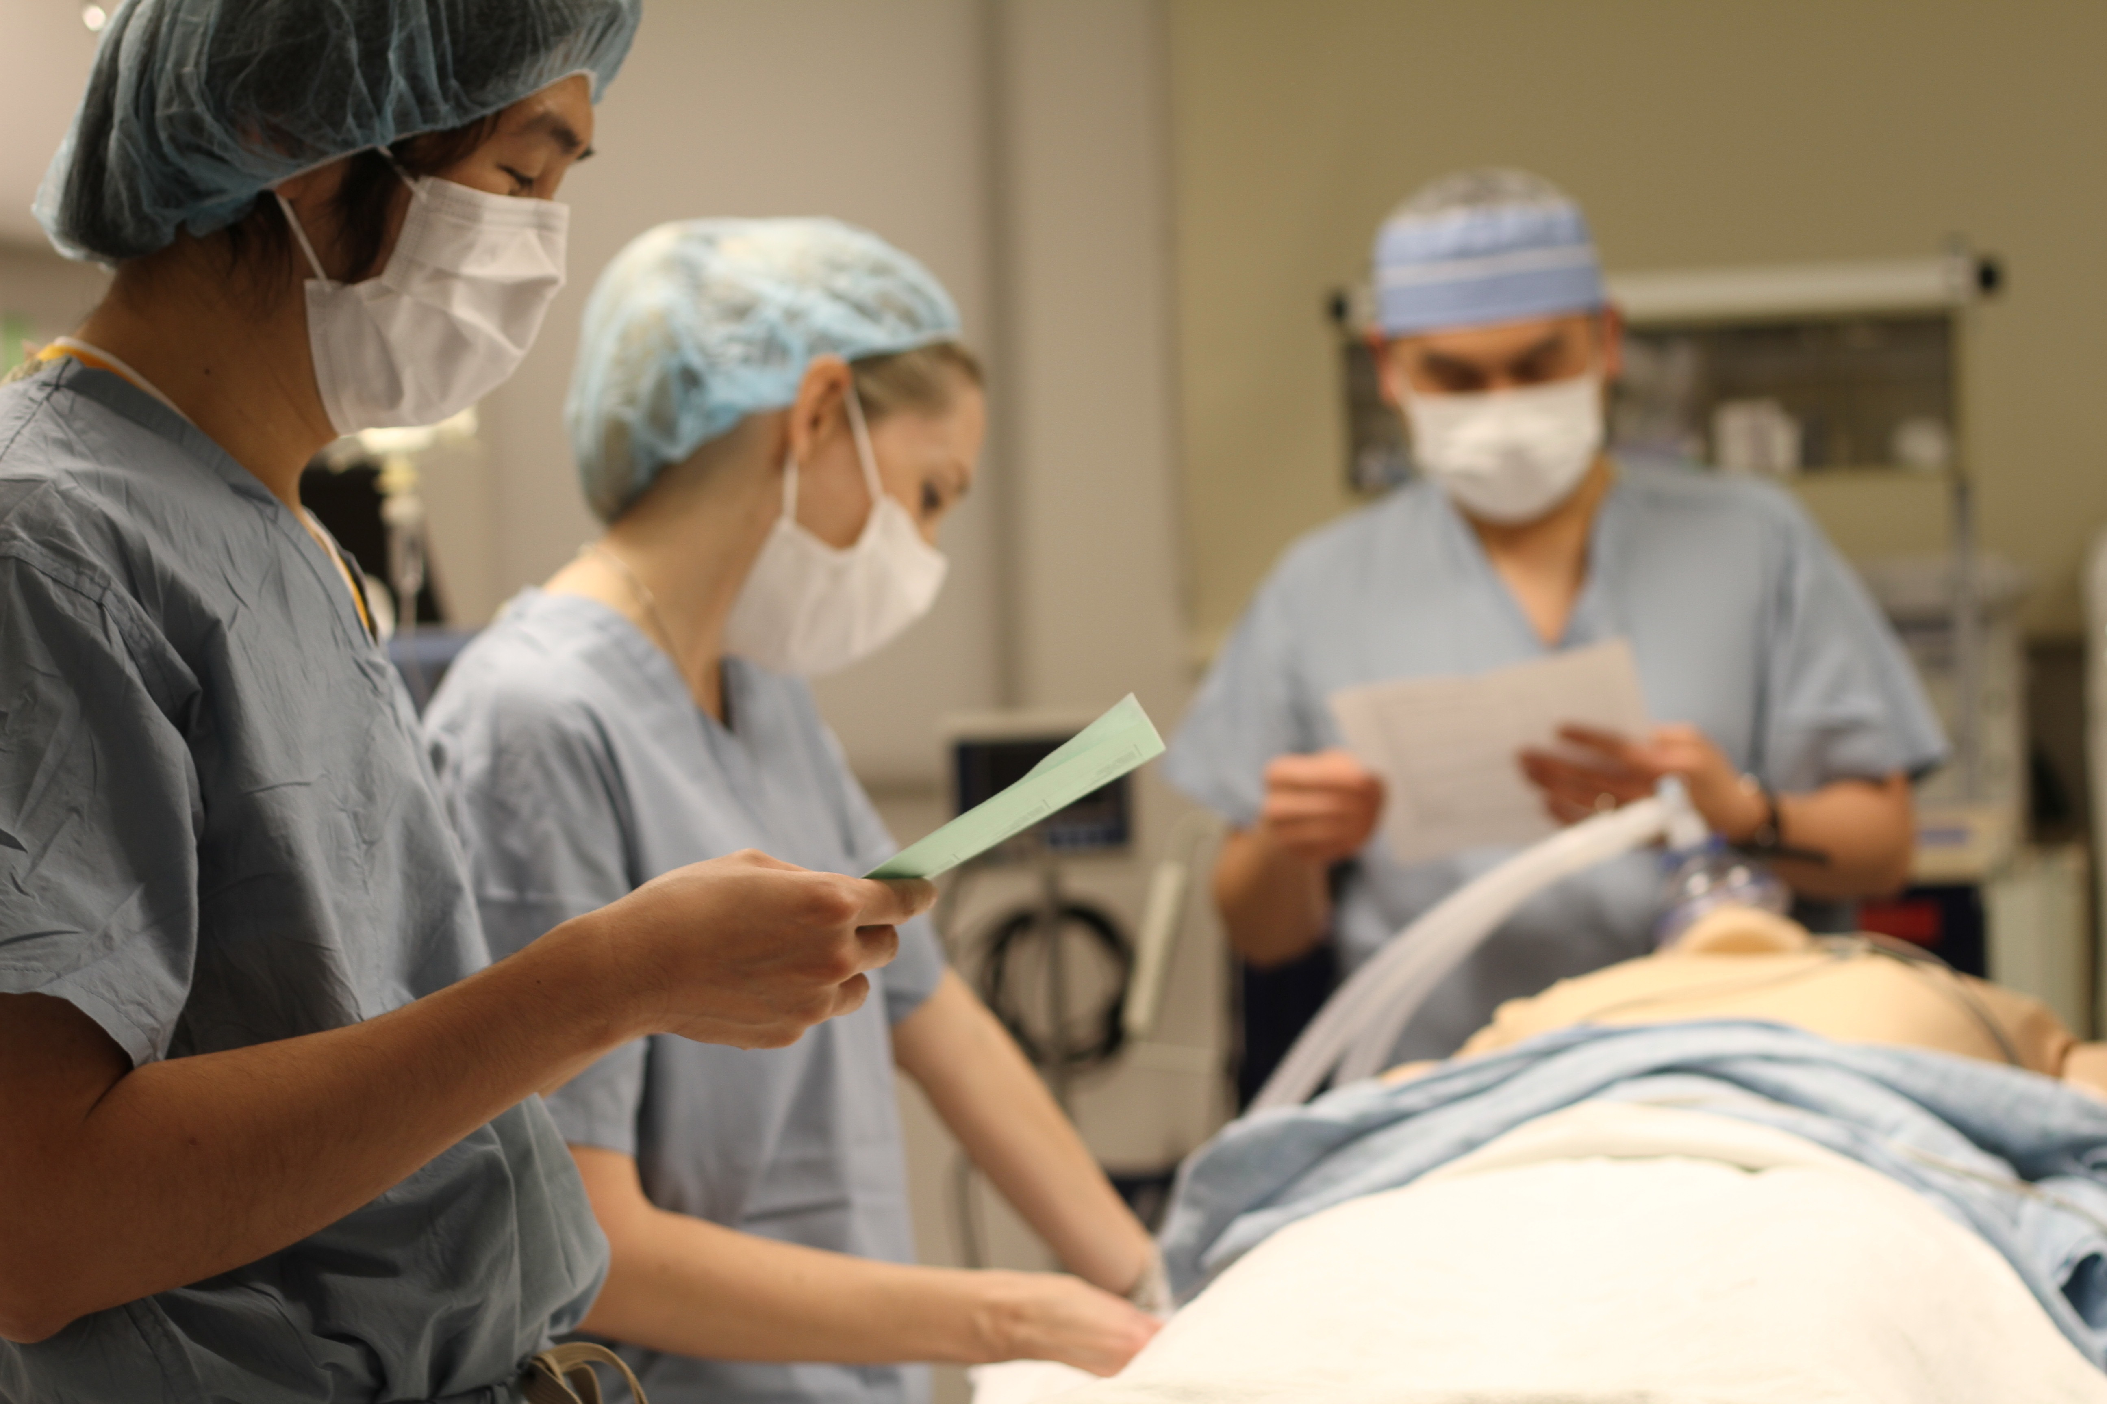
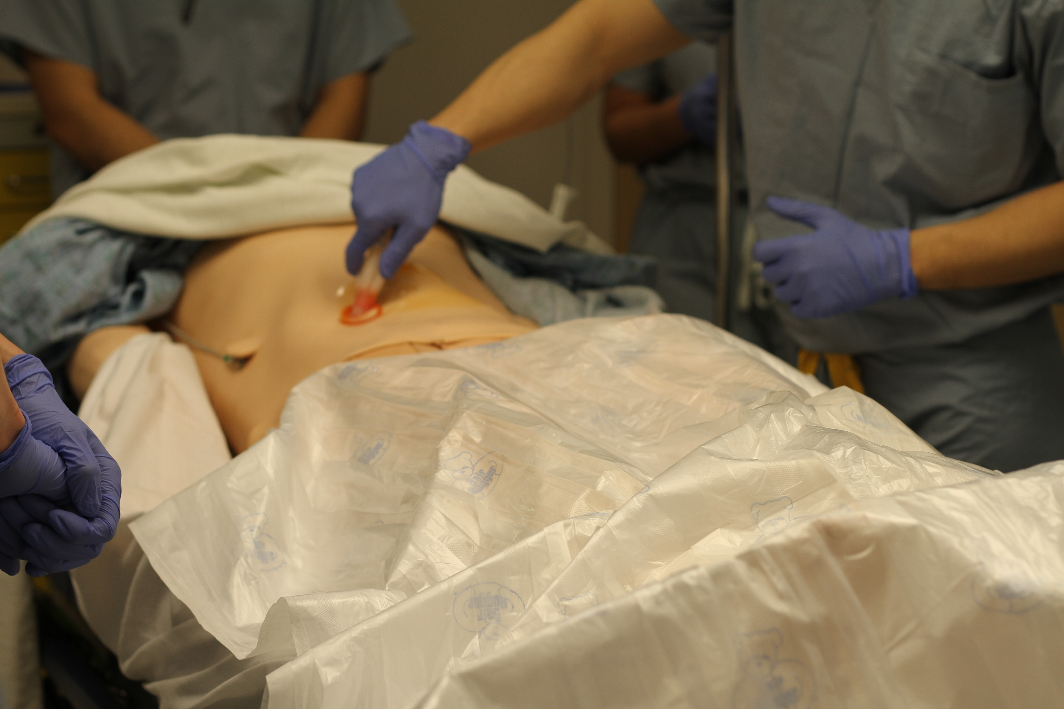
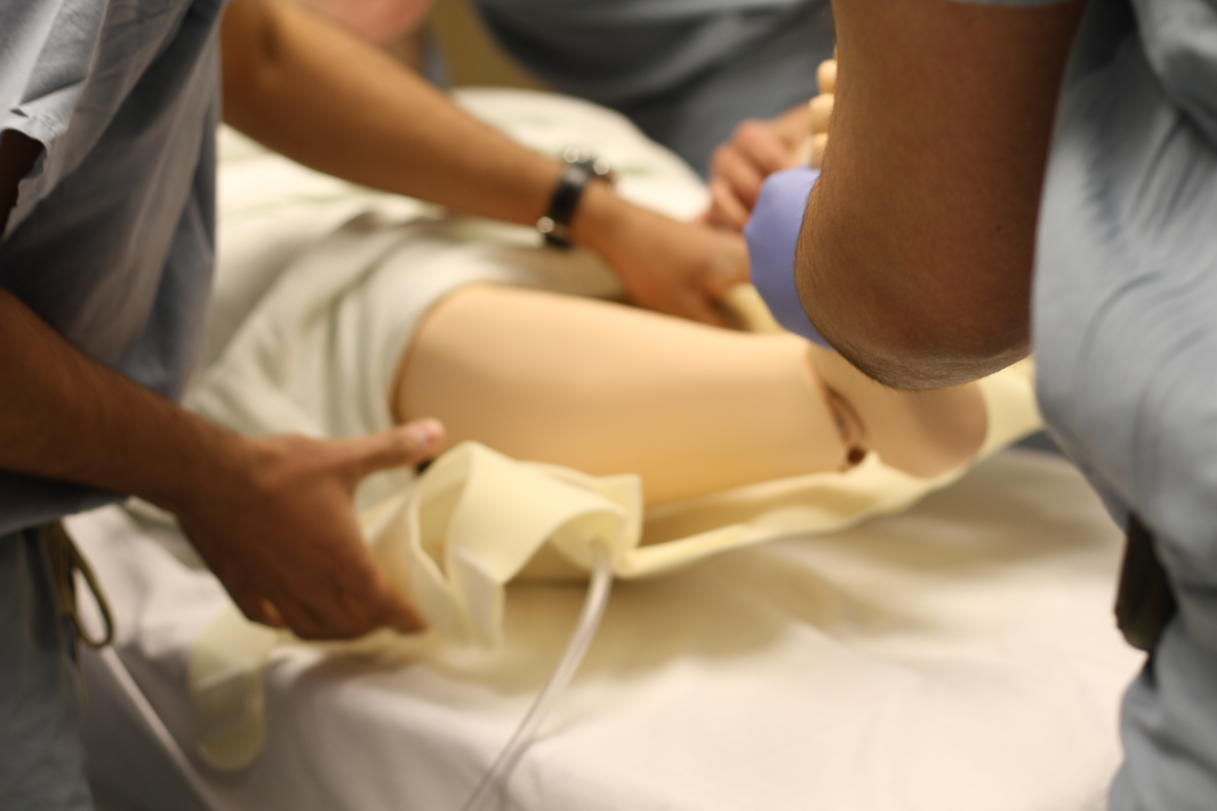
Tasks
Notes:
Increase clerk confidence
Increase involvement early
Increase clerk comfort level in OR in both showing initiative and speaking up

Slide 6
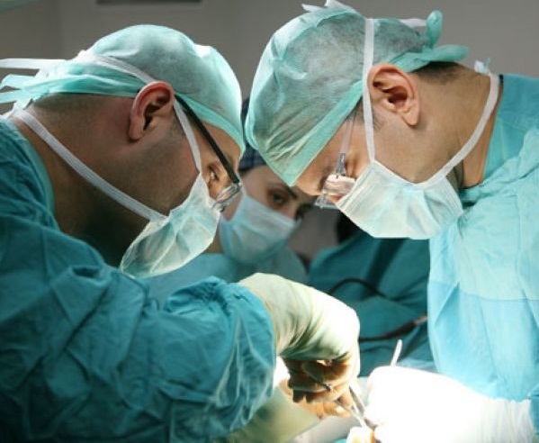
Goals
student
↑ Confidence
↑ Involvement
↑ Comfort
Notes:
Increase clerk confidence
Increase involvement early
Increase clerk comfort level in OR in both showing initiative and speaking up

Slide 7
Results
Notes:
Well of course there was food!

Slide 8
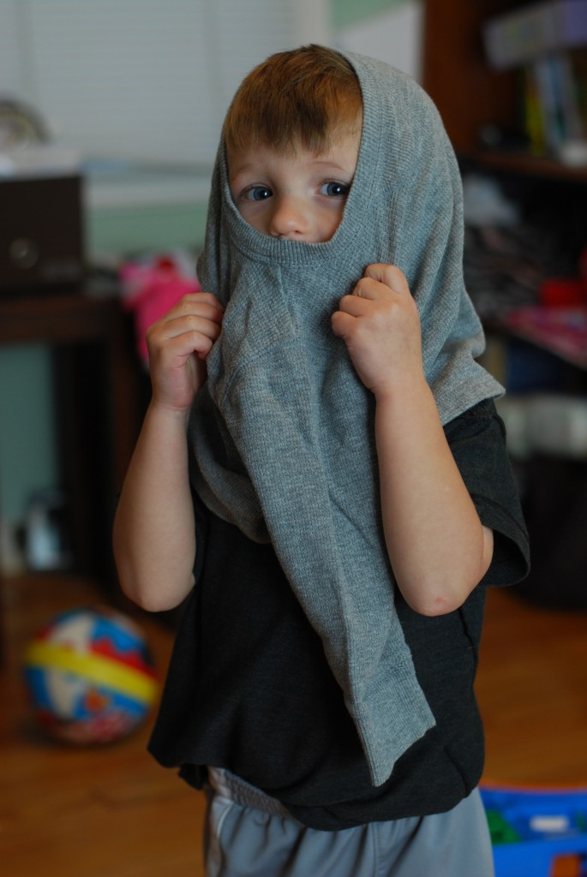
Implications for future simulations
Notes:
Include both start and end of case
Small group sessions such as procedure notes
Reinforce scrubbing, self-gowning and gloving

