Slide 1

New student orientation
Jesse Moore, MD FACS
University of Vermont College of Medicine

Slide 2

Objectives
Describe the essential components of a student orientation
Identify elements of greatest interest to students at the beginning of a clerkship
Identify optimal delivery techniques for curricular expectations
Incorporate opportunities for professionalism instruction to new clinical learners

Slide 3
What has to be included?
LCME Standard 6.1
  “…medical school ensures that the learning objectives for each required learning experience (e.g., course, clerkship) are made known to all medical students …”

Slide 4
What should be included?
Literature review…not helpful
Mid-rotation feedback (LCME req)
  Who, when, how, what’s required

Slide 5
What should be included?
Exams, grading policy
How to report mis-treatment
How to reach you

Slide 6
What should be included?
Why not ask our students?
  End of orientation & end of clerkship
  1st 2 sessions and last 2 sessions

Slide 7
What we do
1 hour with me
1 hour with clerkship coordinator
Core topics: shock, abd pain, abd CT, periop management, wound healing
Skills: suturing, knot tying, NG, foley, IV
Standardized patient: abdominal pain

Slide 8
What our students said
64 students
  Better response rate with early students

Slide 9
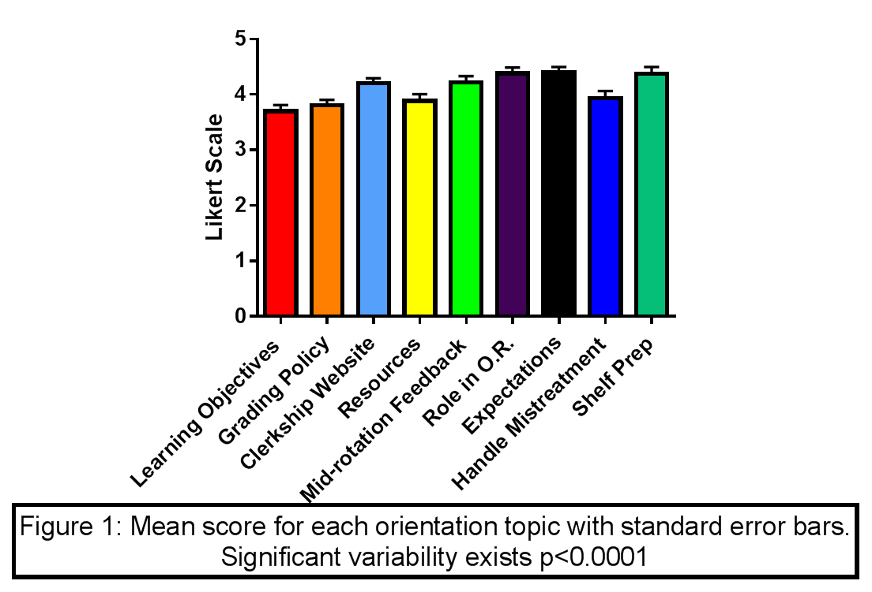
What our students said
*
*
*
Notes:
Find out from Conor if this is all students or stratified and which are signif (* are in the PPT)

Slide 10

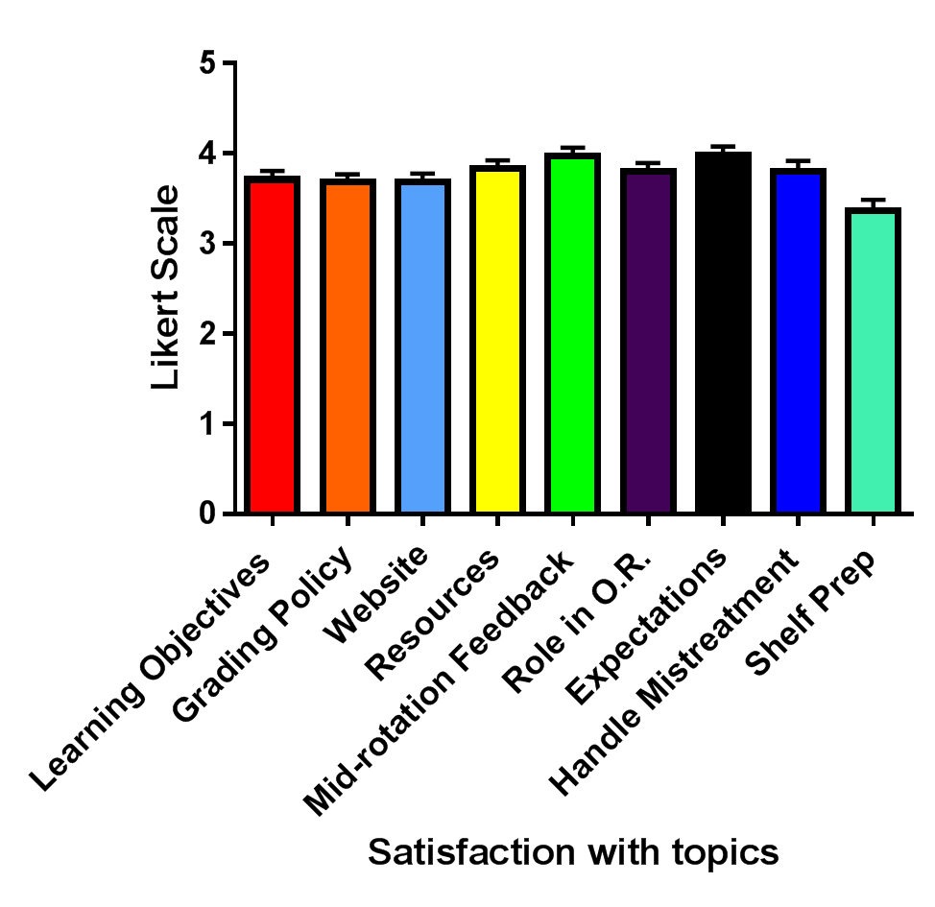
*
*
*
*
*
*
Notes:
Student responses after completing the clerkship show less satisfaction with our review of course expectations than responses immediately following orientation (p=0.0341)
Descriptive responses indicate 31% of early session students want orientation time devoted to hospital tours and ward expectations vs. 8% in later sessions (p=0.13)

Slide 11
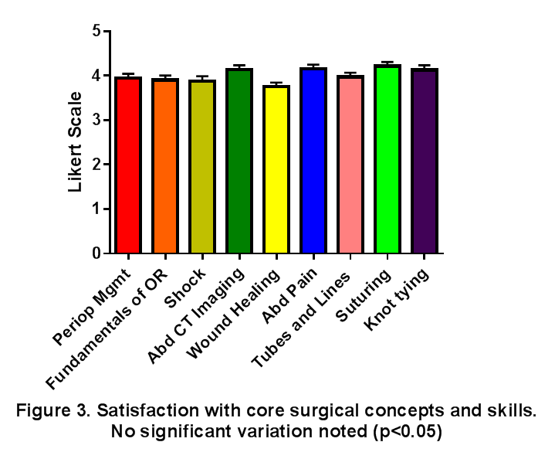
What might be included?
Core topics
Core skills
Notes:
Core topics
our data did not show that students valued any one area more than others
Clerkship directors should THINK about they’re curriculum, faculty strengths, disparities across affiliate sites
Core skills
over 80% of students felt the skills covered were sufficient (FIND out from Conor what some of the 20% said)

Slide 12

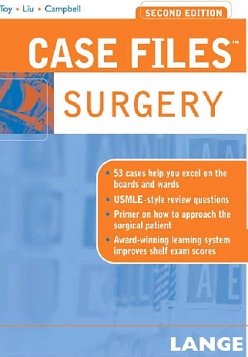
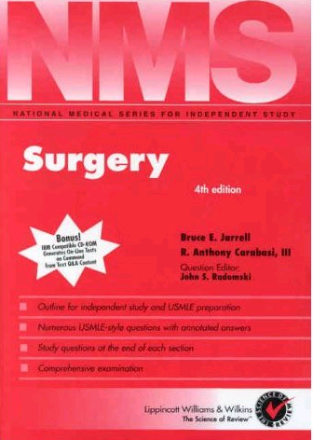
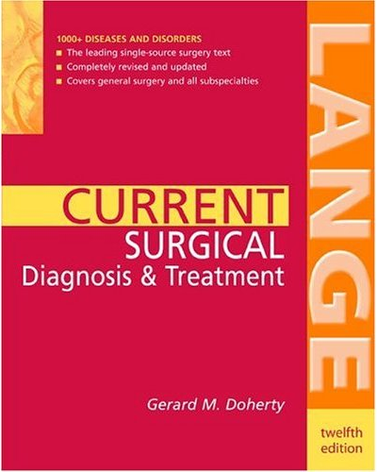
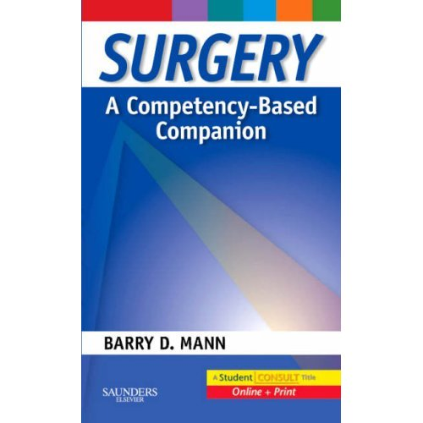
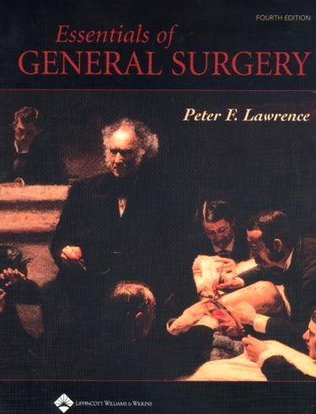
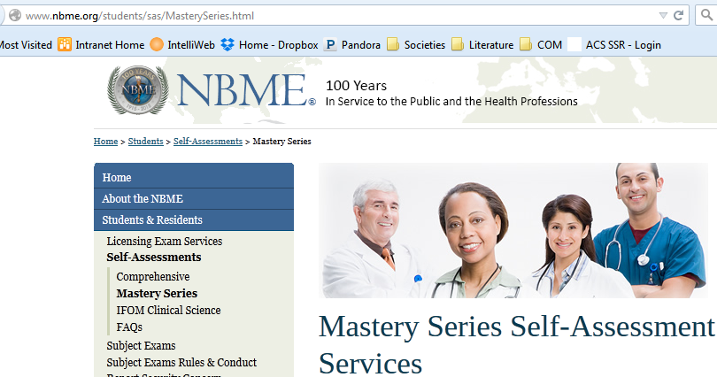

What might be included?
Study tips
Notes:
Information regarding shelf preparation rated as less satisfactory among all students

Slide 13
Expectations
My expectations
  Put the patient first – temporal
  Grooming/scrubs
  Timeliness
Notes:
Student responses after completing the clerkship show less satisfaction with our review of course expectations than responses immediately following orientation (p=0.0341)

Slide 14
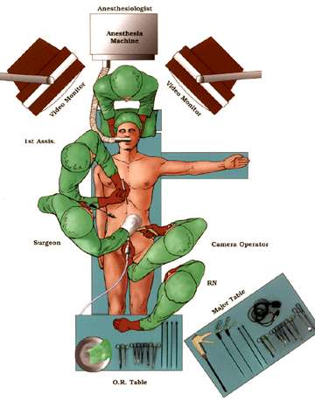
What to expect in the or
Surgeon
Resident
You !
Notes:
Discussion of priorities for each person and how that translates into teaching
pathophys and anatomy easy to teach
beginning and end of case
what they’ll get to ‘DO’

Slide 15
Expectations
Faculty expectations
  Prepping for the OR
  Tablets/smart phones/texting
Resident expectations
  document
Notes:
Student responses after completing the clerkship show less satisfaction with our review of course expectations than responses immediately following orientation (p=0.0341)

Slide 16
Professionalism
Set the expectations
  Grooming
  Tablets/smart phones/texting
  Timeliness
  Prep for the OR

