Slide 1


Slide 2

Optimizing Faculty Time
Jeremy Lipman, MD

Slide 3
No Disclosures

Slide 4

Problem
You have valuable content for the students
Need someone to deliver it
  Too many times to the well for some
  Others are sequestered
How to optimize all available resources to teach the students?

Slide 5
Overview
Develop strategies to recruit and motivate faculty for student teaching sessions.
Discuss options for alternative personnel for student instruction
Identify possibilities for self-directed learning

Slide 6
Survey
Limitations implementing ACS skills curriculum
50% - resident and faculty availability
  Time, space, money were others

Slide 7
Faculty Recruitment Tools
Faculty Development
Teaching Awards?
eRVU

Slide 8
Faculty Recruitment Tools:
Faculty Development
Improves attitudes towards teaching
Provides feedback
Peer role-models and networking
Learners notice improvement
Steinert, Med Teacher, 2006

Slide 9
Faculty Recruitment Tools:
Teaching Awards
Outcome data are limited
May be a double-edged sword
Accuracy, Motivation, Public
Schindler, DaRossa, J Surg Ed, Dec 2013

Slide 10
Faculty Recruitment Tools: eRVU
Teaching, Research and Service
  Attend journal club: 0.5 pts
  Grand rounds presentation: 2 pts
  Receive annual teaching award: 15 pts
Average 22 pts / month
Quarterly bonus $145 - $6,128
Williams, Dunnington, Acad Med. Feb, 2003
Cramer Acad Med 2000

Slide 11
Faculty Recruitment Tools: eRVU
Some report clinical productivity decreased
Perception of “gaming”
  Increase in non-peer reviewed articles
Cramer Acad Med 2000

Slide 12
Alternative Instructors
Skills Coach
Near-peer teachers
Patients

Slide 13
Alternative Instructors:
Skills Coaches
Surgical Techs and First Assists
Trained to teach a task by surgeon
Outcomes as good as surgeon teaching
Kim, Dunnington, Am J Surg, Jan 2010

Slide 14
Alternative Instructors:
Near-Peer Teachers
Learners
Teachers
More time
Appropriate level
Safe atmosphere
Teaching skills
Reinforce concepts
Safe atmosphere
Bulte, Med Teacher, Sep 2007

Slide 15
Alternative Instructors:
Patients
Teach impact, not physiology
Reinforces themes
Integrated into curriculum
Jha, Med Educ. May, 2009
Towe, Med Teacher, Feb, 2013

Slide 16
Non-Faculty Resources
Self-Directed Learning
Crowd Sourcing
Spaced Education Games

Slide 17
Non-Faculty Resources:
Self-Directed Learning
Learners work through module with no supervision or outside feedback
Guided by self-assessment metrics
Significant improvement in technical skills
Could be done with no faculty involvement
Wright, Horvath, Surgery, June, 2012

Slide 18
Non-Faculty Resources:
Self-Directed Learning
Teach basics to perform advanced skills
Faculty presence during basic task training did not effect performance of advanced skills
Entire curriculum did not need faculty
Jensen, Am J Surgery, July 2009

Slide 19
Non-Faculty Resources:
Crowd Sourcing
Pose a question or task to the group
Create a central information repository
  Google Drive
Revisions ultimately lead to an accurate database of information
Hansen, Acad Med. June, 2013

Slide 20
Non-Faculty Resources:
Crowd Sourcing
Posted videos can be reliably assessed
Feedback included
Very short turnaround
$1 per feedback
Chen, J Surg Research, Mar 2014

Slide 21
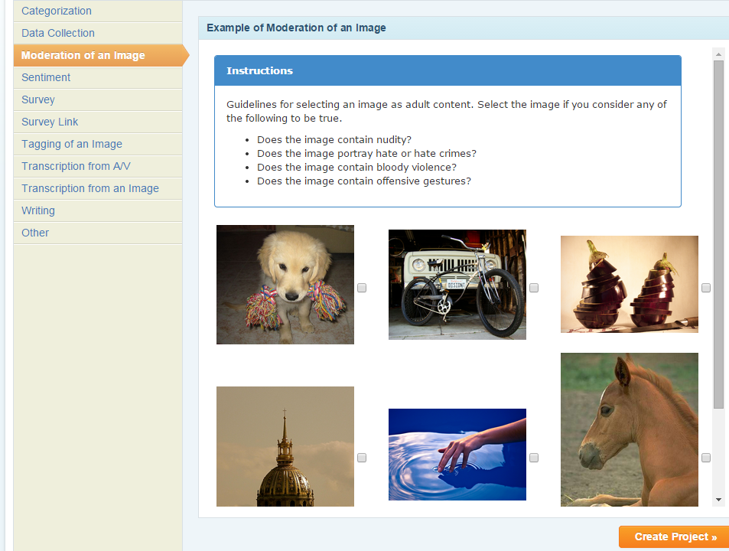
https://requester.mturk.com/create/projects/new

Slide 22
Non-Faculty Resources:
Spaced Education Games
Questions on key topics emailed daily
Immediate feedback
Engaging
Improves knowledge retention
Kerfoot, Acad Med. Oct, 2012
Kerfoot, Med Education. Jan 2007

Slide 23
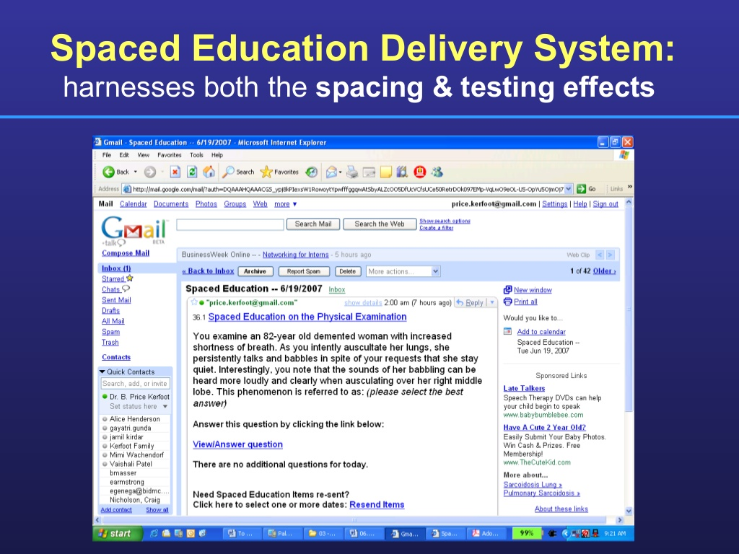
http://www.slideshare.net/QstreamInc/lessons-from-harvard-using-gamification-to-juice-your-sales-training

Slide 24
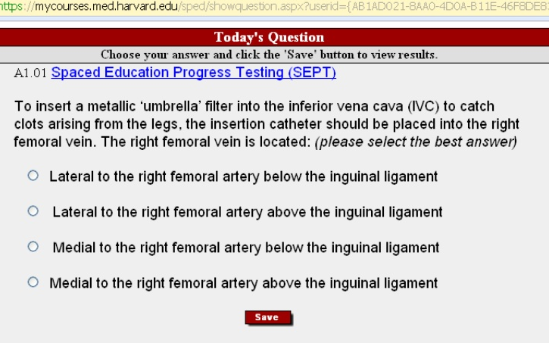

Slide 25
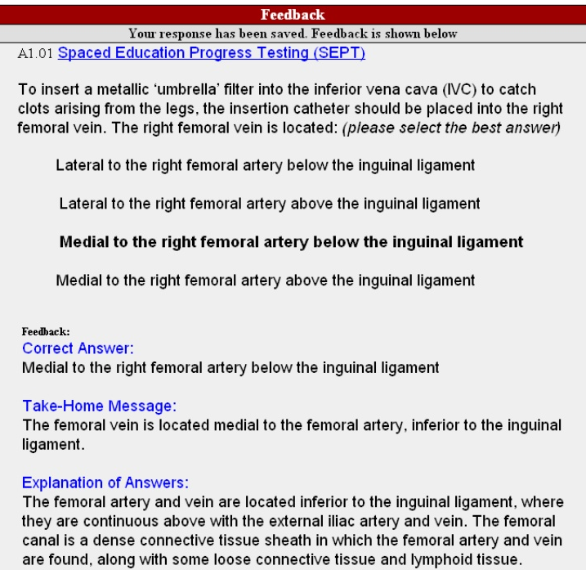

Slide 26
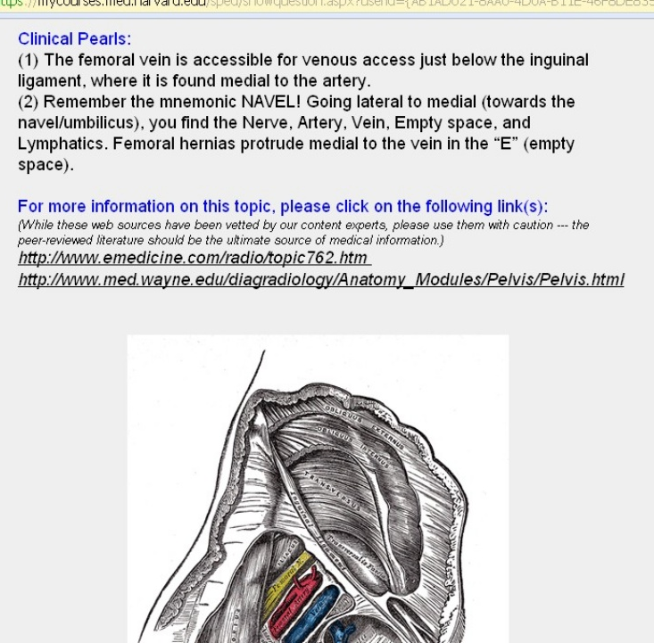

Slide 27
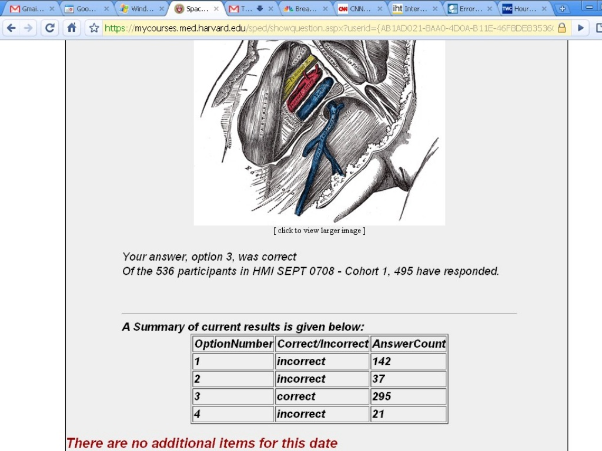

Slide 28
Conclusion
Many options exist to optimize the use of physician time
Many alternatives require more up-front effort
Need to find the right models for your program

