Slide 1
Post- Procedure Performance Analysis and Immediate Feedback using Operative Assessment Tool and Video: A Blended Instructional Model
Iman Ghaderi, Sreekumar Subramanian
Department of Surgery
University of Arizona, Tucson, AZ
Surgical Education Week, Seattle
April 2015

Slide 2
Background
Duty-hour regulations
Concerns about development of operative competencies in the current model of surgical training
More significant in advanced laparoscopic and cardiothoracic surgical procedures
Notes:
They require more technical training to achieve proficiency

Slide 3
Methods
Conceptual framework:
Reflective practice as an instructional model
Operative assessment tools & the videos of procedures

Slide 4
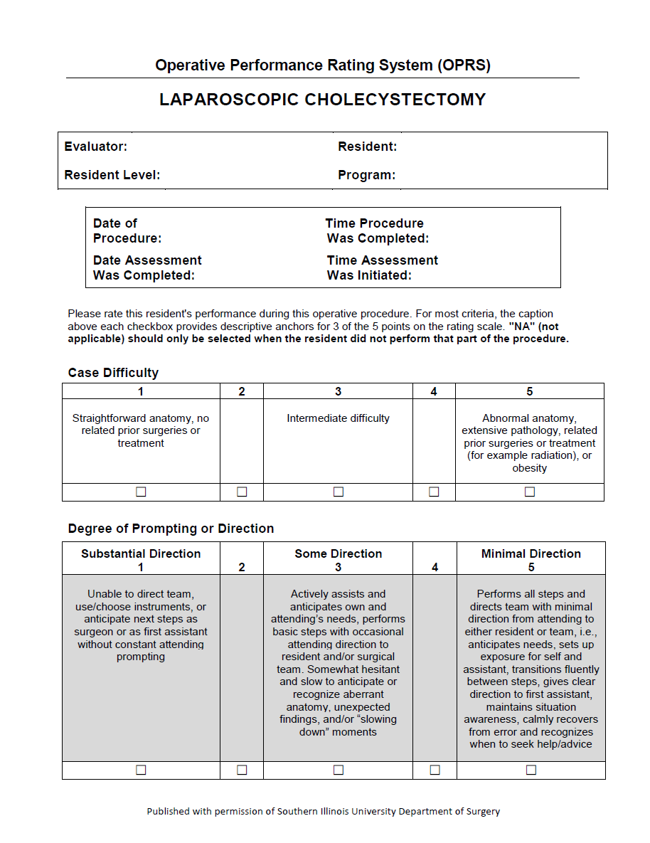

Slide 5
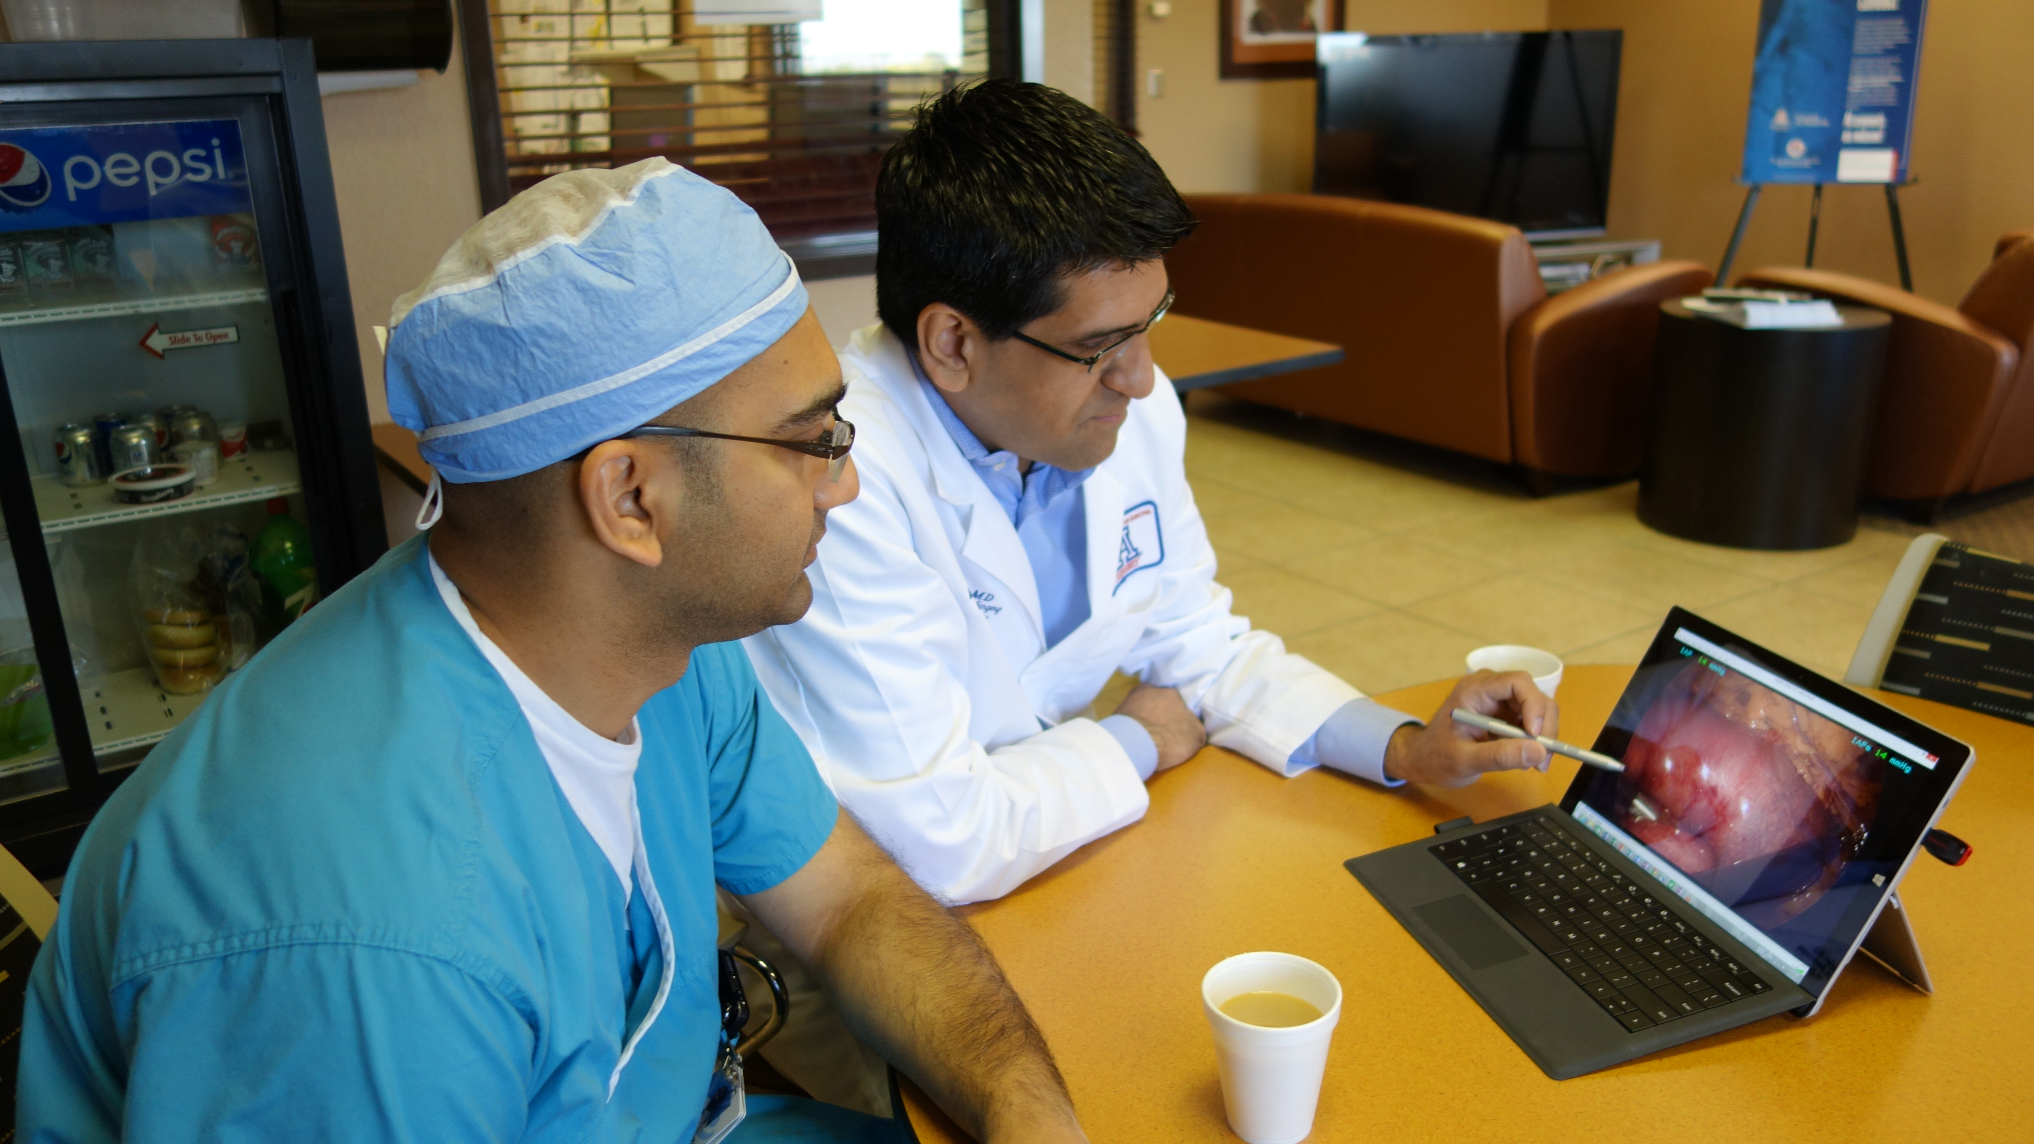
Procedure
Notes:
Review the important steps of operation with attention to areas of difficulty or technical challenge in a low-stress environment (perioperative area)
The procedure reviewed on a portable tablet using digitally recorded videotapes: for immediate structured feedback and coaching

Slide 6
Results
3-5 mins to complete & review the assessments
5-10 mins to review a video
Residents’ perspective:
Feedback was constructive and more specific, allowing for more precise advancement of surgical skills

Slide 7
Discussion
Tracking the trainee’s progress:
Video log
Individual portfolio of performance
Notes:
Tracking the trainee’s progress for and formative and summative assessment

