Slide 1
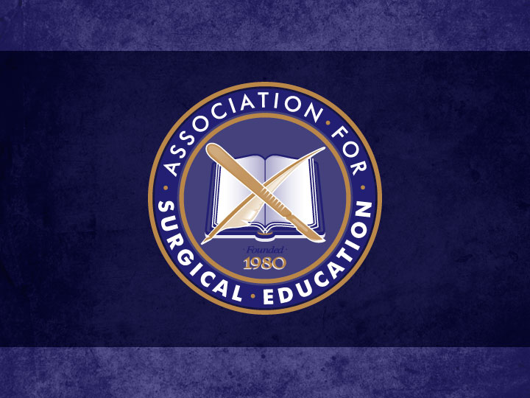

Slide 2
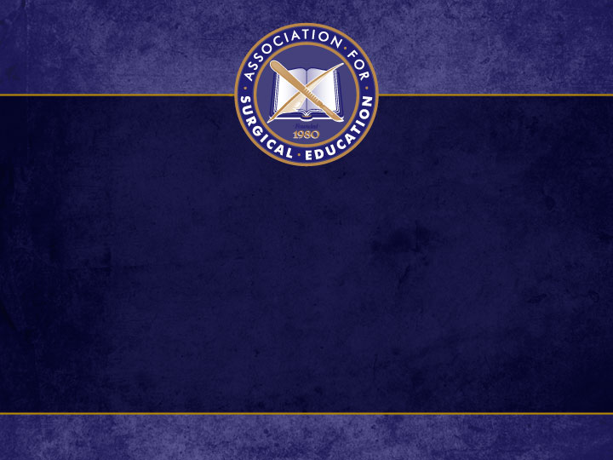
Spaced Education for Improving Surgery Clerkship NBME Scores Matthew R. Smeds, Jason Mizell, Katherine Berry University of Arkansas for Medical Sciences Little Rock, Arkansas

Slide 3
Background
Mobile device use increasing among physicians and medical trainees
Use in formal education settings not routine
Educational philosophies (game-based and spaced-education theory) lend themselves to mobile-device based education
Use of case-based questions have been shown to statistically improve scores on NBME examinations
General surgery rotation can be intimidating
Notes:
90% of residents have smart phones, 40% of tables
Current use is primarily as decision making tools or easy access to information
Why not routine? Reliability of apps, superficial learning (rapid info inhibits internalization of knowledge), distraction, and device specific limitations
SURGERY is intimidating – 45% of students express feelings of intimidation, unrealistic expecations of knowledge, and poor or inadequate learning experiences

Slide 4
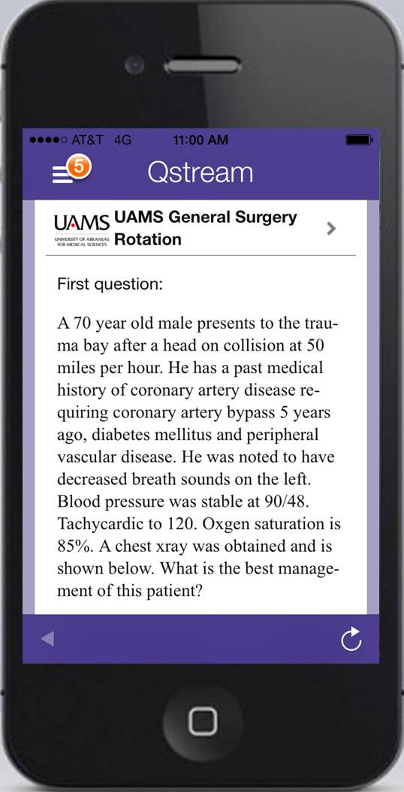
Intervention
Development of an app-based curriculum for general surgery rotation
Delivers 8 questions daily
Scored immediately with explanation and reference for more information
Questions repeated in a “spaced-based” manner
Notes:
Questions can be delivered via email or app or directly on website

Slide 5
Results
Current Study Habits for High Yields Tests | Number of Students (%)
Practice Exams | 96 (96%)
Read Textbook | 83 (83%)
Lectures/Talks | 66 (66%)
Online Videos | 45 (45%)
Group Study | 36 (36%)
Discuss Topics with Staff | 30 (30%)
Review Relevant Journals | 30 (30%)
Flash Cards | 23 (23%)
Listen to Audio-Text | 8 (8%)
Demographic | # of Students (%)
Answered Survey | 100/109 (92%)
Age
18-24 | 45/100 (45%)
25-34 | 53/100 (53%)
35-44 | 1/100 (1%)
>45 | 1/100 (1%)
Gender
Male | 66/100 (66%)
Female | 33/100 (33%)
Unknown | 1/100 (1%)
Carry Smart Phone | 98/100 (98%)
Notes:
Beginning survey given to all patients at beginning of the rotation. All offered use of the app.
Questions can be delivered via email or app or directly on website
Students are using technology at high levels to answer questions

Slide 6
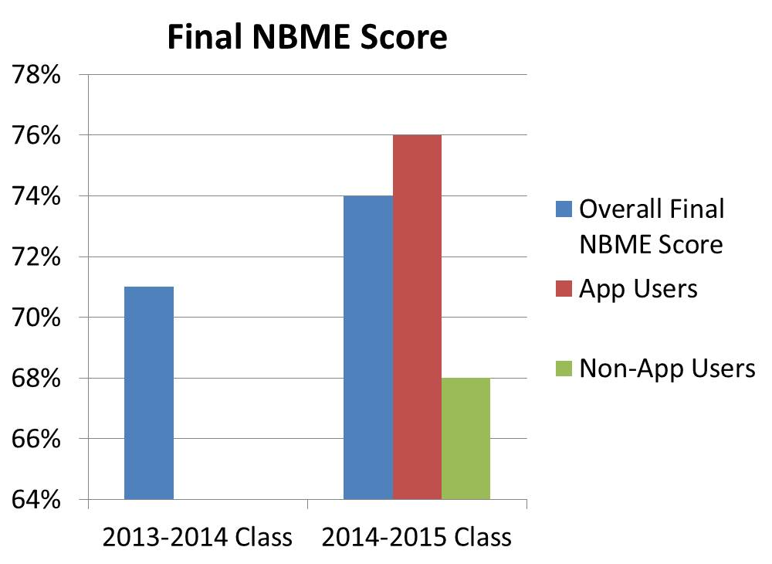
Results
85/109 (78%) of students used the app
Notes:
Statistical increase in overall NBME score compared to last year’s group as well as between users and non app userss
Academic achievement similar between last year and this year but statistically different between users and non users

Slide 7
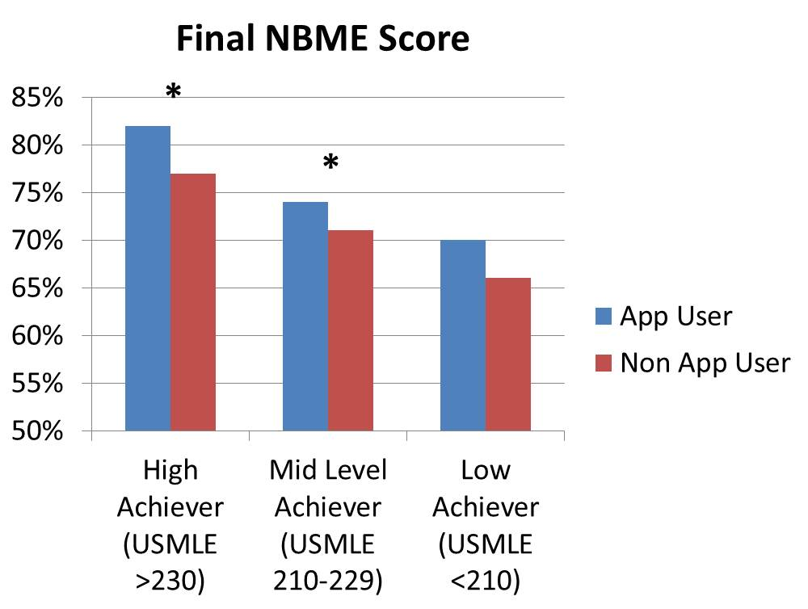
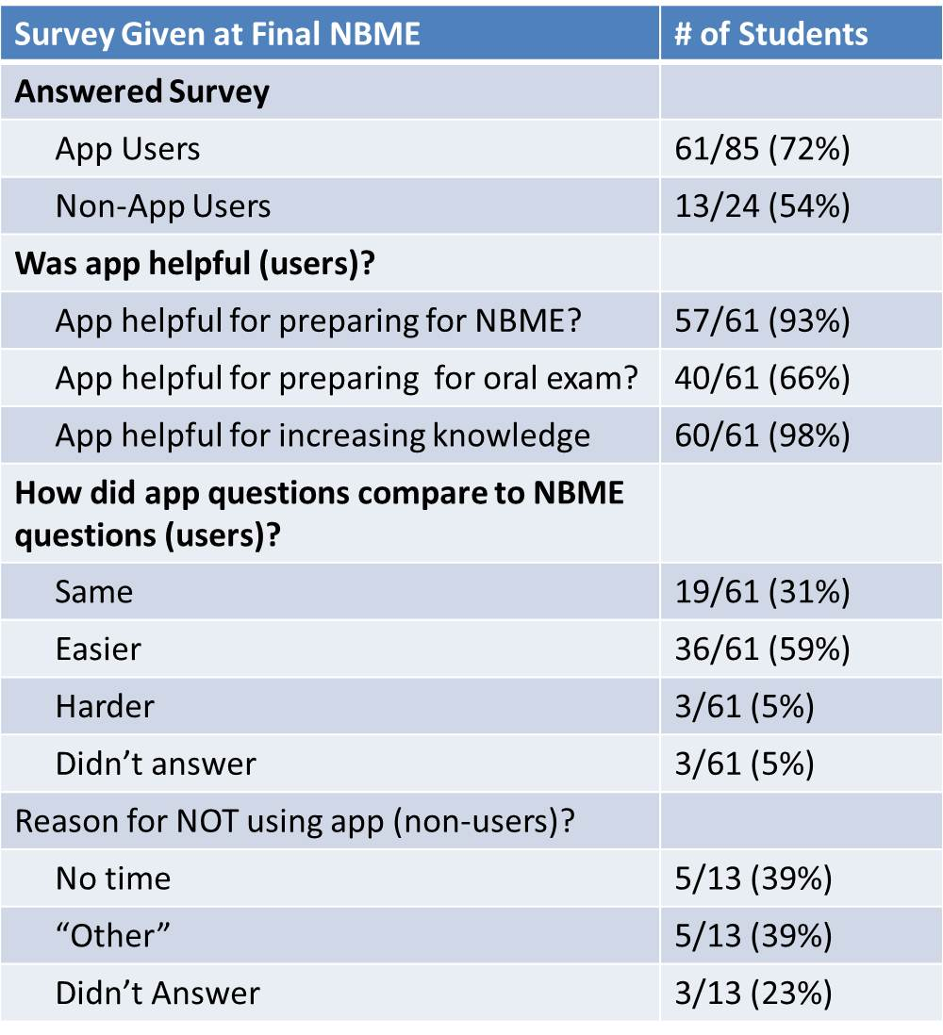
Results
Notes:
Controlling similarly achieving students between app users and non app users from last year showed statistically different nbme scores between users and non users in both high and mid level ahcieving students. There was a difference in low achieving students but not quite statisticaly significant. Also, HIGHER achiever students used the app more (higher scores) than the low achieving students (statistically different)

Slide 8
Conclusions
Medical students are increasingly using technology for education
Use of a app with case-based questions in a general surgery curriculum improves final NBME examination scores
Higher achieving students are more likely to use the app
Comparing students with similar academic achievement, users of the app have increased NBME examination scores

Slide 9
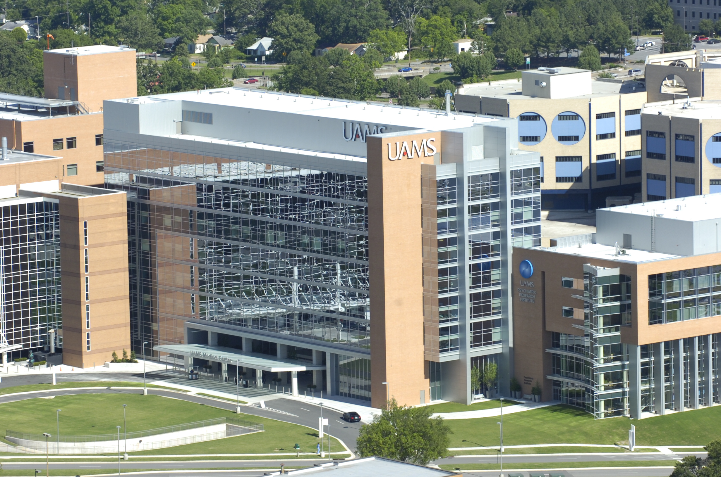
Questions?

