Slide 2
‘Where’s Your Badge?’ Using Digital Badges to Demonstrate Clinical Competency On Surgical Clerkship Amalia Cochran MD, FACS Ruth Braga MSN, RN University of Utah

Slide 3
Proving Clinical Skills
Methods for Sharing Competencies
Paper Checklists
Multiple Institutions
Methods for Demonstration/Pass Off Undefined
Notes:
When a medical student demonstrates the ability to competently perform a clinical skill, we struggled with finding a reliable way to help them share that information. Paper checklists were often lost, medical students would be required to perform the skill again, or they would just miss out on being allowed to which was a waste of time. Because our students visit multiple sites during their training, and some of the sites have variation in their training, we wanted to provide a more durable but mobile method for students to be able to show anyone, anywhere, that they had been taught, and demonstrated competency in their clinical skills.

Slide 4
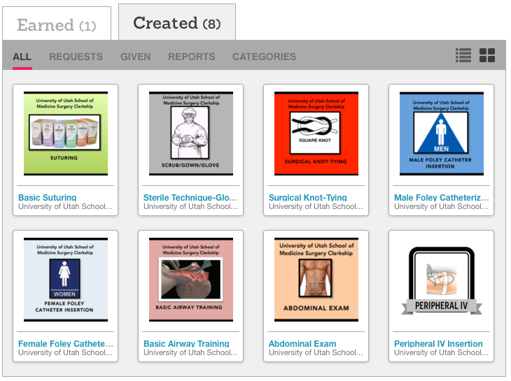
Solution: Digital Badging
Notes:
Based on the ACS/ASE Medical Student Simulation Based Surgical Skills Curriculum, we have created digital badges for the 8 clinical skills shown here. After researching various vendors, we selected a company that offered a free account, the ease of designing and uploading our own badges, and did not require students to have an account in order to receive a badge. When competency is demonstrated, students are issued a digital badge via email. These can be retrieved on any device where they can access their email, shared on social media, and do not have an expiration date. When the badges are clicked on, a full description of the competency and what was required appears.

Slide 5
Outcomes
Transition from paper to digital
Availability and no-expiration is appealing
Increased confidence in medical student skills from staff and administration
Medical Students are able to do hands-on
Notes:
Digital badging for our surgical clerkship began in July 2014. Although the concept of the ability to pull up a badge on their smart phone and show it to staff or residents at any facility has been well received by medical students, we are aware that there will be a period of getting used to this new format. The availability of digital badging and its effectiveness recently contributed to convincing hospital administration to allow medical students to participate in foley catheter placement because of the concrete evidence that they had proven clinical competence.

Slide 6
2015-16 Plans
Increase skills offerings
Implement badging on other clerkships
Report outcomes to other colleges on campus
Follow up with students and monitor use
Notes:
For the 2015-16 academic year, our plan is to increase the skills offerings for our students, and begin training other clerkship coordinators on implementing badging on their clerkships. Other colleges at the University of Utah such as the College of Engineering are looking to implement, so we will be sharing our findings with them. Our students who have received badges at this point will be followed up with to determine if they are utilizing the badges. For questions or assistance, please feel free to contact us.

