Slide 1
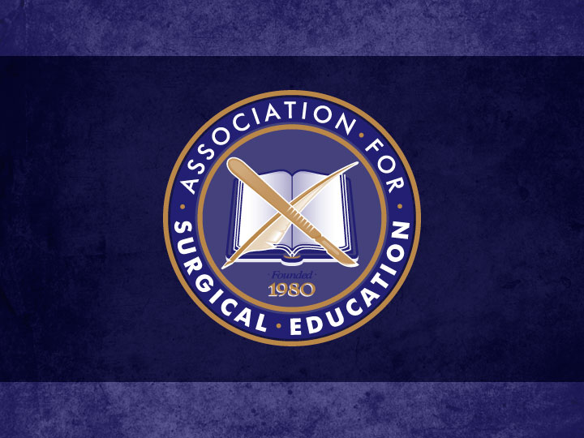

Slide 2
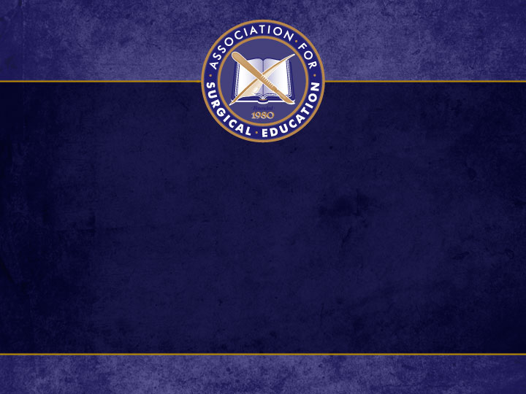
“Body Double”: The Concurrent Use of Anatomy Lab Cadavers for Resident Trauma Training Derek B. Wall, MD, FACS Michelle M. Olson, MD, MACM, FACS, FACRS Carle Foundation Hospital Urbana, IL

Slide 3
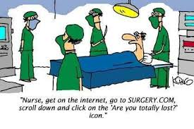
Impediments to Trauma Training
Prevalence of nonoperative management
Advanced imaging
Minimally-invasive techniques
Work hour restrictions

Slide 4
Simulation with Cadavers
Multiple open training models described
UCLA study*:
Effective for learning anatomy, steps of an operation, increasing confidence in performance
58% would spend free time in cadaver lab
Advanced Surgical Skills for Exposure in Trauma (ASSET)
*Lewis CE, et al. A novel cadaver-based educational program in general surgery
training. J Surg Educ. 2012;69:693-698.

Slide 5
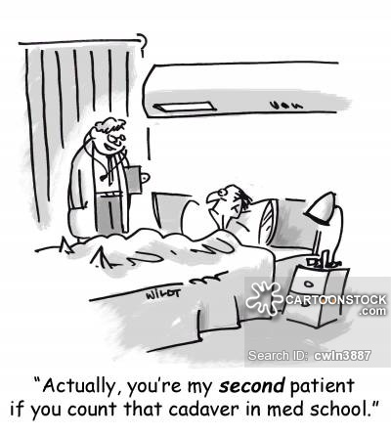
A potential solution…
Affiliation with University of Illinois
Cadaveric anatomy lab for M1 students
Resident program seamlessly integrated so that the student program remains unchanged

Slide 6
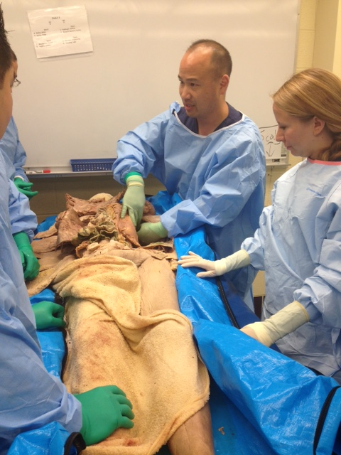
Procedural Training
Chest tubes
Medial visceral rotation

Slide 7
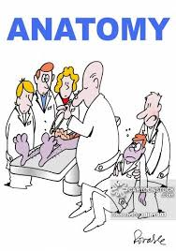
Initial Results
Advantages
Rated more effective than other methods for teaching chest tubes
High ratings for visceral rotation
Disadvantages
Need to leave hospital for training
Pliability of tissue
Smell

