Slide 1

Rahul J Anand MD FACS
Virginia Commonwealth University Department of Surgery
Infiltrating the M1 and M2 years

Slide 2

WHY MEDICAL STUDENT TEACHING IS IMPORTANT?
The 8 week surgery clerkship is a reflection of our field
Our interest in the success of this clerkship reflects our commitment
Medical Student Education
To the future of the field
Our goal is not to get students to go in to surgery – but to gain an appreciation of the field

Slide 3
WHY MEDICAL STUDENT TEACHING IS IMPORTANT?
If we can attract students to the field –
THAT IS A BONUS!

Slide 4
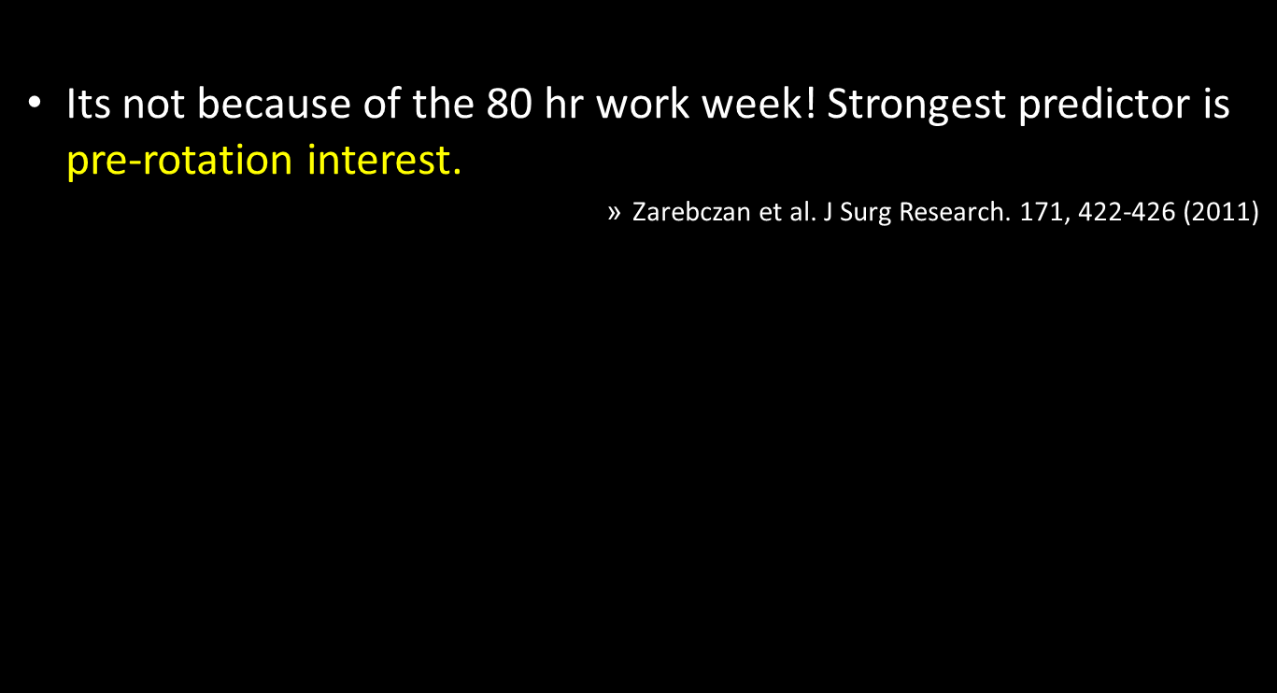
WHY DO STUDENTS GO IN TO GENERAL SURGERY?

Slide 5
We need to Understand Where Students are Coming From
Take yourself back to Med School
Did you have any preconceptions of Surgery? – Or of surgeons?

Slide 6
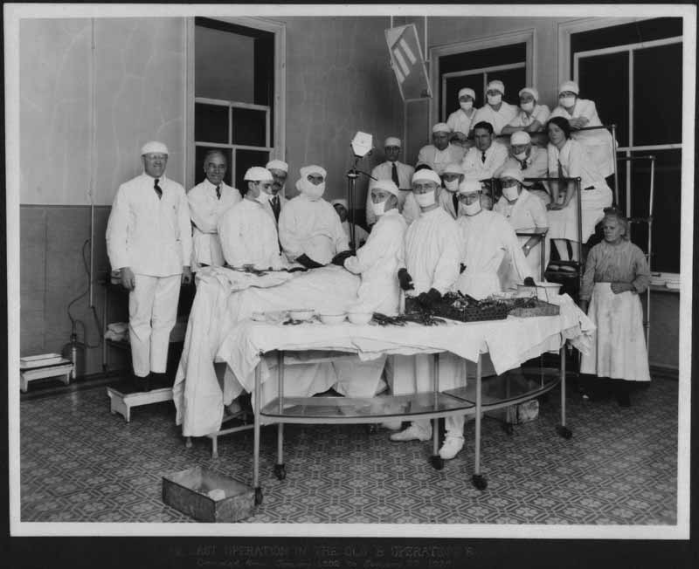
What are pre-conceptions of Surgery that the Student May have?

Slide 7
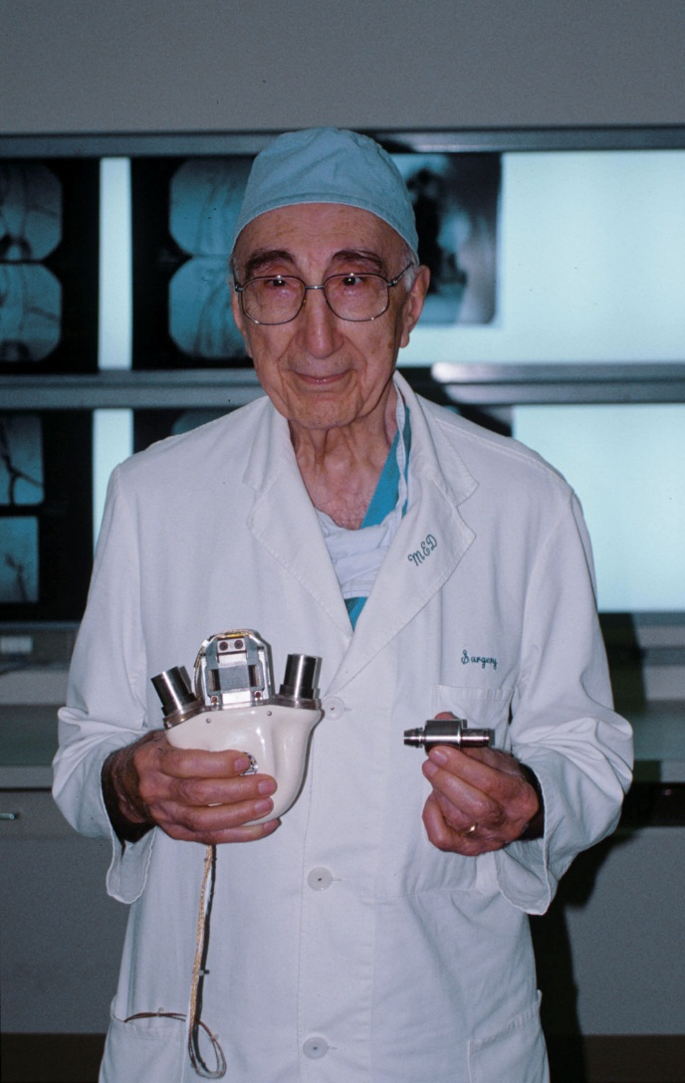
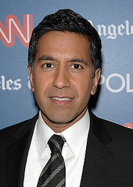
Do Students have Pre-Conceptions of Surgeons?
vs.

Slide 8
Student Pre-Conceptions of a surgery Clerkship
INTERESTS
Surgical practice
Technical Skills
Balance
FEARS
Fatigue
Hours
Poor performance
Mental Abuse
IN ORDER TO SUCCEED, WE NEED TO RECOGNIZE THESE FEARS
Pettit. Am J Surgery. 189. (2005) 492-496

Slide 9
Role Models
Positive Role models on the Surgery Rotation are Important to the Success of the Rotation
Attendings and Residents shape the career of EVERY medical student

Slide 10
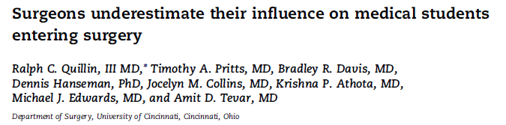
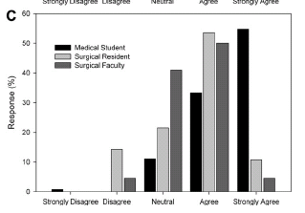
Surgical Faculty and Residents Play an Important Role in Shaping the PATHS OF MEDICAL STUDENTS

Slide 11
Faculty and Residents UNDERESTIMATE their influence
Faculty and residents should be cognizant of their influence
This influence can be paramount in a students decision to pursue surgery

Slide 12
AS SURGICAL ATTENDINGS AND RESIDENTS– WE HAVE AN INFLUENCE ON OUR STUDENTS

Slide 13
U Cincinnati Survey Study
Med Students and Surgery Applicants identify positive role models and mentors in surgery
Residents and Faculty View themselves as role models
Residents and Faculty UNDERESTIMATE their influence.

Slide 14
WHY DO STUDENTS GO IN TO GENERAL SURGERY?
Interest in career choice develops before the third year clerkship
        Goldin et al. J Am Coll Surg 2012
We need to foster (not kill) – this interest

Slide 15
DO STUDENTS HAVE PRE-CONCEIVED NOTIONS?
so in roughly 2 weeks i'll be starting my surgery clerkship...i'm a little concerned because i'm not really a morning person and i've heard a lot of horror stories... however, when i am passionate about things...i do what i have to in order to succeed....now strangely enough the more i hear about surgery from classmates...the more it intrigues me...
Student Doctor Network

Slide 16
Prospective Student
Interested
Excited
Afraid

Slide 17
What are we up against?

Slide 18
The Response
Attitude- Lose it …. suppress your personality, too. If you like to joke, they'll think you don't take anything seriously. Exception is in the OR (again, their favorite place), where a few properly told jokes/anecdotes/observations can lighten the burden of that 4 hour lap appy. Basically, you are a drone to them … No stupid questions, either … As a matter of fact, unless you want to actually be a GS resident at the hospital you are working, I would steer clear of asking any questions, unless you already know the answer. Let the upper levels focus on pimping the intern, not you! Find the nice surgeon, work with him/her if you need an LOR.
Student Doctor Network

Slide 19
The Response
…. on rounds, you should be last in line walking down the hall. If you get the green light to scrub into a case, never ever finish scrubbing before anyone above you. Even if the attending spends 3 seconds scrubbing, don't even think about finishing before the resident …
… Many of them will ignore you, try to offend you, and criticize you over the smallest details, even if you are a rock star of a student.
Don't ever let your guard down. They most likely have no interest in being your friend or getting to know you as a person. If you ever start to feel like they are warming up to you, it's a trap. Keep your guard up.
Student Doctor Network

Slide 20
The Response
… attendings don't seem to care that much, especially if you're in a big program where there a lot of people on a team. They simply don't have time …. Try to learn if your attending does ask questions in the OR; some barely talk at all. A few are merciless. Surgical Recall should save you from feeling too bad.
Student Doctor Network

Slide 21
The Response
Well, I disagree about questions. I ask them in the OR, but almost always ask whether I can ask. The attendings have all been very happy to get questions and I walk away with understanding I didn't have before.
… if you are polite to the scrub/circulating nurses, they can make your life much better as well (2 have helped me learn to suture, I always get the foley insertions, and get corrected quietly if necessary)….
Student Doctor Network

Slide 22
Why is this important?
If students gain a negative view of our field before the M3 year, this viewpoint can be carried forward

Slide 23
How do we foster M1 and M2 students?
By infiltrating the M1 and M2 years
  SHADOWING PROGRAMS
  SURGICAL INTEREST GROUP
  TEACHING M1 and M2 CLASSES
  USE M4 STUDENTS TO MENTOR M1 AND M2
  STUDENT SUPPORT GROUPS
  HAVE A “PANEL” FOR YOUR CLERKSHIP
  GET INVOLVED WITH MEDICAL SCHOOL COMMITTEES
  CAREER ADVISING

Slide 24
TRAUMA SHADOWING PROGRAM

Slide 25
I am not sure if this is an idea of interest or one you would be interested in exploring but if you are I would certainly be interested in helping coordinate.
VCU M1 Medical Student

Slide 26
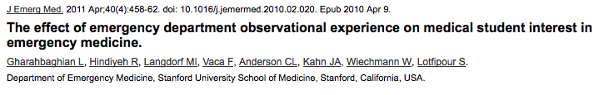
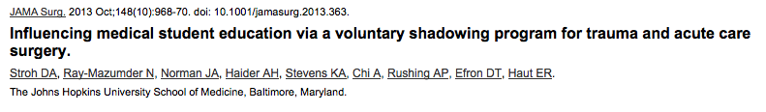
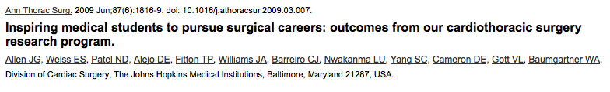
TRAUMA SHADOWING PROGRAM

Slide 27
TRAUMA SHADOWING PROGRAM
Use the Google document to sign up for available shifts
Students are given access to everything they need
  Scrubs
  Operating room access
  ICU access
  ER access
  On call room access

Slide 28
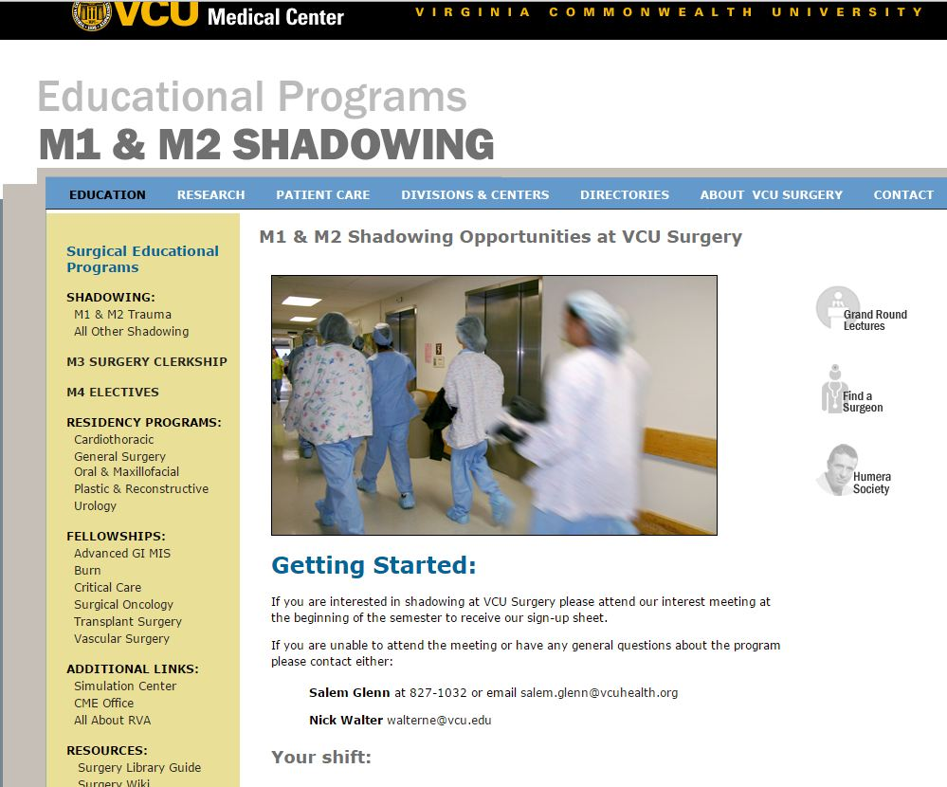
TRAUMA SHADOWING PROGRAM

Slide 29
TRAUMA CALL PROGRAM
Friday nights (5:30pm – 7:00am)
Saturday daytime (8:00am – 6:00pm)
Saturday nights (5:30pm – 7:00 am)

Slide 30
BLUNT ADVICE WE GIVE THEM
Refrain from bringing bags to the hospital; you will not have a safe place to store them.
Please try to gauge the right times for conversation, etc.
You will not have a pager - share your number with a resident and/or M3.
M3’s get to scrub on cases etc. You are a shadow
Shadow the entire team not just the attending.

Slide 31
RESULTS OF SHADOWING PROGRAM
“…the most amazing shadowing experience I have ever had in a hospital”
“Everyone was incredibly friendly and eager to teach which was wonderful and helped make this a rewarding experience”
“I think the most important lesson from this experience is the ability to gauge what I should know and what skills I should have as a 3rd year student and as a resident”

Slide 32
TRAUMA SHADOWING PROGRAM
We are continuing this program indefinitely

Slide 33
STUDENT SURGICAL INTEREST GROUPS

Slide 34
SURGICAL INTEREST GROUPS
Present in about 50% of medical schools
Name the group
Topics for discussion
  Surgical Fields
  Interview technqies
  Lifestyle issues
  Suture workshops

Slide 35
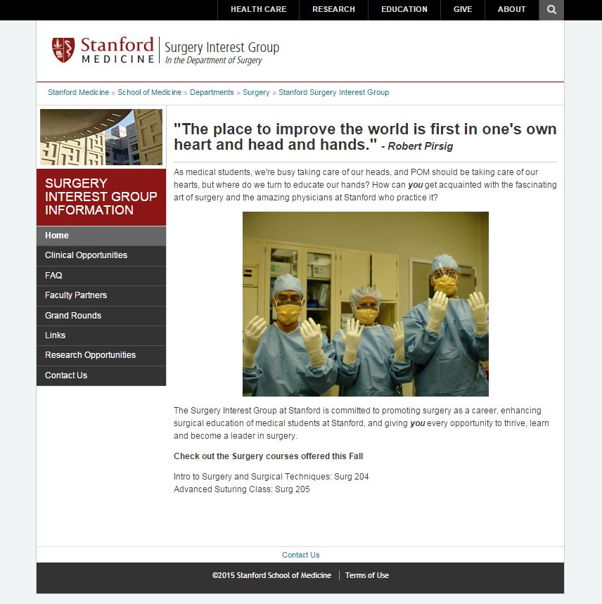

Slide 36
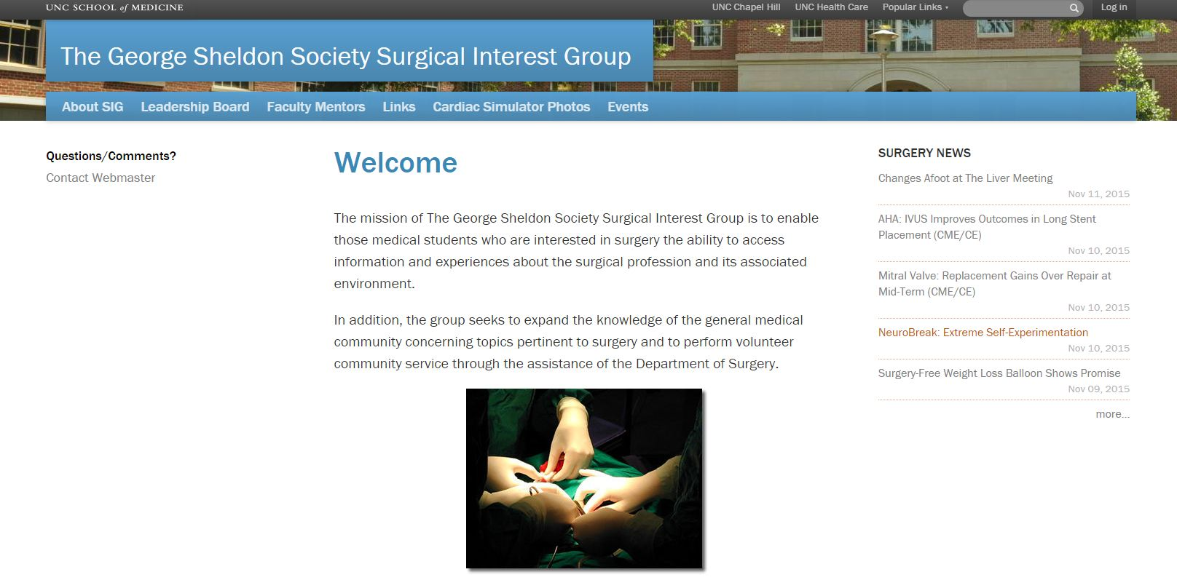

Slide 37


Slide 38
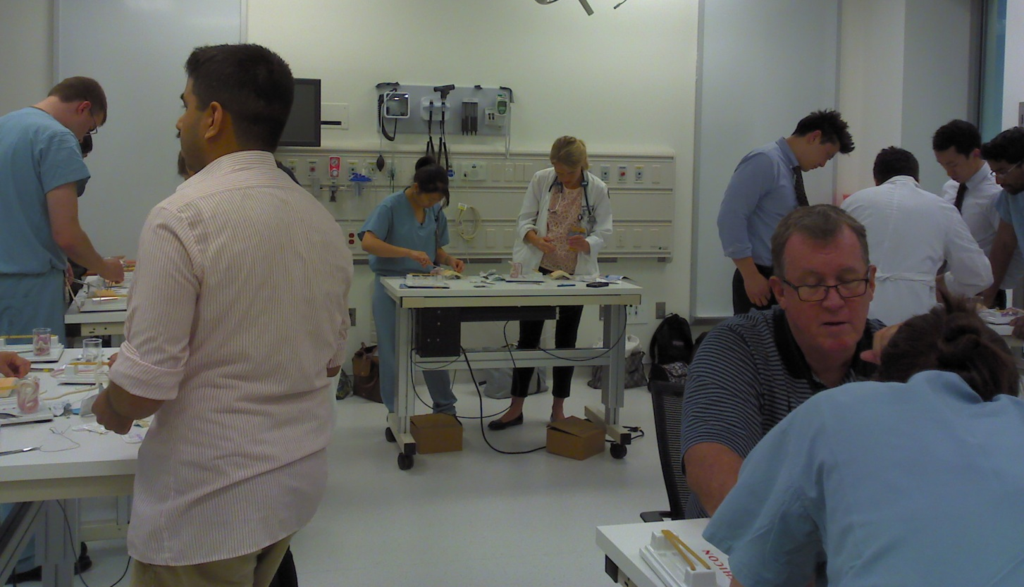
M1 / M2 Suture Workshop

Slide 39
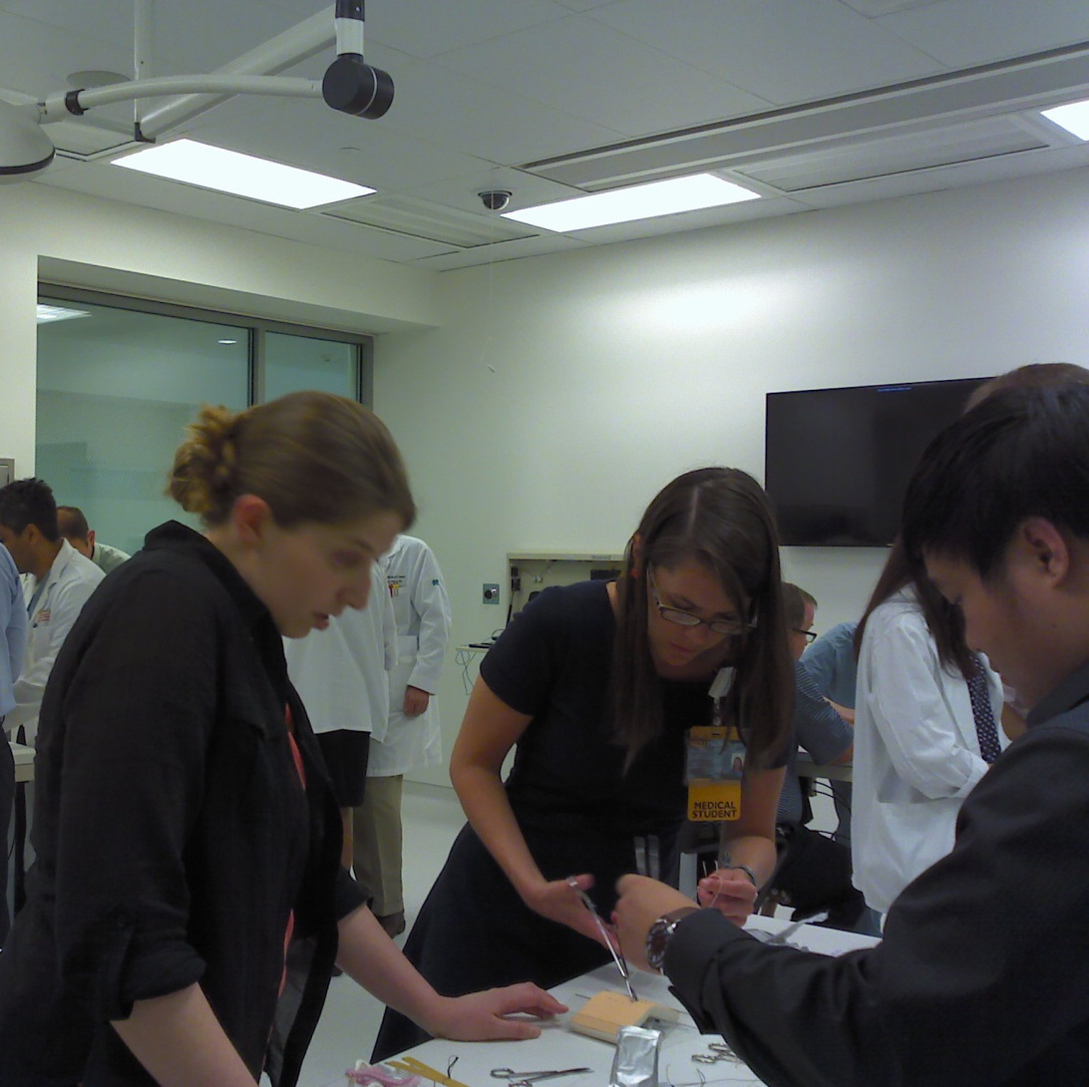
Suture Workshop
M4 STUDENTS ALWAYS WELCOME!!

Slide 40
Utilize M4 students to mentor M1 and M2
Host a suture workshop
Have surgical M4 students help to teach
M4 students enjoy the teaching and the practice
Shows M1 and M2 that “normal students” become surgeons!

Slide 41
SURGICAL INTEREST GROUPS
Plan a lunch time session for career planning
Assemble a diverse group of residents (Chief, Lab, Junior, Intern)
Show up to lunch time session to talk about lifestyle, career paths
Dispell myths !

Slide 42
DISPELL MYTHS
“Unless there is somewhere else you would ever rather be than the OR - don’t do surgery.”
Surgeons don’t talk to their patients
Surgeons are all “mean”
Don’t choose your career based on lifesyle

Slide 43
Anand’s Lifestyle Line
People always talk about not sacrificing their lifestyle for their career
I say it works both ways.
Don’t sacrifice your career for your lifestyle
They are one and the same!

Slide 44
TEACHING M1 AND M2 COURSES

Slide 45
TEACHING M1 and M2 courses
Seek out the course director
Offer your services
Give the M1 and M2 students a RARE surgical perspective on disease
“CLINICAL CORRELATIONS OF THE CHEST AND ABDOMEN.”

Slide 46
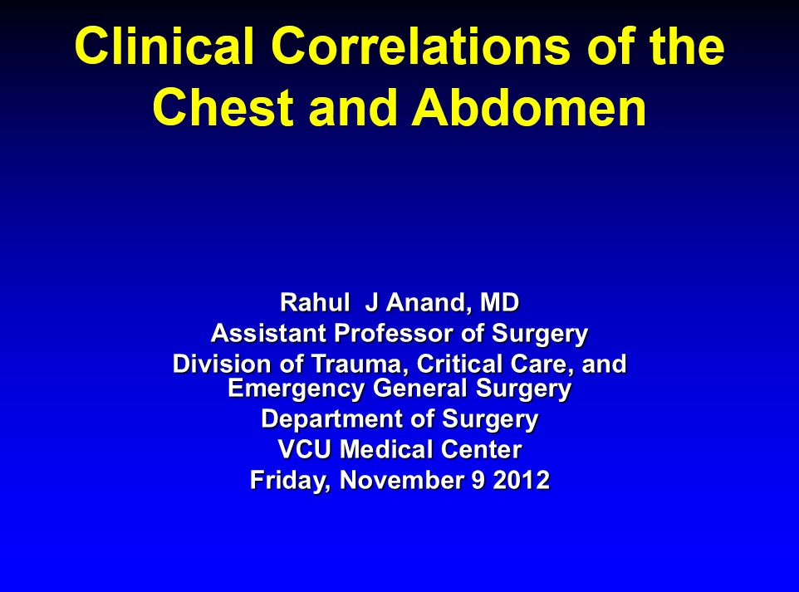
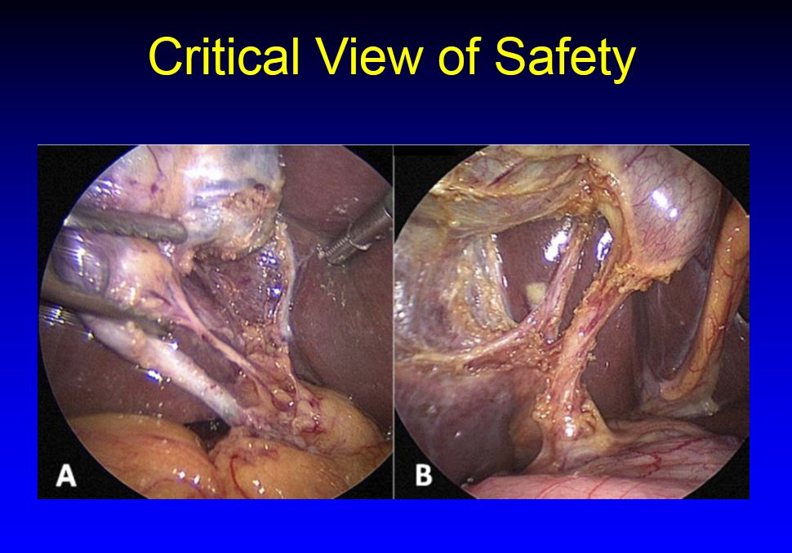
BREAK UP THE MONOTONY OF FIRST 2 YEARS

Slide 47
PROJECT “HEART”

Slide 48
PROJECT “HEART”
Longitudinal medical student advising program
Project HEART stands for Healing with Empathy, Acceptance, Respect and inTegrity.
Prevent burnout and apathy
Communication skills, resilience, introspection, and methods of stress management necessary to help them develop their professional identity in medicine.

Slide 49
Become a Mentor For M1 and M2

Slide 50
M1 and M2 small group sessions
Low time commitment (1 hour every other month)
A good chance to get face time
Easy

Slide 51
What I contribute to Project HEART
A unique surgical perspective
Topics we have talked about this year
  Time management
  Listening Skills
The knowledge that if I don’t do it, someone else will!

Slide 52
CLERKSHIP DIRECTOR PANEL

Slide 53
Clerkship Director Panel
Introduces them to your face
CoOrdinator should be there also
Goes over expectations for third year
Gets everyone on the same page

Slide 54

\
VIDEO SHOWN AT EXPECTATIONS MEETING

Slide 55
GET INVOLVED WITH MEDICAL SCHOOL COMMITTEES

Slide 56
\
MEDICAL SCHOOL COMMITTEES
Admissions Committee
Promotions Committee
  Involved in the advancement of students from one year to the next
Curriculum Committee

Slide 57
CAREER ADVISING

Slide 58
\
CAREER ADVISING
Have an open door policy for anyone who wants to talk about career
M1 and M2 will soon be M4s in the match
Always make the time
If you don’t do it some other department will!

Slide 59
\
INFILTRATE THE FIRST 2 YEARS
IF YOU DON’T DO IT SOMEONE ELSE WILL
MAKES THE M3 YEAR A LOT EASIER
HELPS YOU OUT ALSO

Slide 60


