Slide 1


Slide 2

Student Mistreatment: Culture, Expectations, and Perception
Sam Campbell, MD, FACS

Slide 3

Objectives
Describe the types of student mistreatment
Identify the differences in mistreatment between the student, resident, and attending faculty
Recognize the relationship between the learning environment and culture that may foster mistreatment

Slide 4

Student Mistreatment – Pre 1982

Slide 5
Student Mistreatment
1982 Henry Silver, MD in JAMA observed parallels in behavior between children who had been abused and medical students during the weeks and months after beginning medical school.

Slide 6
Student Mistreatment
Silver postulated that the alterations in attitude and behavior observed might be due to avoidable, unnecessary, and harmful abuse.

Slide 7
Student Mistreatment
Silver further postulated that the changes went unrecognized or, if recognized, they went largely ignored.

Slide 8
Student Mistreatment
1990 Silver and Glicken did a survey of the incidence, severity, and significance of medical student abuse as perceived by the medical students at the University of Colorado. (JAMA 1990;263:527-532)

Slide 9
Student Mistreatment
46.4% indicated that they had been abused at some time while enrolled in medical school
80.6% of seniors stated that had been abused by the senior year

Slide 10
Student Mistreatment
69.1% of those abused reported the experience as of “major importance and very upsetting”
49.6% noted the most serious episode affected them for a month or more

Slide 11
Student Mistreatment
Lastly, 16.2% said the episode of abuse would “always affect them”
No significant difference was noted by gender in the prevalence of major abusive experiences, or reactions to the abusive episodes

Slide 12
Student Mistreatment
Older students reported a higher incidence of perceived abuse

Slide 13
Student Mistreatment
Baldwin, Sheehan et.al. in JAMA (1990) did a pilot survey of a third-year medical school class to explore student perceptions of mistreatment and professional misconduct
Survey used was developed in collaboration with the AMA Office of Education Research

Slide 14
Student Mistreatment
Three fourths students had become more cynical about academic life and the medical profession
Two thirds felt worse off than their peers in other professions

Slide 15
Student Mistreatment
One fourth would have chosen a different profession had they known in advance about the extent of mistreatment they would experience

Slide 16
Student Mistreatment
More than a third thought about quitting medical school

Slide 17
Student Mistreatment
No differences between men and women
73% were cursed or sworn at
24% were threatened with physical harm 15% by patients 7% by residents or interns 3% by clinical faculty

Slide 18
Student Mistreatment
44% placed at unnecessary medical risk 28% by clinical faculty
    16% by nurses
47% perceived psychological mistreatment

Slide 19
Student Mistreatment
Residents and Interns 44% from residents and interns assigned tasks for punishment not education 41% threatened with unjustifiable bad grade 40% took credit for student’s work

Slide 20
Student Mistreatment
Clinical Faculty
29% tasks for punishment 17% unjustifiable bad grade

Slide 21
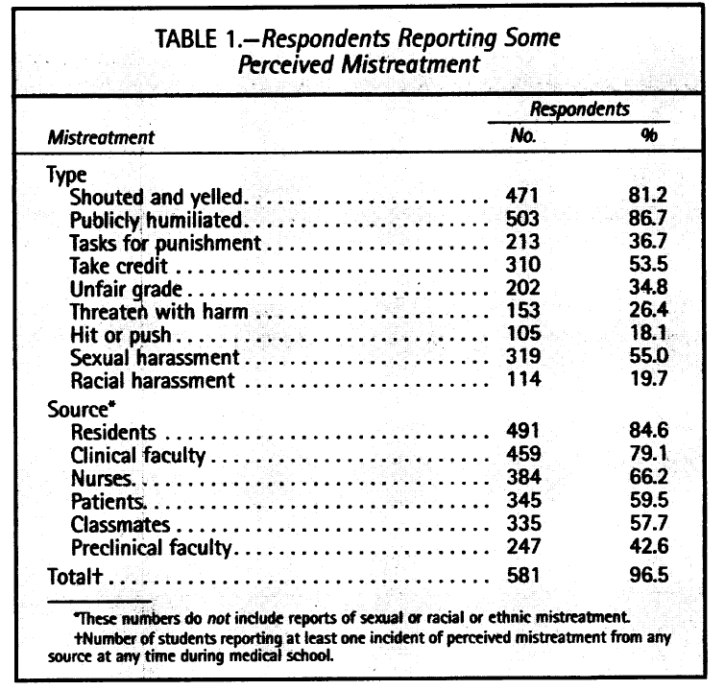
De Witt Baldwin, Jr. et al. (1991) reviewed Senior students at 10 medical schools

Slide 22
Student Mistreatment
No differences based on age, sex, religion, marital status, or having a parent who is a physician

Slide 23
Student Mistreatment
AAMC (1991) first included questions about mistreatment in the Medical School Graduation Questionnaire (GQ)
17% to 20% of medical students reported mistreatment

Slide 24
Student Mistreatment
LCME 2010 requested the AAMC and AMA to investigate the constant reports of mistreatment of medical students

Slide 25
Student Mistreatment
AAMC GQ has evolved
Questions in 2012 GQ had five themes: general mistreatment, sexual, racial/ethnic, gender, and sexual orientation

Slide 26
Student Mistreatment
GQ 2011 definition of mistreatment: either intentional or unintentional, occurs when behavior shows disrespect for the dignity of others and unreasonably interferes with the learning process

Slide 27
Student Mistreatment
Examples include “sexual harassment; discrimination or harassment based on race, religion, ethnicity, gender, or sexual orientation; humiliation; psychological or

Slide 28
Student Mistreatment
Examples (continued):
physical punishment; and the use of grading and other forms of assessment in a punitive manner”

Slide 29
Student Mistreatment
LCME Element 3.6 STUDENT MISTREATMENT
A medical school defines and publicizes its code of professional conduct for faculty-student relationships in its medical education program, develops effective written policies

Slide 30
Student Mistreatment
LCME Element 3.6 STUDENT MISTREATMENT
that address violations of the code, has effective mechanisms in place for a prompt response to any complaints, and supports educational activities aimed at preventing inappropriate behavior.

Slide 31
Student Mistreatment
LCME Element 3.6 STUDENT MISTREATMENT
Mechanisms for reporting violations of the code of professional conduct (e.g., incidents of harassment or abuse) are well understood by students and ensure that any violations

Slide 32
Student Mistreatment
LCME Element 3.6 STUDENT MISTREATMENT
can be registered and investigated without fear of retaliation.

Slide 33


Slide 36
Student Mistreatment

Slide 37
Student Mistreatment
Stanford has created “Tools for Students to Create a Respectful Learning Environment”
Includes scripts for students that may be useful to avoid mistreatment

Slide 38
Student Mistreatment - Tools
When asked to run an errand: “I find the clinical experience to be so interesting and important. I would prefer not to miss any of it in order to pick up coffee.”

Slide 39
Student Mistreatment - Tools
To avoid being left without a role when a patient is deteriorating: “During this month, when a patient becomes unstable, in what way can I participate?”

Slide 40
Student Mistreatment - Tools
To help with communication when a patient is deteriorating suggest the following at the beginning of the month/week/day: “It would be helpful to have a phrase that denotes that a patient is unstable so that those who are

Slide 41
Student Mistreatment - Tools
present are aware of this, but the patient and family are not alarmed. Perhaps something like ‘let’s all pay attention.”

Slide 42
Student Mistreatment - Tools
When there has been an erroneous assumption or statement: “I am sorry about this misunderstanding. I may not have understood you clearly.”

Slide 43
Student Mistreatment - Tools
When something offensive has been said: “I think I understand the meaning that you intended, however, it might be offensive to others because of the ambiguity. Did you mean… (Restate comment without offensive portion)?”

Slide 44
Student Mistreatment - Tools
In response to someone yelling: “I can hear you well, there is no need to raise your voice.”

Slide 45
Student Mistreatment - Tools
In response to profanity or inappropriate comment: “I would prefer if you use professional terminology so that I can learn the best way to handle this difficult situation.”

Slide 47


Slide 48
Student Mistreatment
In Summary:
The most common mistreatment is humiliation
Fear over humiliation has impacted the use of the Socratic method of teaching

Slide 49
Student Mistreatment
As educators we must develop a standard for “having gone too far” based on what a reasonable observer would conclude.
We are required to follow the LCME 3.6 Element

Slide 50
References
Silver HK. Medical students and medical school. JAMA. 1982; 247:309-310.
Silver HK, Glicken AD. Medical student abuse. Incidence, severity, and significance. JAMA. 1990; 263:527-532.

Slide 51
References
Sheehan KH, Sheehan DV, White K, Leibowitz A, Baldwin DC Jr. A pilot study of medical student “abuse”. JAMA. 1990;263:533-537.
Baldwin DC Jr, Daugherty SR, Eckenfels. Student perceptions of mistreatment and harassment during medical school-A survey of ten United States schools. West J Med. 1991 Aug; 155:140-145.

Slide 52
References
Mavis B, Sousa A, Lipscomb W, Rappley MD. Learning about medical student mistreatment from responses to the medical school graduation questionnaire. Academic Medicine. 2014; 89:705-711.

Slide 53
References
Gan R, Snell CM, Snell L. When the learning environment is suboptimal: exploring medical students’ perceptions of “mistreatment”. Academic Medicine. 2014;89:608-617.

Slide 54
References
Liaison Committee on Medical Education. Data collection Instrument for survey visits in AY 2016-2017.pg 1-4.
Stanford Medicine Student Wellness; Tools for students to create a respectful learning environment; online pg.1-2.

Slide 55
References
Reifler DR. The pedagogy of pimping educational rigor or mistreatment?. JAMA. 2015; 314:(22):2355-2356.

