Slide 1


Slide 2

Remediation & Standard Setting in Clerkships
Laszlo Kiraly MD FACS
Associate Professor of Surgery
Oregon Health & Science University

Slide 3

Case #1
John is a third year medical student. He was a middle performer in his first two years.
At the end of his rotation, he receives a failing score on his shelf exam.
Clinical assessments reveal that John was well liked by his teams. Attendings commented on a below average fund of knowledge and wrote “he should read more.” .
Clerkship director, what do you do?

Slide 4
Case #2
Mary is a third year medical student. She was a high performer in her first two years.
At the end of his rotation, she receives a high score on his shelf exam.
Assessments reveal marginal scores clinically. Residents cite awkward patient and team interactions. Attendings cite an inability to convey key information on patient presentations.
Clerkship director, what do you do?

Slide 5
Case #3
Travis is a third year medical student. He was a middle performer in her first two years.
At the end of his rotation, he receives a marginal score on his shelf exam.
Assessments reveal marginal scores clinically. Residents commented that he was often late to rounds. During large segments of the work day, the team was not clear on his whereabouts. He called in sick for the last two days of the rotation.
Clerkship director, what do you do?

Slide 6
Objectives
Recognize the challenges involved in remediation of a surgical clerkship
Develop a strategy to define standards and plans for remediation prospectively
Identify solutions for remediation of professionalism issues.

Slide 7
GME vs UME
More development in GME literature
Institutional vs clerkship approach
Public Accountability

Slide 8
Lessons Learned
Develop clear policies & procedures early
Comply with institutional guidelines
Customize to surgical clerkship assessment

Slide 9

Related Hot Topics
Individual Learning Plan
Individual Curriculum
Mastery/Competency vs. Ranking System
EPA

Slide 10
Standard Setting: Why?
Shelf Exam example. Pre-determined.
Clearly defining failing and passing critical
Avoid defining acceptable performances “on demand”.

Slide 11
Shelf Exam Examples

Slide 12
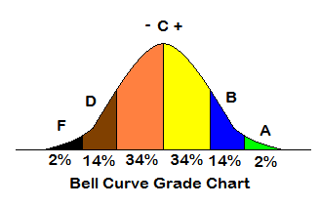
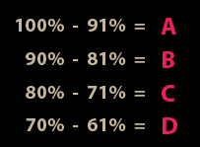
Standard Setting: How?
Relative based (norm)
  Within 2 SD
Absolute based (criterion)
  Above 60%
Downing SM, Tekian A, Yudkowsky R. Teaching and Learning in Medicine. 18(1): 2006.

Slide 13

Expert Input
Even absolute standards require “cutoffs”
Select credible, expert “judges”
Balance feasibility
Define the borderline student
  Identifying borderline more difficult

Slide 14
The trouble with experts
Experts are content experts
Expectations too high
If standards are completely absolute, the process is inefficient and requires multiple iterations.

Slide 15
Can you fail one assessment of your clerkship and still pass?
Examples:
  Score high on clinical evaluation, fail the shelf
  Pass clinically, Pass shelf, Fail an OSCE
  Pass shelf, Fail oral exam
Assessments often target different domains

Slide 16
Specific Standard Setting Techniques

Slide 17
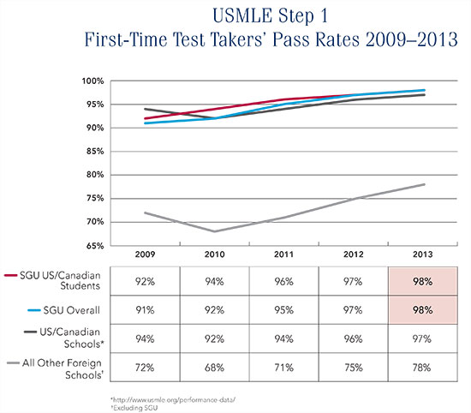
Terminology
Passing Score
Passing Rate
Inverse Relationship

Slide 18
Angoff Method: Five Steps
1. Discuss characteristics of borderline student
2. Consensus with specific examples
3. For each exam/assessment item, each judge estimates a rating.
4. Blinded recording
5. Systematic combining of results.

Slide 19
Hofstee Method
Obtain mean, standard deviation, and quartile measures.
Judges discuss data and assessment.
Judges answer 4 questions:
  1. The lowest acceptable percentage of students to fail the exam.
  2. The highest acceptable percentage of students to fail the exam.
  3. The lowest acceptable percent correct score that allows passage of the exam.
  4. The highest acceptable percent correct score required to pass the exam.

Slide 20
Hofstee

Slide 21
Use consensus to set standards
Clerkship annual meeting
Separate meeting analogous to clinical competency committee
New assessments require pragmatic approach
Using consistent processes validates your standards

Slide 22
Remediation
Student misses pass threshold.
Should all remediation be uniform?
How much flexibility does your institution have?
Examine your “willingness” to fail a student.

Slide 23
Should we diagnose the reason for failure?
Clinical Skills Exam study defined categories
  1. Pre-existing academic issues (56%)
  2. Testing issues or organizational problems (23%)
  3. Extenuating psychosocial factors (15%)
  4. Nonverbal learning issues (9%)
  5. Attitudinal issues (professionalism) (30%)
A Kalet CL Chou Remediation in Medical Education. 2014

Slide 24
Remediation Best Practices
Support from Dean
Mandatory participation
Learn diagnoses
Collaborative Development of individual plan
Frequent monitoring and documentation
Longitudinal faculty – student relationships
Tailored strategies
Variety of methods
Attitudes and motivations
Self- monitoring
Emotional support
Faculty mentoring, directo observation, and feedback
Kalet, Tewksbury, Ogilvie, Yingling. 2014

Slide 25
Creating an Individual Learning Plan – Medical Knowledge
Kalet 2014

Slide 26
Creating an Individual Learning Plan – Medical Knowledge
Diagnose cause. Seek aid from SOM.
Structured reading assignments with faculty mentor before formal remediation
Consider alternate test/quizzes
Structured partial remediation of rotation

Slide 27
ILP - Interpersonal Skills
Interpersonal Skills / Emotional Intelligence
Outliers may present as a failing clinical score
Assistance from Dean’s office
Videotaped encounters
May need to remediate entire clinical rotation after correction.

Slide 28
ILP - Professionalism
Early and often reporting with established mechanism.
Consider Failure of rotation based on failure to meet professionalism objectives.
Is it too late?
Should we be intervening at the admissions stage?
Complex reflective and coaching strategies.
May need to remediate entire clinical rotation after correction.

Slide 29
ILP – Clinical Reasoning
Organizational difficulties.
Gathers information, but no synthesis.
Faculty mentoring
Direct observation
Case based problem solving
One minute clinical preceptor
Partial to full remediation of clinical rotation with above tools

Slide 30
Back to the cases

Slide 31
Case #1
John is a third year medical student. He was a middle performer in his first two years.
At the end of his rotation, he receives a failing score on his shelf exam.
Clinical assessments reveal that John was well liked by his teams. Attendings commented on a below average fund of knowledge and wrote “he should read more.” .

Slide 32
Group Thoughts?

Slide 33
Case #2
Mary is a third year medical student. She was a high performer in her first two years.
At the end of his rotation, she receives a high score on his shelf exam.
Assessments reveal marginal scores clinically. Residents cite awkward patient and team interactions. Attendings cite an inability to convey key information on patient presentations.

Slide 34
Group Thoughts?

Slide 35
Case #3
Travis is a third year medical student. He was a middle performer in her first two years.
At the end of his rotation, he receives a marginal score on his shelf exam.
Assessments reveal marginal scores clinically. Residents commented that he was often late to rounds. During large segments of the work day, the team was not clear on his whereabouts. He called in sick for the last two days of the rotation.

Slide 36
Group Thoughts?

Slide 37
Conclusions
Students fail for a variety of reasons.
Setting clear standards makes for easier decisions later.
Identify domain of failure.
Diagnose specific issue.
Create an individualized learning plan.
Remediate, deliver frequent feedback, and document.
Remediating professionalism controversial.
Students may fail on professionalism grounds alone.

