Slide 1


Slide 2



Defining Grades in the Surgery Clerkship
Jeremy M. Lipman, MD
MetroHealth Medical Center
Case Western Reserve University School of Medicine

Slide 3

No Disclosures

Slide 4
Background
Grades are influential
Significant variability in grade assignment
Grade inflation is common
Devalued without a consistent meaning
Plymale, J Surg Ed, May, 2010
Pulito, Med Educ. 2007
Bowen, AJS, April, 2015

Slide 5
Grade Breakdown
25% Shelf
10% OSCE
10% Oral
55% Clinical Assessment

Slide 6
Overview
Components
  Objective
  Subjective
Challenges
Opportunities

Slide 7
Components of Grade
Absolute or Relative
Compensatory
Cutoff
Value of diverse methods
Schindler Am J Surg. 2007

Slide 8
Objective Measures
NBME Shelf exam
OSCE
Oral exam
Essay
Technical skills

Slide 9
Shelf
Seen as the objective standard
  Scores biased by prior clinical exposure
Poor correlation with clinical evaluation
  Even with more time, still poor
Does it assess what we want to know?
Reteguiz, Fam Med, 2002
Awad J Surg Res. 2002
Farrell J Am Coll Surg. 2010
Goldstein m J Surg. 2014

Slide 10
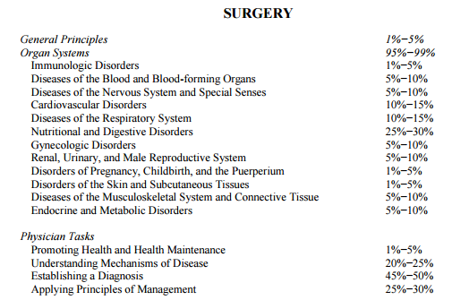
nbme.org

Slide 11
OSCE
Can differentiate level of training
Needs to target a specific skill or concept
Merrick J Surg Res. 2002
Falcone J Surg Educ. 2011

Slide 12
Oral Exam
Correlation with other factors unclear
Importance of frame of reference setting
  If goal is objective grading
  May have value to guide study

Slide 13
Essay
Increased grades for those doing worse
  Decreased grades for honors students
Strict standard setting
Correlated with NBME
  May just increase weight on non-clinical factors
Smart Am J Surg. 2016

Slide 14
Technical Ability
Can we reliably assess this in a student
Does it matter
Is it our responsibility to assure all doctors can perform simple procedures
  This is an EPA

Slide 15
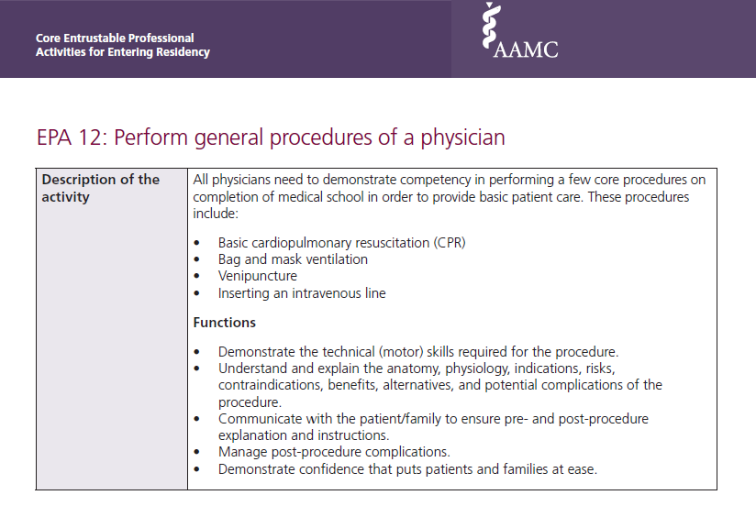
AAMC Core EPA Faculty and Learner Guide, 2014 (with permission)

Slide 16
Technical Ability
Many tools exist – quality?
Necessary for assessment?
coldslitherpodcast.files.wordpress.com/2012/02/operation.jpg
Kogan, JAMA, 2009
AAMC Core EPA Faculty and Learner Guide, 2014

Slide 17
Subjective Measures
Decide who will evaluate
Deal with inconsistency
Define important measures

Slide 18
Who is evaluating
Student selected
Faculty generated
Physician only

Slide 19
Variability
Evaluators
Clerkship directors
Institutions
Students

Slide 20
Standardize Assessment
Example of rating
Rationale behind rating
Effective in 1 hour
Schindler Am J Surg. 2007
George, J Surg Ed, 2013

Slide 21
Challenges
Experience is fragmented
June v/s July
Culture of assessors
Motivation to assess

Slide 22
Subjective Measures
ACGME Core Competencies
Patient Care
Medical Knowledge
Practice Based Learning and Improvement
Systems Based Practice
Professionalism
Interpersonal Skills and Communication
Selection criteria
  LCME requires competency based curriculum

Slide 23
Program Directors
Program selection
Unclear variability between institutions
Honor societies

Slide 24
Clerkship Director
Fair / defensible
Consistent
Weigh the evidence

Slide 25
Students
Clear criteria focus efforts
Fair treatment
Directs formative feedback

Slide 26
Program Directors
Round 1
Round 2
Round 3
Consensus
AGREEMENT
Consensus
Round 1
Round 2
Round 3
Clerkship Directors

Slide 27
Results
14 Program Directors
  65 unique characteristics
  Consensus on 23
15/15 Clerkship Directors
  62 unique characteristics
  Consensus on 22

Slide 28
Agreement
Communication skills
Outstanding clinical acumen
Synthetic ability
Absence of professionalism issues
Outstanding work ethic
Self-directed learner
Accurate and complete history and physicals
Enthusiastic
Becomes an essential member of the care team
NBME Shelf exam

Slide 29
Opportunities
Performance based assessments
  Bridge EPAs and Milestones
  Competency based assessment

Slide 30


EPA 1: H&P
EPA 2: Prioritize a differential diagnosis following a clinical encounter
EPA 3: Recommend and interpret common diagnostic and screening tests
EPA 4: Enter and discuss orders and prescriptions
EPA 5: Document a clinical encounter in the patient record
EPA 6: Present a clinical encounter
EPA 7: Form clinical questions and retrieve evidence to advance patient care
EPA 8: Give or receive a patient handover to transition care responsibility
EPA 9: Collaborate as a member of an inter-professional team
EPA 10: Recognize a patient requiring urgent or emergent care and initiate evaluation and management
EPA 11: Obtain informed consent for tests and/or procedures
EPA 13: Identify system failures and contribute to a culture of safety and improvement
AAMC Core EPA Faculty and Learner Guide, 2014 (with permission)

Slide 31

Milestones
  Residents should get beyond “critical deficiency” by first review
flickr.com

Slide 32
X
S
141 “core” surgical operations
  Cholecystectomy, breast biopsy
  Extra-anatomic bypass, vagotomy
acgme.org/acgmeweb/portals/0/pdfs/milestones/surgerymilestones.pdf
2015-16 curriculum accessed at: portal.surgicalcore.org/public/curriculum

Slide 33
X

Slide 34
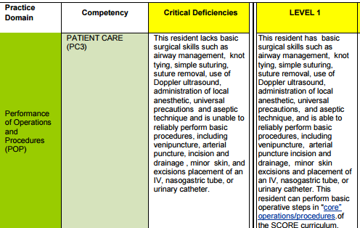
X
X
acgme.org/acgmeweb/portals/0/pdfs/milestones/surgerymilestones.pdf

Slide 35
X
X

Slide 36
X
X

Slide 37
X
X

Slide 38
X
X

Slide 39
Performance Based
Clerkship Milestones
  Grades assigned based on level of progression

Slide 40

Final Assessment
Need to define the endpoint
  Digital badges
  Clinical Competency Committee
  OSCE
wingofzock.org – BUSM+
Shapiro Institute for Education and Research, Millennium Conference 2015

Slide 41
Conclusion
Clear grading metrics are valuable
Faculty development is important
Opportunity for innovation

