Slide 1




Troubleshooting 106
Use of oral exams and OSCEs for student assessment
Jesse Moore, MD FACS
Kathryn Butler, MD FACS
Pam Rowland, PhD

Slide 2

Objectives
Describe how to implement an oral exam and OSCE assessment of a medical student.
Compare and contrast target areas for assessment using Oral exams and OSCE’s.
Describe the evidence to support the use of oral and OSCE assessments.
Compare and contrast challenges for implementing an OSCE vs Oral exam

Slide 3
Schedule
Innovative Assessment – OSCEs
Innovative Assessment – Oral exams
Small group workshop
Preparing faculty to administer oral exams

Slide 5

Troubleshooting Your Clerkship 106
Innovative assessment: OSCEs
Kathryn L. Butler M.D. FACS

Slide 6

Assessment: Then and Now

Slide 7
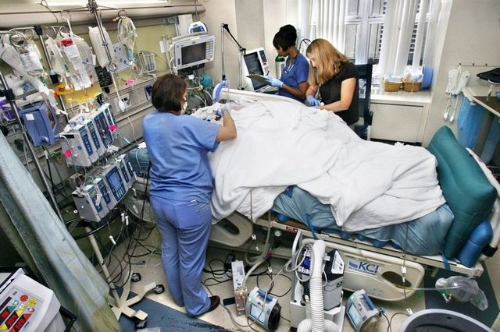





Pre-Medical Assessment

Slide 8
Learning Objectives
Consider strengths and drawbacks of evaluations in medical student assessment
Consider strengths and drawbacks of oral exams and OSCEs for medical student assessment
Design an oral exam/ OSCE based upon a clinical problem

Slide 9

The Problem
Faculty-written feedback constitutes the chief means of student assessment in medical schools
Multi-institutional data
since the 1990s:
  Evaluations subjective
  Variable reliability
  Reflect recollections of case presentations and write-ups
  Infrequent critical appraisals of clinical skills

Slide 10
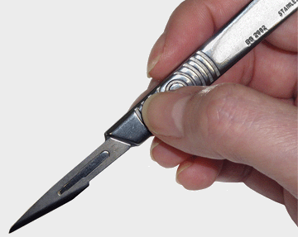
The Problem. . . With Surgeons
Surgeons have sporadic encounters with students, limiting opportunities
for substantive feedback
Less longitudinal contact
than in other specialties
Efficiency a requirement
Variability in clinical acuteness, volume, and breadth creates barriers to standardized evaluation.

Slide 11
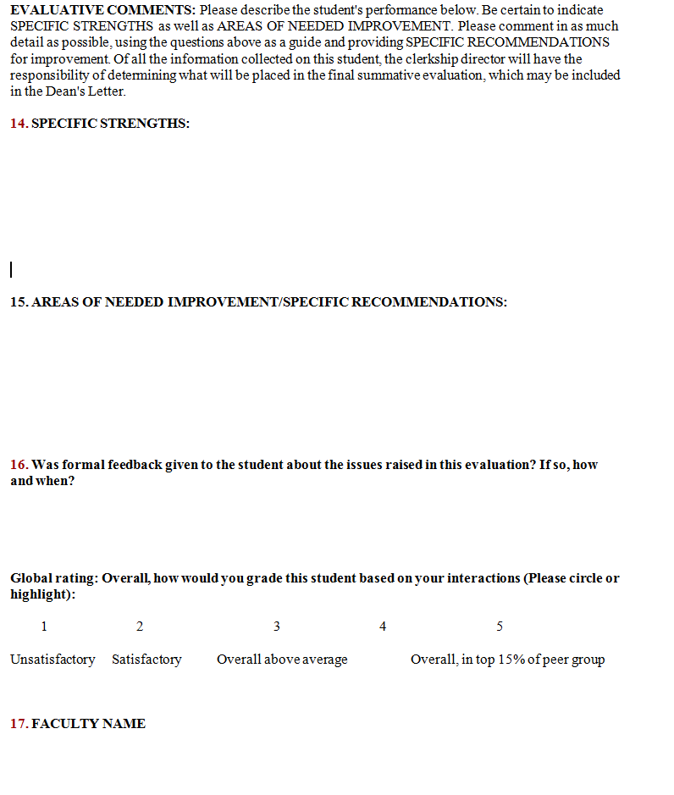

Slide 12
23%
20%
2%

Slide 14
?

Slide 15
EVAL COMMENTS (total) | 1684
INITIATIVE | 17.0%
ENTHUSIASM | 11.7%
FUND OF KNOWLEDGE | 10.1%
SUMMATIVE COMMENTS | 8.0%
TEAM CONTRIBUTION | 8.0%
HISTORY TAKING | 5.9%
PERSONALITY | 5.8%
COGNITIVE PROCESS | 5.8%
PROFESSIONALISM | 5.5%
TECHNICAL SKILLS | 4.5%
BEDSIDE MANNER | 3.7%
COGNITIVE APTITUDE | 3.5%
PRESENTATIONS | 3.3%
NAVIGATING SYSTEMS | 3.1%
LEADERSHIP SKILLS | 2.3%
COMMUNICATION SKILLS | 1.2%
PHYSICAL EXAM | 0.4%
RADIOLOGY | 0.1%

Slide 16
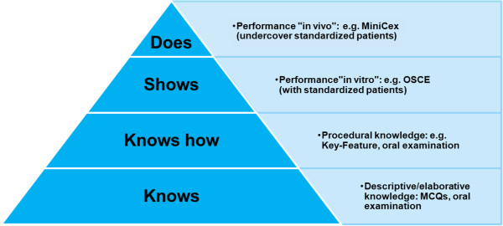
Alternatives to Faculty Evaluations

Slide 17
Objective Structured Clinical Examination
Students tested in simulated scenarios designed to reflect clinical encounters
Scored based upon their achievement of pre-determined learning objectives
Designed to test a student’s communication, decision making, and clinical assessment abilities in a dynamic fashion
Seeks to evaluate reasoning and application, rather than rote fact retention

Slide 18
OSCEs in Surgery
Surgical literature contains few descriptions of OSCEs used for medical student assessment
EM and OB/Gyn clerkships have reported success
ACS recently recommended an OSCE to assess clinical practice readiness for incoming for surgery interns

Slide 19
Building an OSCE - Content
Content of exam based upon:
  Best practice guidelines
  Goals and objectives for clerkship
  Expert consensus among clerkship leadership

Slide 20
Building an OSCE --Response Process
Minimize sources of error associated with test administration
Standardized assessment tool after polling multiple faculty
  Incorporated feedback to identify key learning objectives and critical maneuvers for each clinical scenario
Created a composite assessment rubric consisting of both checklists and a global score
Same proctors administer exam each block
Students practice on the simulator before the exam

Slide 21
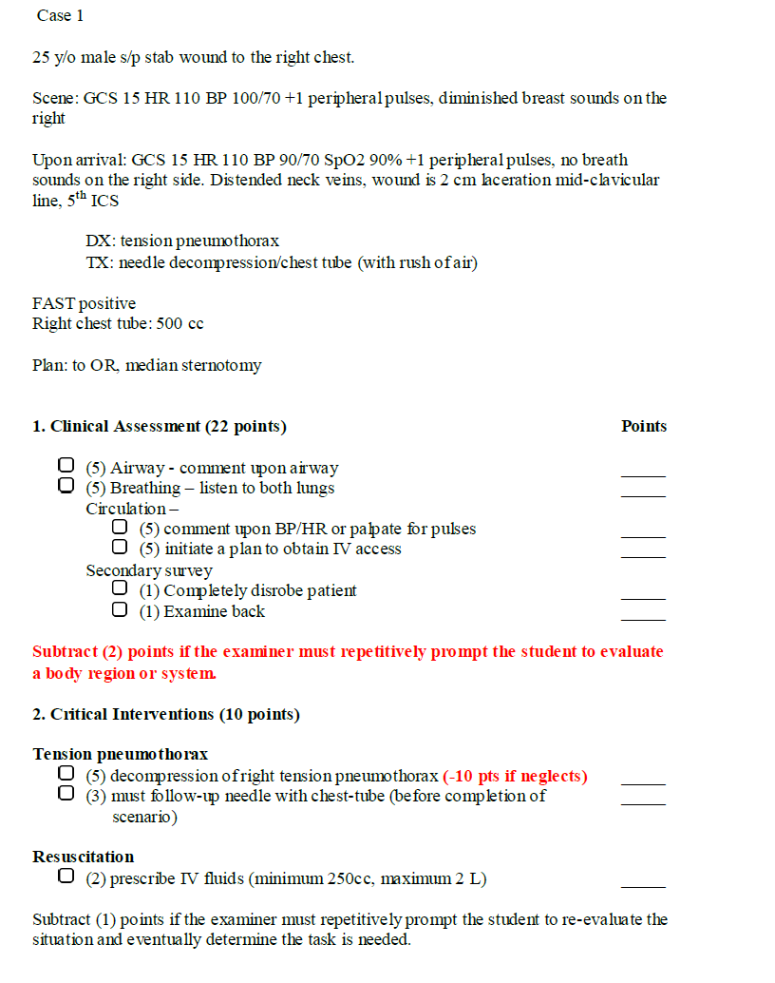
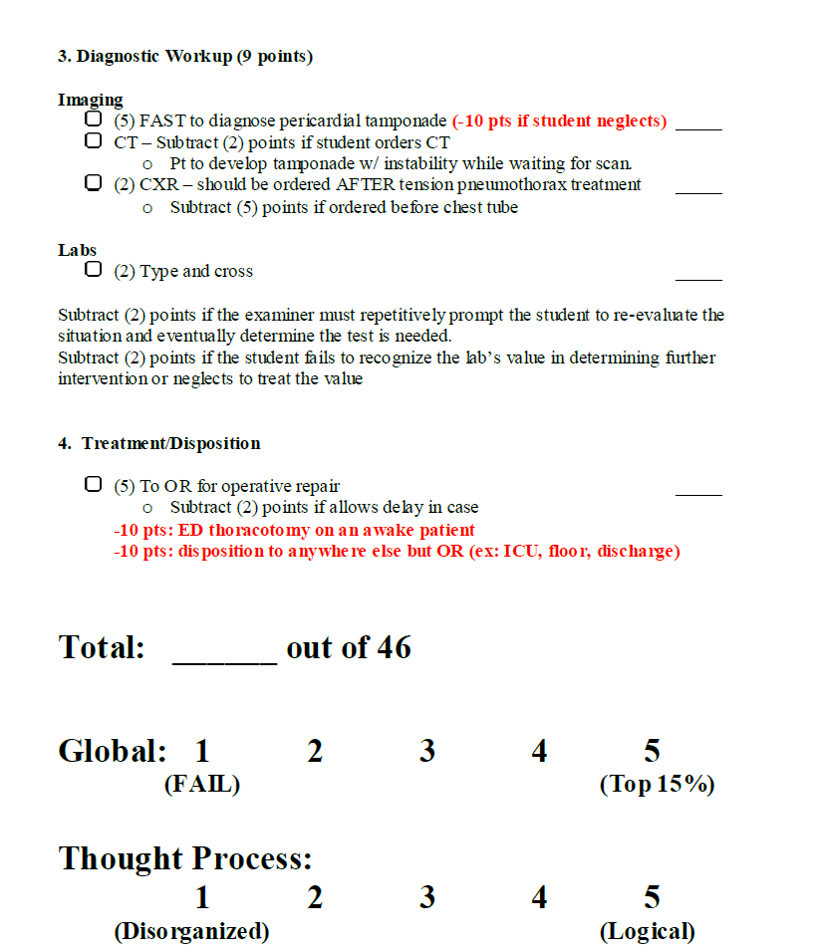

Slide 22
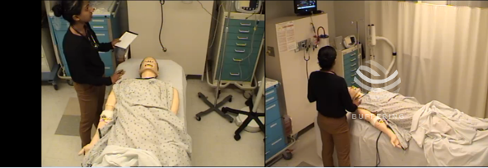
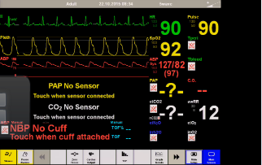

Slide 23
OSCE COMMENTS (total) | 505
COGNITIVE PROCESS | 37.0%
PATIENT MANAGEMENT | 27.5%
DIAGNOSTIC WORKUP | 12.5%
SUMMATIVE COMMENTS | 8.5%
PHYSICAL EXAM | 5.3%
HISTORY TAKING | 4.6%
LEADERSHIP SKILLS | 1.6%
BEDSIDE MANNER | 1.2%
COMMUNICATION SKILLS | 0.8%
FUND OF KNOWLEDGE | 0.8%
PROFESSIONALISM | 0.2%
NAVIGATING SYSTEMS | 0.2%

Slide 24
Commentary Analysis
Pos:Neg Ratios:
7:1
1:3
 | POSITIVE COMMENTS | NEGATIVE COMMENTS | TOTAL
EVALS | 1409 | 275 | 1684
OSCE | 162 | 343 | 505
P<0.05

Slide 25
Feedback Summary
OSCE has higher frequency of feedback (p<0.05) regarding:
  Cognitive process
  Physical exam
  Diagnostic workup
  Patient management
Evaluations have higher frequency of feedback regarding:
  Fund of knowledge
  Bedside manner
  Navigating systems
  Professionalism
  Initiative
  Enthusiasm
  Personality
“Areas to improve”
“Specific strengths”

Slide 26

Troubleshooting Your Clerkship 106
Innovative assessment: Oral exams
Jesse Moore M.D. FACS

Slide 27
Oral exams
The upside

Slide 28
Oral exams
  The upside: Zelenock et al Surgery 1985
  Students and faculty like them!
  Unique contribution to grade assignment
Preparation for board certification process
    Gen surg, optho, ER, anesthesia, psychiatry, neurology, OB/Gyn, radiology
Notes:
Surgery. 1985 Jun;97(6):737-44. Oral examinations: actual and perceived contributions to surgery clerkship performance.
Zelenock GB, Calhoun JG, Hockman EM, Youmans LC, Erlandson EE, Davis WK, Turcotte JG. Abstract PMID: 4002121
3-year experience at the University of Michigan
surveys identified faculty and student opinion regarding the oral examination. The results were consistent during the 3-year period of study. Faculty and student opinion regarding the examination as an evaluation process and motivational device were positive, as was opinion regarding the breadth and depth of knowledge tested and the examination as a learning experience and an accurate reflection of students' performance
Multiple regression analysis of the relationship between the oral examination and ward grades, written examination grades, and the final grades
significant correlation between the oral examination and other evaluation parameters. Stepwise regression analysis revealed that the oral examination contributed unique information to final grade determination.
.
12 boards still use orals

Slide 29

Oral exams
The downside…
  Inter-rater reliability
PASS !
FAIL !

Slide 30
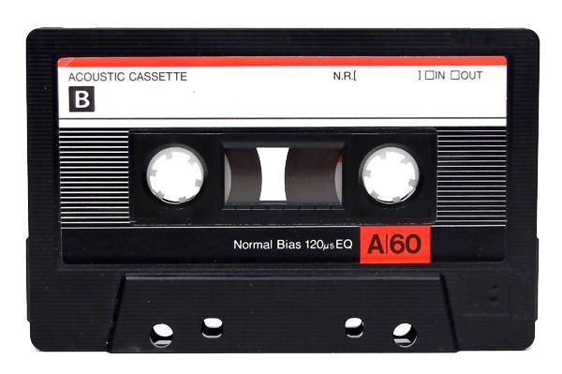
Inter-rater reliability
Kumar et al Adv Health Sci Educ 2001
  Peds clerkship at 6 sites
  Standardized oral exam cases
Notes:
Kumar A1 PMID: 11709636
Locating, characterizing and minimizing sources of error for a paper case-based structured oral examination in a multi-campus clerkship.
Peds clerkship across 6 sites Michigan State, each site assigned own grade, standard cases, examinations were audio-taped.
From audio-tapes five community coordinators scored examiner behaviors and graded student performance. Correlations among examiner behaviors scores were examined. Graphs identified grading patterns of evaluators.
RESULTS:
Exam-givers differed most in their "teaching-guiding" behavior, and this negatively correlated with student grades. Exam reliability was lowered mainly by evaluator differences in leniency and grading pattern; less important was absence of standardization in cases.
CONCLUSIONS:
While grade reliability was low in early use of the paper case-based oral examination, modeling of plausible effects of training and monitoring for greater uniformity in administration of the examination and assigning scores suggests that more adequate reliabilities can be attained.

Slide 31
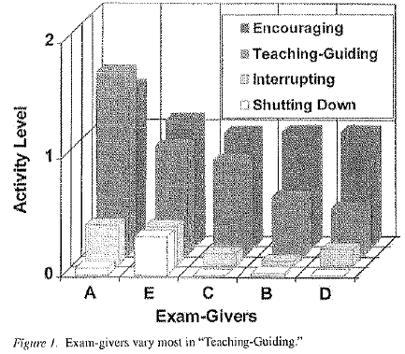
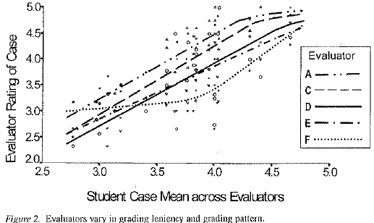
Inter-rater reliability
Kumar et al 2001
Notes:
Significant variation in examiners behavior. Exam-givers differed most in their "teaching-guiding" behavior, and this negatively correlated with student grades ie the more an evaluator engaged in “teaching-guiding” the worse their student’s grades were
Evaluators differed significantly in the grades they assigned to students. Easiest grader is curve to the left, hardest to the right. Same slope indicates evaluators don’t differ in their discrimination. Evaluator F is an outlier (using some different policy altogether). These are non-random differences that would impact a student’s
Exam reliability was lowered mainly by evaluator differences in leniency and grading pattern; less important was absence of standardization in cases.

Slide 32
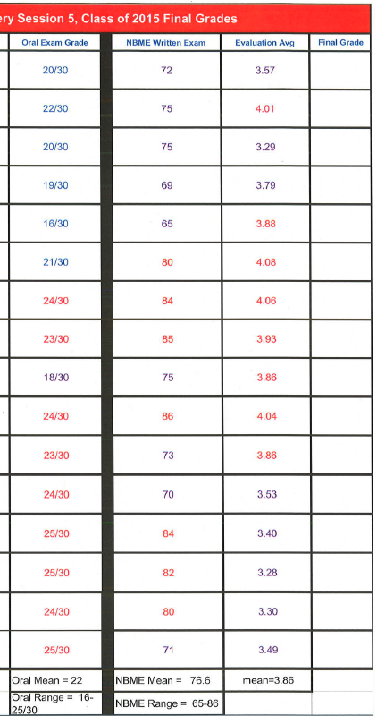
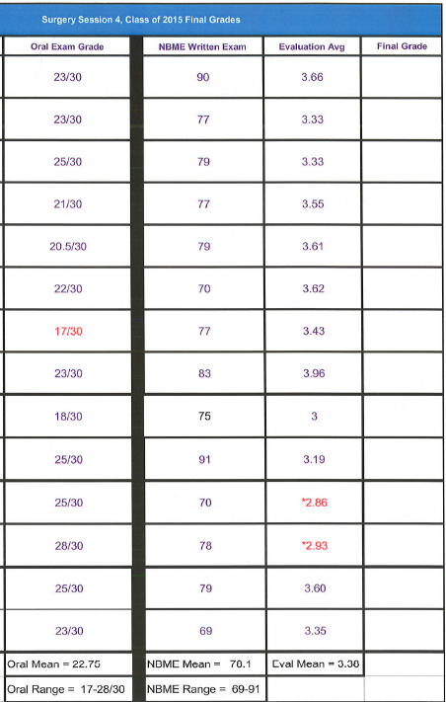
Inter-rater reliability

Slide 33
Oral exams
The downside…
  Bias
  Tests something other than knowledge…
  Faculty intensive
    10 students/session, 3 rooms → 6 faculty/session
      Short notice cancellation
      Faculty knowledge gaps
Notes:
Bias: faculty who have worked with the student previously
Tests something other than knowledge: behavior, attitude, attractiveness

Slide 34
Oral exams – faculty intensive
Burchard, Rowland et al 2007
  282 videotaped oral exams
  Problem solving, verbal skills, nonverbal skills
  Live examiner vs. Evaluator of video
    No difference in summative difference
Notes:
Am J Surg. 2007 Feb;193(2):233-6.
Is it live or is it Memorex? Student oral examinations and the use of video for additional scoring.
Burchard K¹, PMID: 17236853 [PubMed - indexed for MEDLINE]
BACKGROUND:
Oral examination interrater consistency has been questioned, supporting the use of at least paired examiners and consensus grading. The scheduling flexibility of video recording allows more examiners to score performances. The purpose of this study was to compare live performance with video performance scores to assess interrater differences and the effect on grading.
METHODS:
A total of 283 consecutive, structured, videotaped 30-minute examinations were reviewed. A 5-point Likert scale ranked problem solving (2 cases), verbal skills, and nonverbal skills. Nonparametric paired analyses tested for differences.
RESULTS:
Live performance scores were higher for verbal and nonverbal skills and total scores. Video performance scores were higher for problem solving for the first presented case. The largest difference (.29 Likert point) was in nonverbal skills.
CONCLUSIONS:
The minor yet statistical differences in several scores did not actually impact student grades. The use of video recording is sufficiently reliable to be continued and advocated.

Slide 35
My approach
Encounter | Medical knowledge | Patient Care Skill | Assessment tool
Hemodynamically unstable inpatient GI bleed | GI bleeding Shock | Abdominal exam Resuscitation | SP checklist Oral exam score sheet
Outpatient follow-up for abnormal mammogram | Breast mass | Breast exam Counselling | SP checklist Note
ER patient with diverticulitis | Acute abdomen | Abdominal exam Note writing | SP checklist Note
ER patient with septic shock from ascending cholangitis | Acute abdomen Shock | Abdominal exam Resuscitation Note writing | SP checklist Note
ER patient with small bowel obstruction | Bowel obstruction Acute abdomen | Abdominal exam Writing admission orders | SP checklist Orders

Slide 36
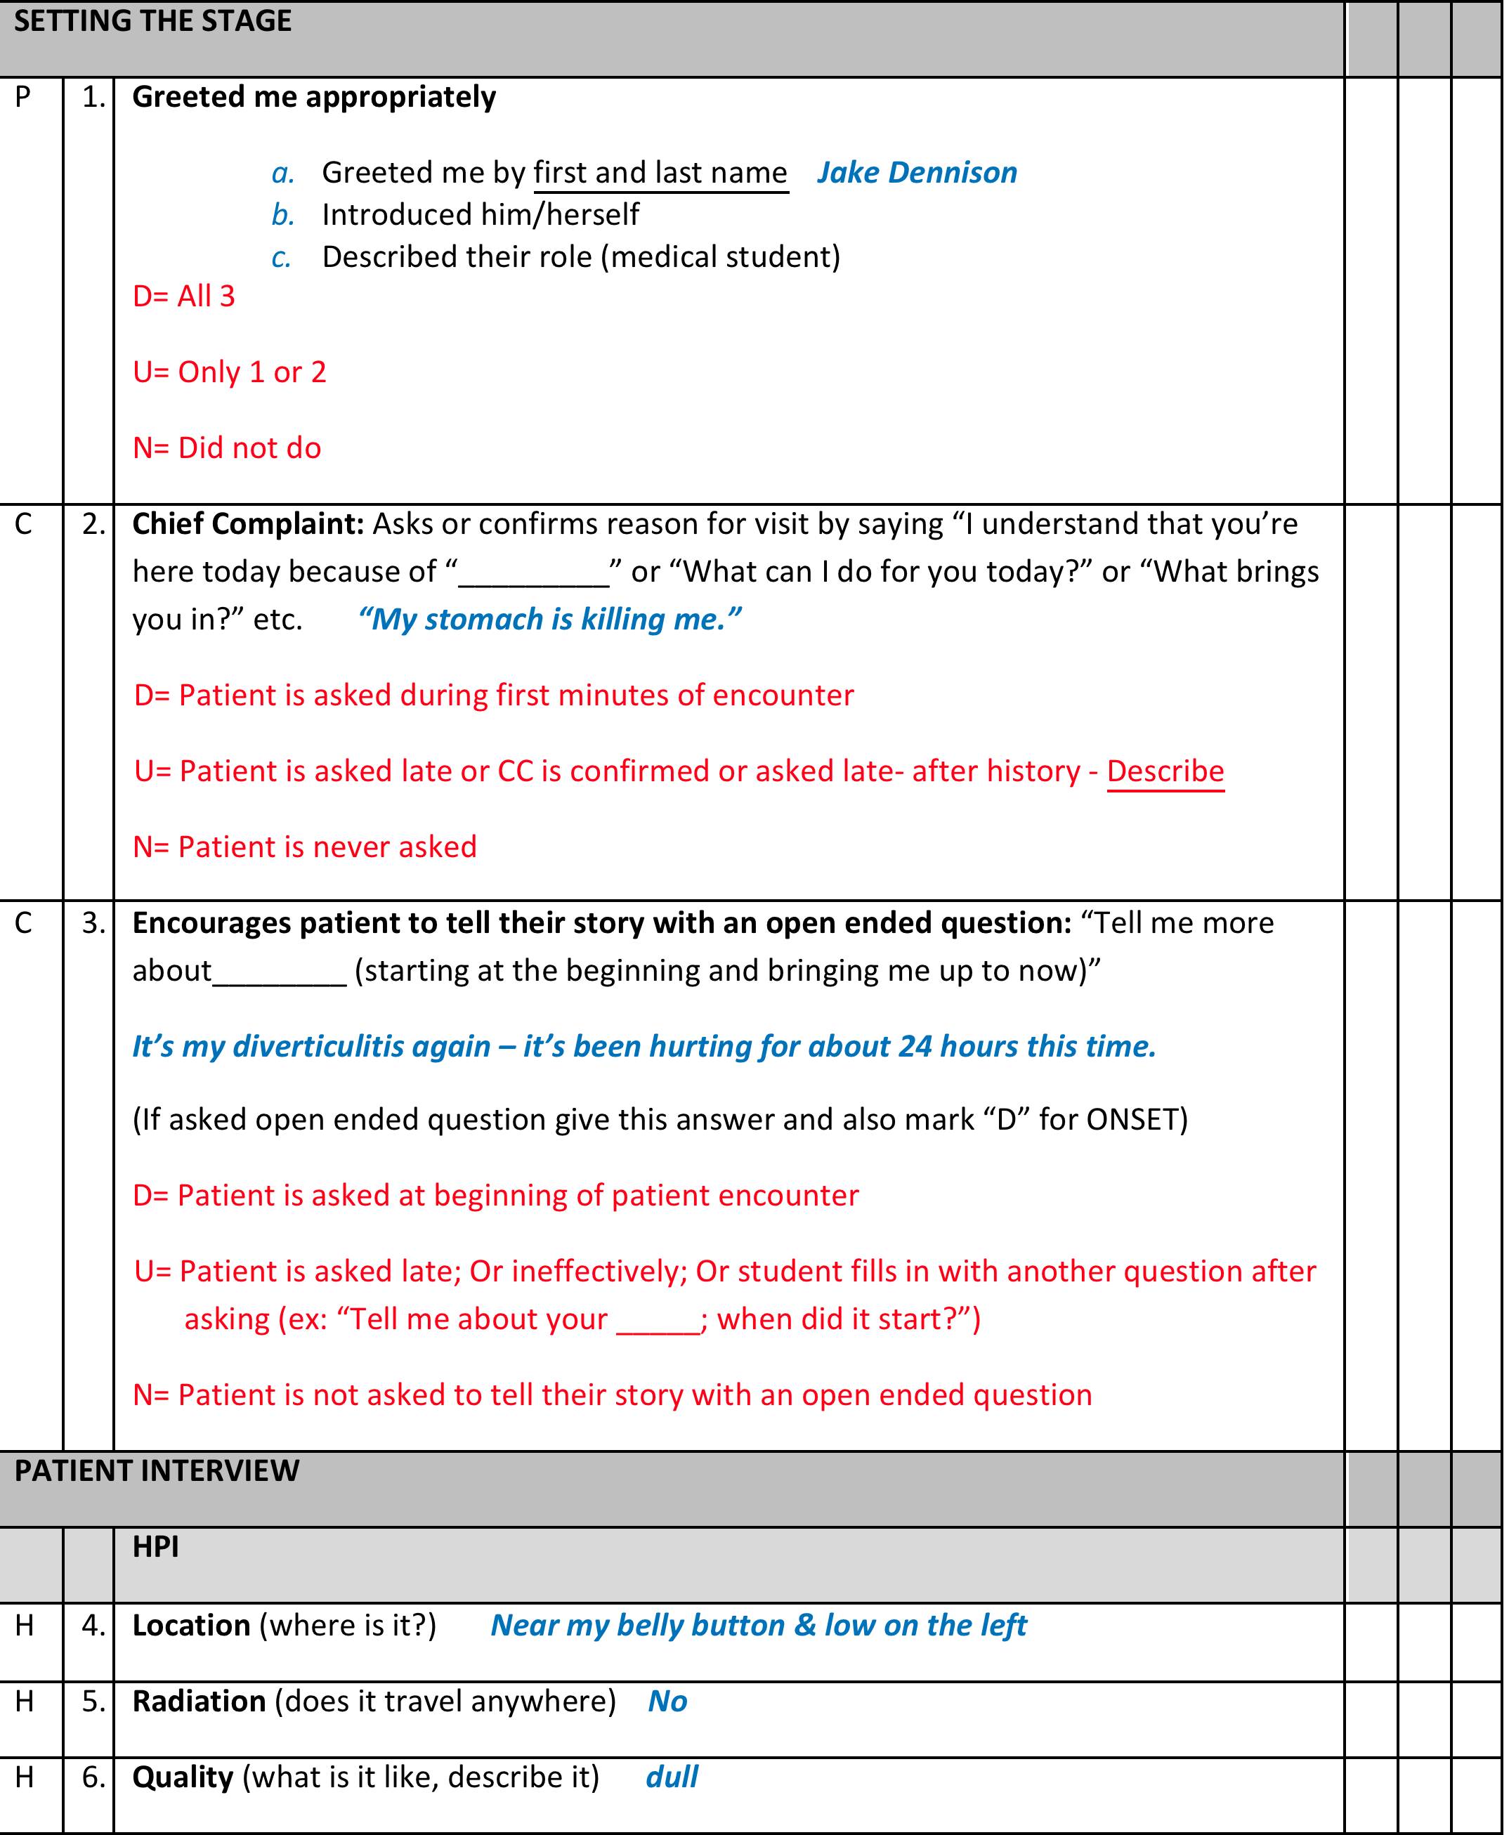
Notes:
Took existing checklist templates and customized them for each patient encounter

Slide 37
My approach
All students come back
Myself, 2 additional faculty
SP assessment

Slide 38
OSCEs and Orals
Additional considerations
  $$$$
  Availability of Sim Lab / Testing centers
  There is no literature in this area!
Notes:
Costs: supplies for any skills based assessment, SP time, admin/coordinator
Availability: increasing use of Sim in medical education means increased demand for space. Clerkships often end at the same time which means lots of demand during a short time for limited space
No literature: opportunity

Slide 39
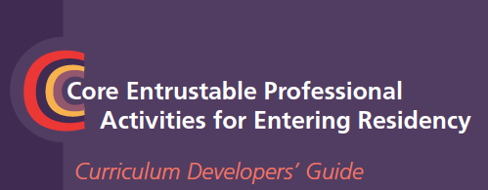
Future directions
Hx and Exam
Prioritize a differential
Recommend and interpret testing
Enter orders
Document in the chart
Present a patient orally
Form clinical questions and find evidence
8. Give or receive sign- out
9. Collaborate as a team member
10. Recognize a patient requiring urgent care
11. Informed consent
12. Perform general procedures
13. Identify system failures

Slide 40

Small group workshop
Groups of 4 (mix of coordinators and directors)
Pick a site – give intro
Develop and OSCE or oral examination to assess 3rd year student’s ability to assess a patient with an acute abdomen

Slide 41
Small group debrief

