Slide 1


Slide 2

Implementing A Longitudinal Clerkship
Robert R. Nesbit, Jr., MD

Slide 3


Slide 4


Slide 5


Slide 6

Discuss the concept of the LIC and its advantages and disadvantages
Describe the role of Surgery in an LIC
Discuss the role of the Surgery Clerkship Director in an LIC

Slide 7
Medical students participate in the comprehensive care of patients over time
Medical students have continuing leaning relationships with these patients’ clinicians
Through these experiences, medical students meet the majority of the year’s core clinical competencies across multiple disciplines simutaneously

Slide 9
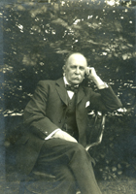
Sir William Osler
“He brought medical students into the wards for bedside teaching”

Slide 10
The Flexner Report
“….seeking to learn the number of patients available for teaching, the variety of conditions that they illustrate and the hospital regulations…..
Continuity of service on the part of the teachers of medicine
The closeness with which the student may follow the individual patients…”

Slide 11
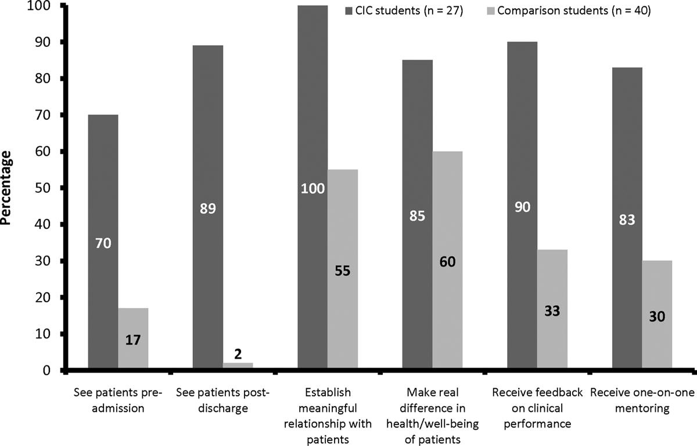
Hirsh – Academic Medicine - May 2012

Slide 12
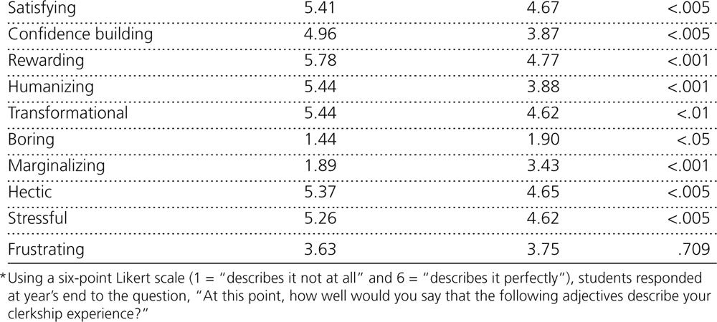
Hirsh – Academic Medicine - May 2012

Slide 13
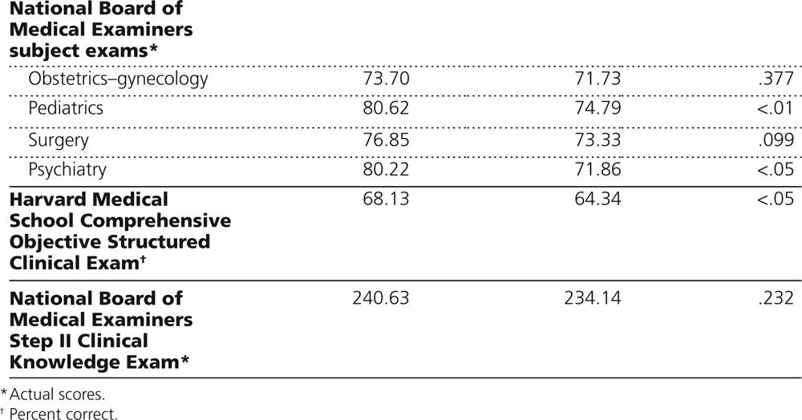
Hirsh – Academic Medicine - May 2012

Slide 14
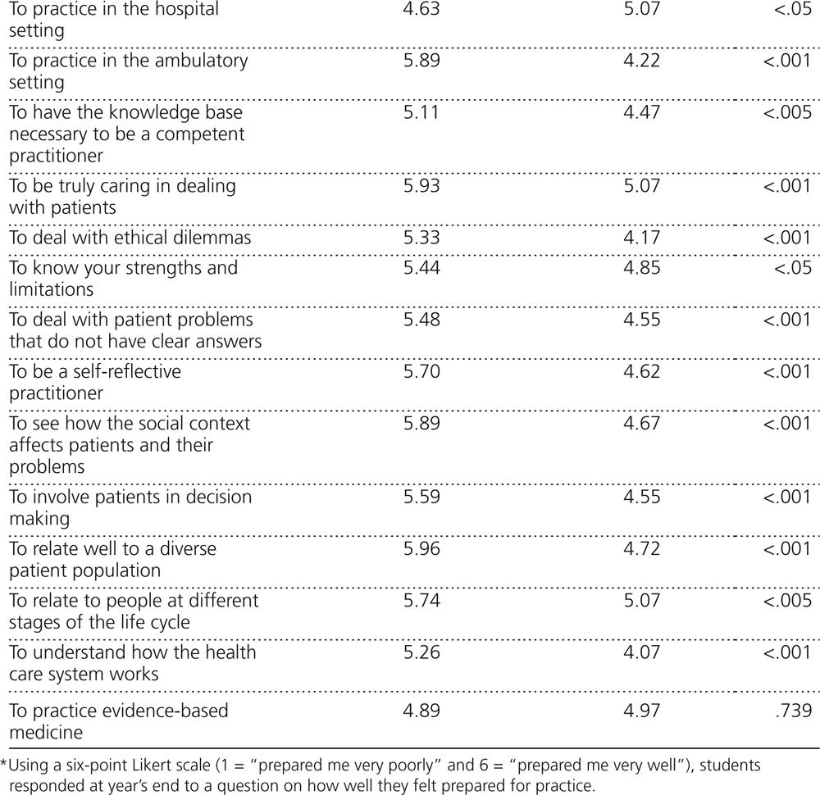
Hirsh – Academic Medicine - May 2012

Slide 15
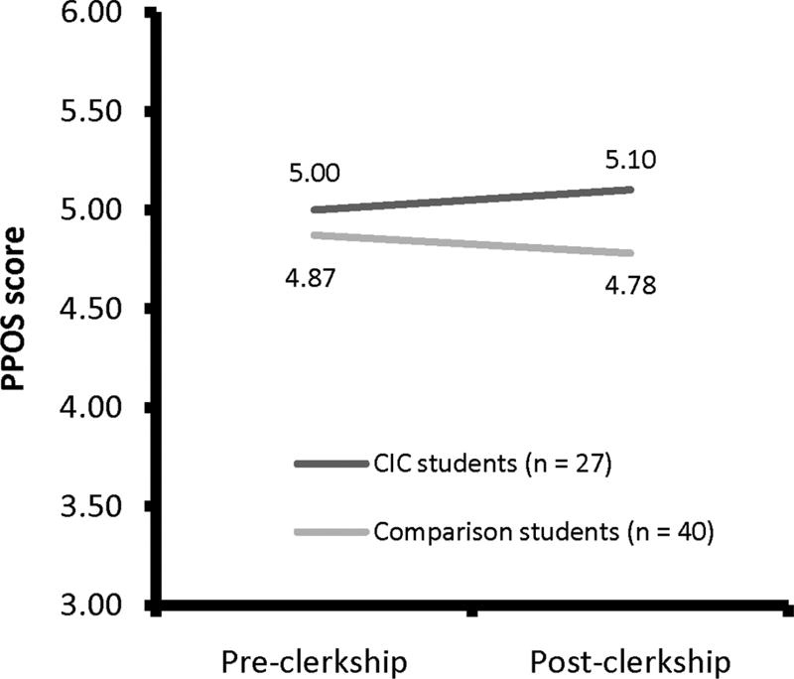
Hirsh – Academic Medicine - May 2012

Slide 16
Hirsh – Academic Medicine - May 2012

Slide 17
UCSF – LIC Mission Statement
‘To educate medical students in an academic setting to practice medicine in a new world that includes evolving healthcare delivery systems, demographic shifts, patient-centered illness models, new health information systems, and changes in graduate medical education.’

Slide 18
UCSF LIC – Core Principles
1. Longitudinal relationships with faculty preceptors and an advisor.
2. Longitudinal relationships with patients, with an emphasis on patient-centered care.
3. A developmentally progressive didactic curriculum and clinical skills workshops with an emphasis on interdisciplinary teaching
4. Continuity with peers.
5. Exposure to undiagnosed illness in acute and chronic care settings.

Slide 19
The LIC
Advantages
  Continuity
  Continuity
  Continuity
Disadvantages
  Very faculty time intensive
  Requires large primary care base

Slide 20
The LIC
An educationally interesting boutique program
But not the future?

Slide 21
?’s

Slide 22

Still!

