Slide 2
ACS/ASE Medical Student Simulation-Based Surgical Skills Curriculum
Robert D. Acton, MD, FACS

Slide 3
Outline
History of Project
Description of Modules
Description of Assessments
Demonstration of Modules
Venipuncture
Communication – Hand -off
Summary

Slide 4
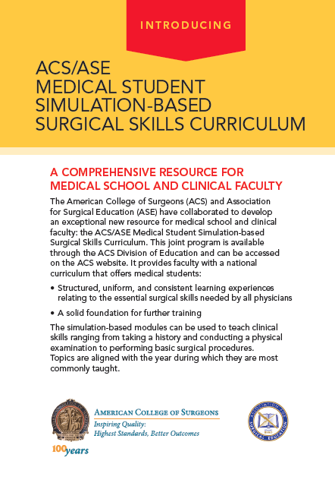

Slide 5
History
ASE 2009 – Lunch Symposium
Simulation Committee Meeting
Initial Module list developed
ASE 2010 – ACS joins and Steering Committee formed
Survey of Clerkship Directors and Students
ASE 2011 – Modules refined and edited
ASE 2013 - Released

Slide 6
Year 1
Universal Precautions
Venipuncture and Peripheral IV
Basic Vascular Exam
Female Pelvic Exam
Breast Exam
Male Groin and Genital Exam
Digital Rectal Exam
Abdominal Exam

Slide 7
Year 2
Nasogastric Tubes
Foley Bladder Catheterization
Intermediate Vascular Exam
Sterile Technique – Gloving and Gowning
Sutures, Staples and Drains – care & removal
Basic Airway Management
Communication
History and Physical
Case Communication

Slide 8
Year 3
Basic Knot tying
Basic Suturing
Intermediate Airway
Local Anesthetics
Arterial Puncture and Blood Gas
Central Venous Catheter / U/S
Thoracentesis
Paracentesis
Interosseous IV
Communication
During Codes
Safe and Effective Hand Offs

Slide 9
Module Outline
Background - overview
Objectives
Assumptions
Reading List
Description of the module
Description of technique – stepwise
Common errors
Supplies
Expert video
Assessment

Slide 10
Module Use - Visits

Slide 11
Next Steps
17 Beta Sites – using 3 modules
Basic Suturing
Basic Knot tying
Basic Airway
Collecting data on use and assessment forms
Suturing and Knot tying at ACS Clinical Congress

Slide 12
Modules are designed to teach universal physician skills to medical students.

Slide 13
Available on ACS Website Division of Education Programs http://MedstudentSimSkills.facs.org

Slide 14
Questions Please try the modules

