Slide 1
Teaching Surgery in an LIC
Association for Surgical Education
Troubleshooting Your Clerkship Workshop
April 30, 2018
Jim Alexander, MD, FACS

Slide 2
Teaching Surgery in an LIC
What is an LIC?

Slide 3
Teaching Surgery in an LIC
What is an LIC?
Longitudinal Integrated Clerkship

Slide 4
Teaching Surgery in an LIC
Longitudinal Integrated Clerkship
Comprised of: Medicine and sometimes -
OB-GYN Neurology
Pediatrics Family Medicine
Psychiatry
Surgery

Slide 5
Teaching Surgery in an LIC
Peds
Psych
Int
Med
OBGYN
Surg
Neuro
Fam Med
Traditional Block Rotation Clerkships
Peds
Psych
Int Med
OBGYN
Surg
Neuro
Fam Med
Longitudinal Continuity of Clerkships

Slide 6
Teaching Surgery in an LIC
Why are we fixing what is not broken?

Slide 7
Teaching Surgery in an LIC
Why are we fixing what is not broken?
Learning theory: Interval learning
Pedagogical: Integrative practice
Changes in healthcare delivery: Chronic / Outpatient
Ethical erosion: Hidden curriculum

Slide 8
Teaching Surgery in an LIC
Learning Theory
Repetitive, interval learning is more effective than a single intervention.
Learn
Learn
Learn
Learn
Time
Rohrer D, Pashler, H. Recent Research on Human Learning Challenges Conventional Instructional Strategies. Educational Researcher 2010;39:406-412.

Slide 9
Teaching Surgery in an LIC
Consultants, Subspecialists, etc.
Faculty Preceptors
Didactics
Individual self-directed learning

Slide 10
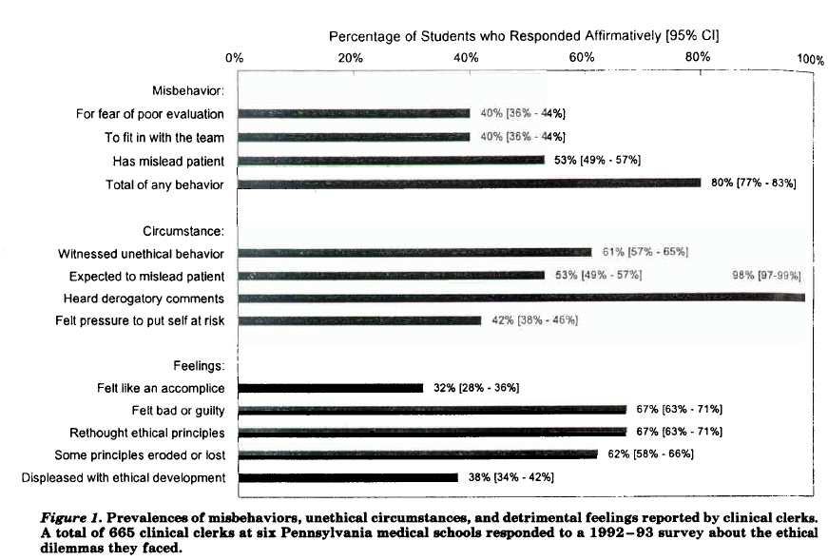
Teaching Surgery in an LIC
Survey of experiences of 665 M3’s and M4’s at six Pennsylvania schools:
Feudtner C, Christakis DA, Christakis NA. Do clinical clerks suffer ethical erosion? Students’ perceptions of their ethical environment and personal development. Acad Med.1994;69(8):670-679.
Feudtner C, Christakis DA. Making the rounds: The ethical development of medical students in the context of clinical rotations. Hastings Center Report Jan-Feb 1994: 6-12.

Slide 11
Teaching Surgery in an LIC
Continuity of Care
Continuity of Curriculum
Continuity of Supervision
Continuity of Idealism
Longitudinal
Integrated
Relationship-based
A year-long, continuous clinical education program
Hirsh DA, Ogur B, Thibault GE, Cox M. "Continuity" as an organizing principle for clinical education reform. N Engl J Med. 2007;356(8):858-66.

Slide 12
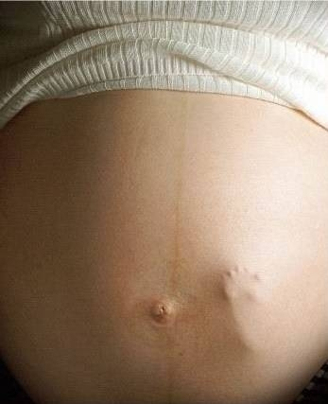
Teaching Surgery in an LIC
What are we expecting?

Slide 13
Teaching Surgery in an LIC
What will be expected of us?
Curricular objectives → NOT DIMINISHED
Experiences: At least as good, consider enhancements
Collaboration (consultants, clearances, etc)
Integrative, holistic

Slide 14
Teaching Surgery in an LIC
Recapture the vision:
The “complete” physician
who can do everything an internist can
and can operate.

Slide 15
Teaching Surgery in an LIC
How will this actually work?
Didactic curriculum unchanged, but only once/year.
Experiential opportunities stretch over the entire duration (1 year), so plenty of time to see the “good” cases.

Slide 16
Teaching Surgery in an LIC
How will this actually work?
 | Sunday | Monday | Tuesday | Wednesday |  | Thursday | Friday | Saturday
7:00 AM | OFF | PATIENT ROUNDS AS NEEDED |  |  |  |  |  | OFF
8:00 AM |  | SDL | OB-GYN | SURGERY | ADULT PRIMARY CARE |  | SURGERY OR TIME
9:00 AM
10:00 AM
11:00 AM
12:00 PM |  | L | U | N | C |  | H
1:00 PM |  | PEDS | SCHOLAR’S WORKSHOP | PSYCH | SDL |  | DIDACTICS
2:00 PM
3:00 PM |  |  | Amb Clinic
4:00 PM
5:00 PM |  | PATIENT ROUNDS AS NEEDED
6:00 PM
7:00 PM

Slide 17
Teaching Surgery in an LIC

Slide 18
Teaching Surgery in an LIC
How will the students be assessed?

Slide 19
Teaching Surgery in an LIC
How will the students be assessed?
Still need to have grades in the traditional disciplines.
Faculty evaluations
NBME Subject Exams

Slide 20
Teaching Surgery in an LIC
Student performance on the NBME Subject Exams has been shown at other schools to be equivalent and/or superior to national averages and that of students not enrolled in LIC’s.

Slide 21
Teaching Surgery in an LIC
Cooper Medical School of Rowan University
Class of 2016
NBME Exam | CMSRU (Mean) | National (Mean)
Family Medicine | 79 | 76
Internal Medicine | 81 | 78
Neurology | 77 | 76
Ob-Gyn | 77 | 76
Pediatrics | 80 | 78
Psychiatry | 85 | 82
Surgery | 81 | 76

Slide 22
Teaching Surgery in an LIC
Harvard’s results
Rewarding*
Confidence
Building*
*P < 0.05
Hirsh et al, 2012; Ogur et al 2007.

Slide 23
Teaching Surgery in an LIC
But they won’t be prepared
to work in the inpatient setting!

Slide 24
Teaching Surgery in an LIC
But they won’t be prepared
to work in the inpatient setting!
Options: Hybrid LIC / mini Inpatient blocks
End-of-M3-year Inpatient intensive
(Early) M4 Inpatient intensive

Slide 25
Teaching Surgery in an LIC

Slide 26
Teaching Surgery in an LIC
Conclusions:
Students’ motivation to learn science, their intellectual rigor, and their spirit of inquiry derive from a profound desire to serve the needs of “their” patients.
Students learn inter-disciplinary, inter-professional team care and professionalism experientially and from faculty in practice.
Students develop a rich understanding of the healthcare system from the patient’s perspective.

Slide 27
Teaching Surgery in an LIC
A new day is dawning.
Questions?

Slide 28
Teaching Surgery in an LIC
Association for Surgical Education
Troubleshooting Your Clerkship Workshop
April 30, 2018
Thank You!
Jim Alexander, MD, FACS

Slide 29
Teaching Surgery in an LIC
THANK YOU!

Slide 30
Teaching Surgery in an LIC

Slide 31
Teaching Surgery in an LIC
Harvard’s results
*p < 0.05
Hirsh et al, 2012; Ogur et al 2007.

Slide 32
Teaching Surgery in an LIC
Ethical Erosion:
Students’ decline in professionalism related to clinical training
Students witness, participate in, and have troubled feelings about disturbing events in their clinical (third) year as they participate on inpatient teams
Feudtner C, Christakis DA, Christakis NA. Do clinical clerks suffer
ethical erosion? Students’ perceptions of their ethical environment
and personal development. Acad Med.1994;69(8):670-679

Slide 33
Teaching Surgery in an LIC
Students’ decline in patient-centeredness seems to occur
as a consequence of their clinical year
Haidet P, Dains JE, Paterniti DA, Hechtel L, Chang T, Tseng E, Rogers JC. Medical student attitudes toward the doctor-patient relationship. Med Educ.2002;36:568-574
Students’ vicarious empathy declines significantly in medical school
Newton BW, Barber L, Clardy J, Cleveland E, O’Sullivan P. Is There a Hardening of the Heart during Medical School? Acad Med 2008;83:244-249.
Hojat M, Vergere M, Maxwell K, Brainard G, Herrine S, Isenberg G, Veloski J, Gonnella J. The devil is in the third year: A longitudinal study of erosion of empathy in medical school. Acad Med 2009;84:1182-1191.
Hojat M, Mangione S, Nasca TJ, Rattner S, Erdmann JB, Gonnella JS, Magee M. An empirical study of decline in empathy in medical school. Med Educ. 38 (9); 934-941 .

Slide 34
Teaching Surgery in an LIC
Unprofessional behaviors among medical students predict
subsequent unprofessional behaviors
Ainsworth MA, Szauter KM. Medical Student Professionalism: Are We Measuring the Right Behaviors? A Comparison of Professional Lapses by Students and Physicians. Ac Med 2006: 81(10):S83-86.
Papadakis MA, Hodgson CS, Teherani A, Kohatsu ND. Unprofessional behavior in medical school is associated with subsequent disciplinary action by a state medical board. Acad Med. 2004;79:244–9.
Papadakis MA, Teherani A, Banach MA, et al. Disciplinary action by medical boards and prior behavior in medical school. N Engl J Med. 2005;353:2673–82.
Tehrani A, Hodgson CS, Banach M, Papadakis MA. Domains of unprofessional behavior during medical school associated with future disciplinary action by a state medical board. Acad Med. 2005;80:S17–S20.

Slide 35
Teaching Surgery in an LIC
Faculty Preceptors
Didactics
Individual self-directed learning

Slide 36
Teaching Surgery in an LIC
Out-Patient
In-Patient
Faculty Preceptors
Didactics
Individual self-directed learning

