Slide 1


Slide 2

Teaching the Teachers
Rahul J Anand MD
Assistant Professor of Surgery
Department of Surgery
M3 Medical Student Clerkship Director
Virginia Commonwealth University

Slide 3

ED 24
Residents and Fellows as Teachers
Must be familiar with clerkship objectives
Must be prepared for Teaching
System for evaluation and remediation

Slide 4
Disseminating Information to Teachers
One of the easiest things to do is to GIVE A GRAND ROUNDS
Establishes your role as a CD in the department
Easy way to disseminate Information

Slide 5
Talking Points for GRAND ROUNDS
Data about why Teaching is Important
Overcoming Barriers to Teaching
How to TEACH in the CLINIC
How to TEACH in the operating room

Slide 6

WHY TEACHING IS IMPORTANT

Slide 7
WHAT DO WE TELL OUR TEACHERS?
The surgery clerkship is a reflection of our field
Our interest in the success of this clerkship reflects our commitment
  Medical Student Education
  To the future of the field
Our goal is not to get students to go in to surgery – but to gain an appreciation of the field

Slide 8
GOALS OF THE CLERKSHIP
To Educate about surgical disease
NOT to recruit

Slide 9
WHY MEDICAL STUDENT TEACHING IS IMPORTANT?
If we can attract students to the field –
THAT IS A BONUS!

Slide 10
WHY DO STUDENTS GO IN TO GENERAL SURGERY?
Its not because of the 80 hr work week! Strongest predictor is pre-rotation interest.
        Zarebczan et al. J Surg Research. 171, 422-426 (2011)
Operative exposure and interaction with residents and faculty
        O’Herrin et al. J Surg Research. 119, 124-129 (2004)

Slide 11
DATA FOR THE TEACHERS
Interest in career choice develops before the third year clerkship
        Goldin et al. J Am Coll Surg 2012
We need to foster (not kill) – this interest

Slide 12
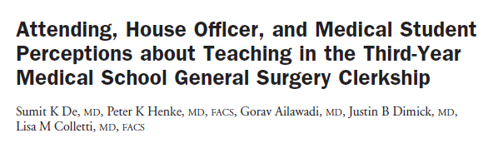
Over 95% of residents and faculty want students on service
Faculty and Students agree that residents were the primary teaching source
De et al. J Am Coll Surg 2004;199:932-942

Slide 13
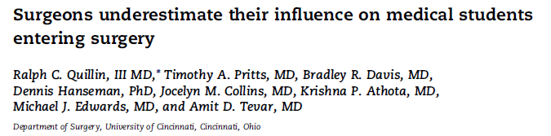
Faculty and Residents UNDERESTIMATE their influence
Faculty and residents should be cognizant of their influence
This influence can be paramount in a students decision to pursue surgery

Slide 14
AS SURGICAL ATTENDINGS AND RESIDENTS– WE HAVE AN INFLUENCE ON OUR STUDENTS

Slide 15


Residents who are effective educators influence medical students to pursue surgical careers
Med students exposed to highest rated residents were more likely to go in to surgery as opposed to least effective (12% vs. 4.9%)

Slide 16
Role Models
Positive Role models on the Surgery Rotation are Important to the Success of the Rotation
Attendings and Residents shape the career of EVERY medical student

Slide 17
OVERCOMING BARRIERS TO TEACHING

Slide 18
Overcoming Barriers to Teaching
Every Clinical Encounter can be a teachable moment
FORMAL TEACHING does not require a chalkboard, chairs or slides”
EDUCATE THE resident that every encounter can be a teachable moment

Slide 19
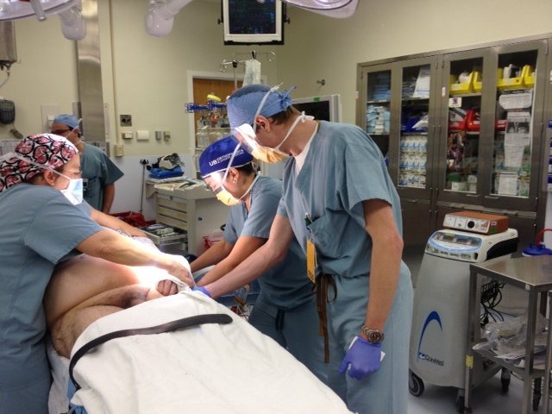
NEARLY EVERY ENCOUNTER CAN BE A TEACHABLE MOMENT

Slide 20
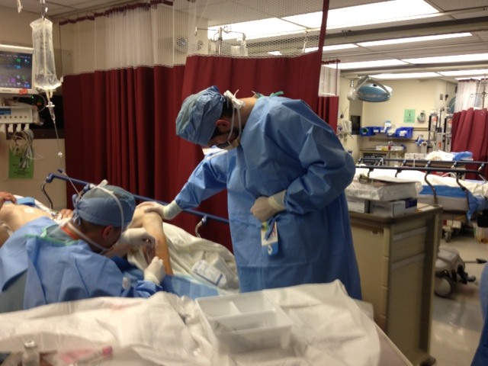
NEARLY EVERY ENCOUNTER CAN BE A TEACHABLE MOMENT

Slide 21
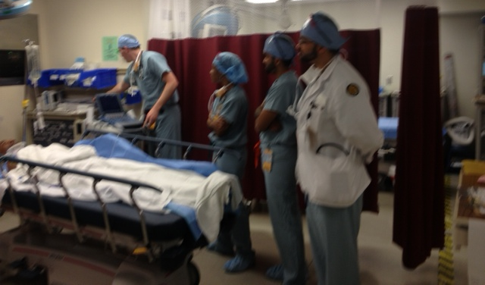
NEARLY EVERY ENCOUNTER CAN BE A TEACHABLE MOMENT

Slide 22
BE A CHEERLEADER
As A CD rejoice when you see these scenes
Encourage “on the fly teaching”
Embrace your role as a cheerleader

Slide 23
Improving Resident Level Teaching
University of Illinois
Wanted to Increase Resident Teaching of Students
  Recruitment
  Use of residents in ORIENTATION
  REDIENTS as TEACHERS
  Teaching AWARDS
  SEND TEACHING EVALUATIONS back to RESIDENTS
  SERVICE Feedback provided

Slide 24
How have we IMPROVED AND ENCOURAGED RESIDENT AND ATTENDING TEACHING AND INCREASED INTERACTION?

Slide 25
Picture Cards
Residents and Attendings have to know student names!
Picture cards distributed at beginning of each block.
Helps to increase interaction / communication

Slide 26
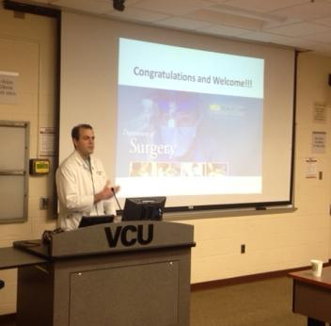
Resident at Orientation
Inclusion of a Chief Resident at Orientation
Helps to Orient Students with respect to resident expectations

Slide 27
Service Liaison
Each 4 week service has been assigned a SERVICE LIAISON for setting attending level expectations

Slide 28
Faculty Accountability
Thursday afternoon Discussion Series
Every Thursday 3pm to 6pm
A REMINDER to FACULTY that Not showing up creates CHAOS
Showing up at last minute – Chaos

Slide 29
Faculty Accountability for Discussion Series
Placed on Calendar
Email Reminder from CC that week
Usually a reminder Page that DAY
FACULTY APPRECIATE THE HARRASSMENT
Conveniently Located IN HOSPITAL

Slide 30
Increased Resident Involvement In Teaching
Increased Use of Lab residents to give Didactic Lectures
Use of Lab Residents for Suture Workshops

Slide 31
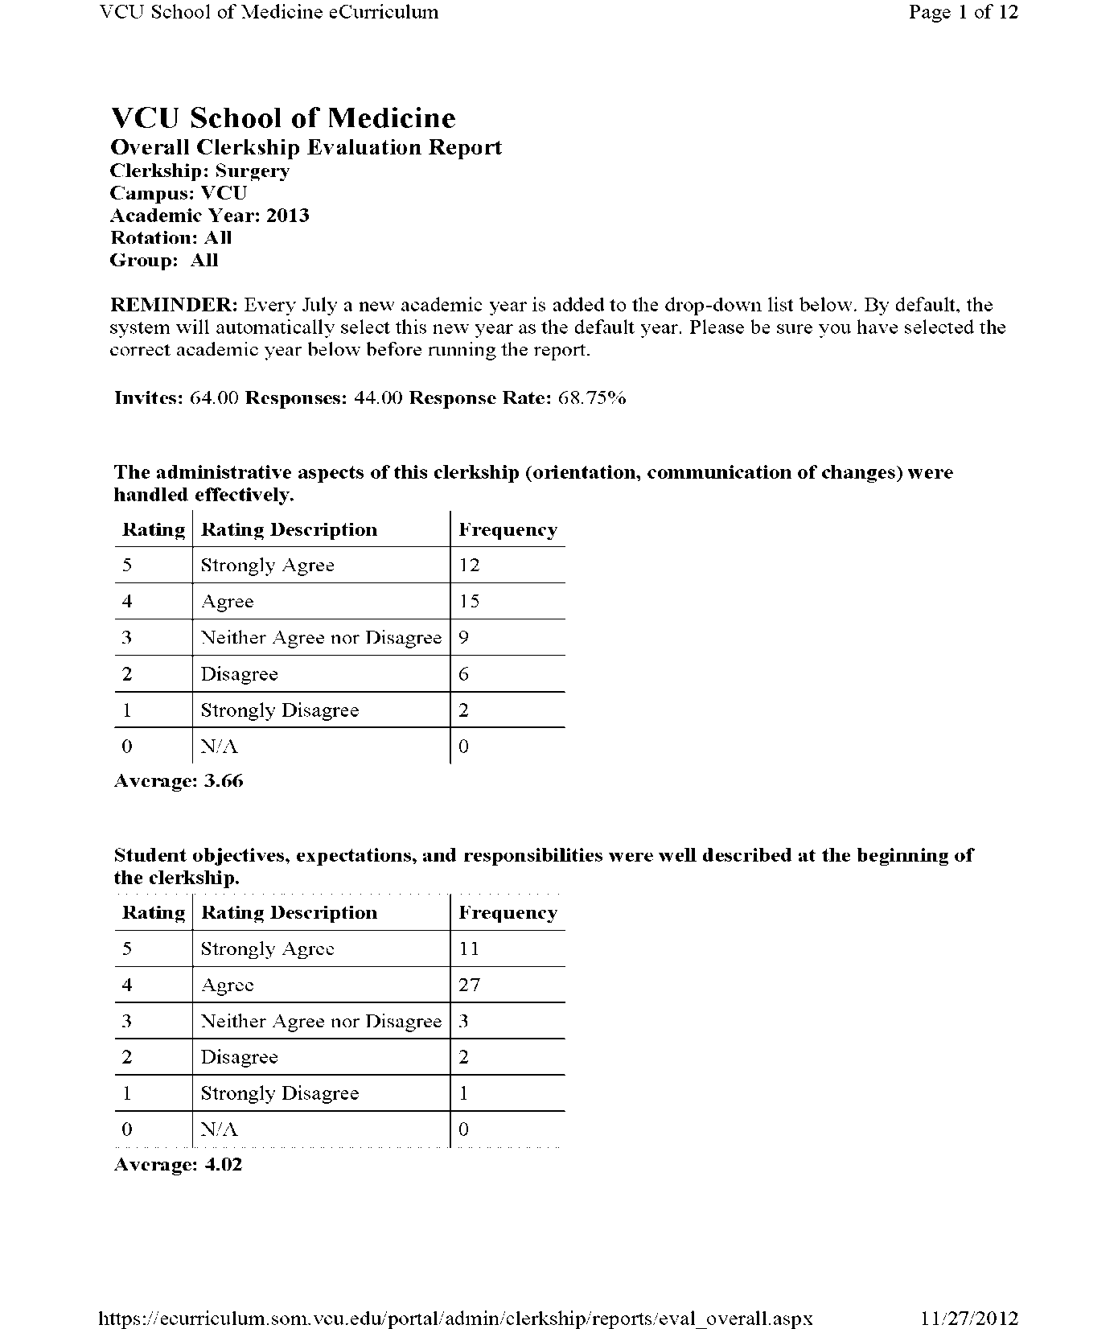
Continuous
Feedback

Slide 32
Constant Feedback
Teaching Evaluations are constantly perused
RESIDENTS, ATTENDINGS, SERVICES ARE evaluated
Problems are addressed on a one on one confidential basis before they turn in to huge issues

Slide 33
Solicitation of evaluations
Residents are solicited twice over 8 week block for student evaluation
Lets residents know that their input matters

Slide 34
Teaching Awards
We recognized that Subspecialties count too!
We give teaching awards for
Resident (1 for General Surgery, 1 for subspecialty)
Attendings (1 for General, 1 for subspecialty)

Slide 35
TEACHING IN THE CLINIC

Slide 36
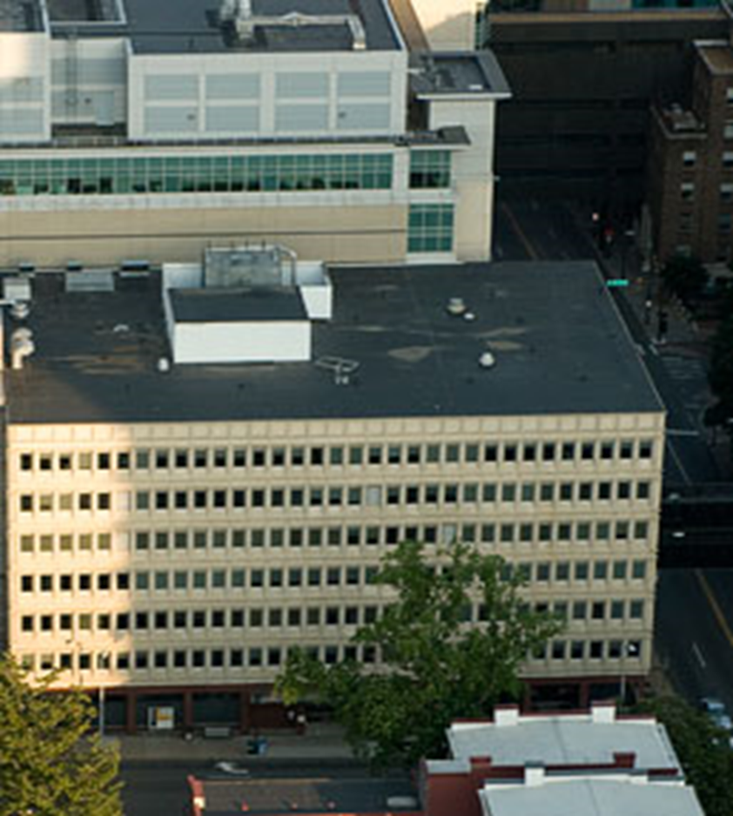
Teaching in the Clinic

Slide 37
Teaching in the Clinic
Remind faculty – most students LIKE clinic
Can be the perfect venue for teaching
Unique opportunity for students to interact one on one with fully clothed patients
The Schedule for the day should be reviewed for patients appropriate for students

Slide 38
Students Learn in the Clinic
“Participation in vascular, surg onc and general surgery clinic were a great experience”
        VCU SCHOOL OF MEDICINE STUDENT – CLASS OF 2014
“…appreciated how organized the rotation was and how much time I got to spend in clinic.”
        VCU SCHOOL OF MEDICINE STUDENT – CLASS OF 2014
“I really enjoyed clinic with the various Attendings. Each one has a different style & set of expectations. It was nice to practice my History & Physical Exam skills, especially in a focused manner as they prefer it done in most Surgery clerkships!”
        VCU SCHOOL OF MEDICINE STUDENT – CLASS OF 2014

Slide 39
Teaching in the Clinic
Have the student see patients with residents for the first few
Definitely have student see a few patients by themselves

Slide 40
Teaching in the Clinic
Have the student present to you
Challenge the student
Force a differential diagnosis
Force a plan
See the patient with the student
Give feedback

Slide 41
TEACHING IN THE OPERATING ROOM

Slide 42
EFFECTIVE TEACHING IN THE OPERATING ROOM
Teaching is often miscalibrated
Teaching in the OR is most focused on TECHNICAL aspects of procedure
Not surprising – resident training

Slide 43
A Humorous But Familiar Scenario
http://www.youtube.com/watch?v=3OAutXRyKZY

Slide 44
A Humorous But Familiar Scenario
“Other wise Excited”
Problems
Many other residents – fellows
Can’t See Anything
Unfamiliar Environment
Interested In Anatomy – forced to imagine it
Not Used to the OR – Clearly Hungry (!)

Slide 45
Effective OR Teaching
Remember Med Student Perspective
Understand their learning needs
INTRODUCE them to the team
Facilitate Participation
Answer questions
Provide Feedback

Slide 46

Student Perspective: CHALLENGES in the OR
Negotiate the physical environment of the OR, cope with emotional impact
Figure out what exactly they can learn from a case
Figure out the social aspect of being a member of the operating team

Slide 47
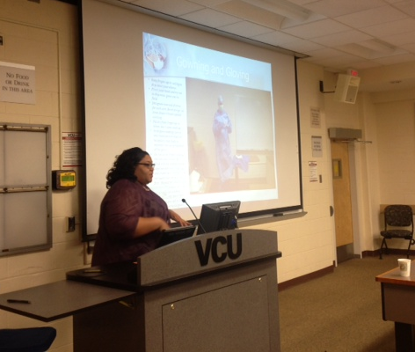
CHALLENGES in the OR
We now have OR STAFF come and talk to the MEDICAL STUDENTS AT ORIENTATION

Slide 48
Effective OR Teaching
Remember Med Student Perspective
Understand their learning needs
INTRODUCE them to the team
Facilitate Participation
Answer questions
Provide Feedback

Slide 49
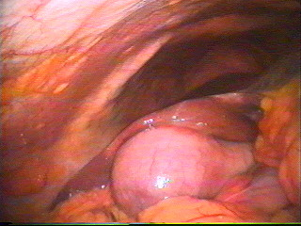
Understand Learning Needs
Anatomy
Disease
Management
Takes 30 seconds

Slide 50
Effective OR Teaching
Remember Med Student Perspective
Understand their learning needs
INTRODUCE them to the team
Facilitate Participation
Answer questions
Provide Feedback

Slide 51
Introduce them to the Team

Slide 52
Make Use of the White Board

Slide 53
Effective OR Teaching
Remember Med Student Perspective
Understand their learning needs
INTRODUCE them to the team
Facilitate Participation
Answer questions
Provide Feedback

Slide 54
Student Involvement
Students feel more fulfilled when viewed as a necessary part of the team
“Laparoscopic camera driving”
Helping to control exsanguinating hemorrhage!
Palpation of normal Anatomy
Make sure they can see!

Slide 55
Student Involvement
GET A MEDICAL STUDENT IN EVERY CASE
Ideally every case should be covered
We Have a 9102 on call pager

Slide 56
Student Involvement
At night GENERAL SURGERY CASES should be covered by the ON CALL MED STUDENT
ON CALL CHIEF should make an effort to contact on call student

Slide 57
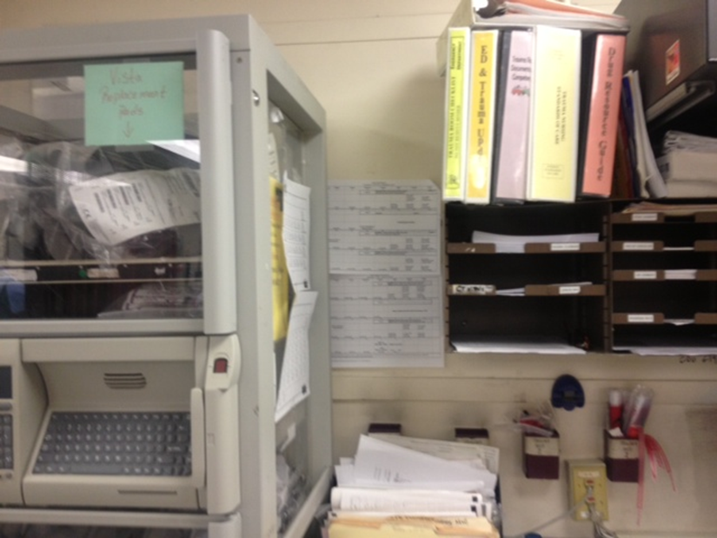
Student Involvement
9102 is the on call rotating pager
Call schedules are POSTED in the trauma bay, and online at GSW

Slide 58
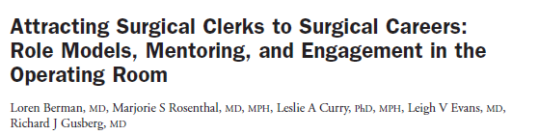
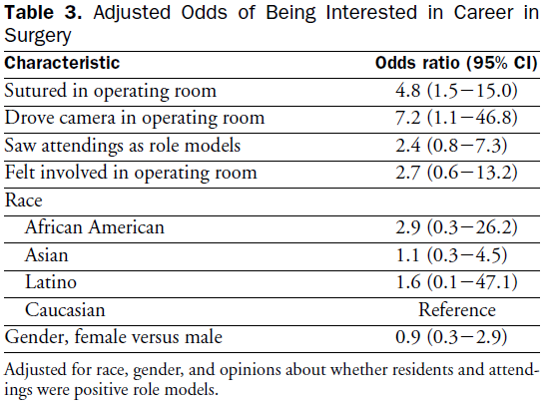


Slide 59
Effective OR Teaching
Remember Med Student Perspective
Understand their learning needs
INTRODUCE them to the team
Facilitate Participation
Answer questions
Provide Feedback

Slide 60

Questioning in the OR
Student Appropriate
  SHELF exam
Relevant to reading
Pimping
  Obscure facts
“Think about how you would educate a referring PCP in the Operating Room”

Slide 61
Effective OR Teaching
Remember Med Student Perspective
Understand their learning needs
INTRODUCE them to the team
Facilitate Participation
Answer questions
Provide Feedback

Slide 62
CONTINUOUS ENCOURAGEMENT OF OUR TEACHERS
FOSTER ON GOING INTEREST
REMEMBER ROLE AS A “ROLE MODEL”
NEARLY EVERY MOMENT CAN BE TEACHABLE
USE THE CLINIC AS A TEACHING VENUE
RECOGNIZE THE OPERATING ROOM AS A PLACE TO GET STUDENTS INVOLVED
WE ALL NEED TO WORK ON FEEDBACK
(YOU MAY INSPIRE SOMEONE TO GO IN TO SURGERY)

