Slide 1
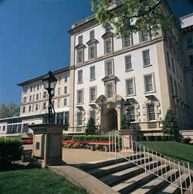

“Stop trying to reinvent the wheel”
ACS 4th year Prep Curriculum Update
Surgical Education Week
30 April 2018

Slide 2
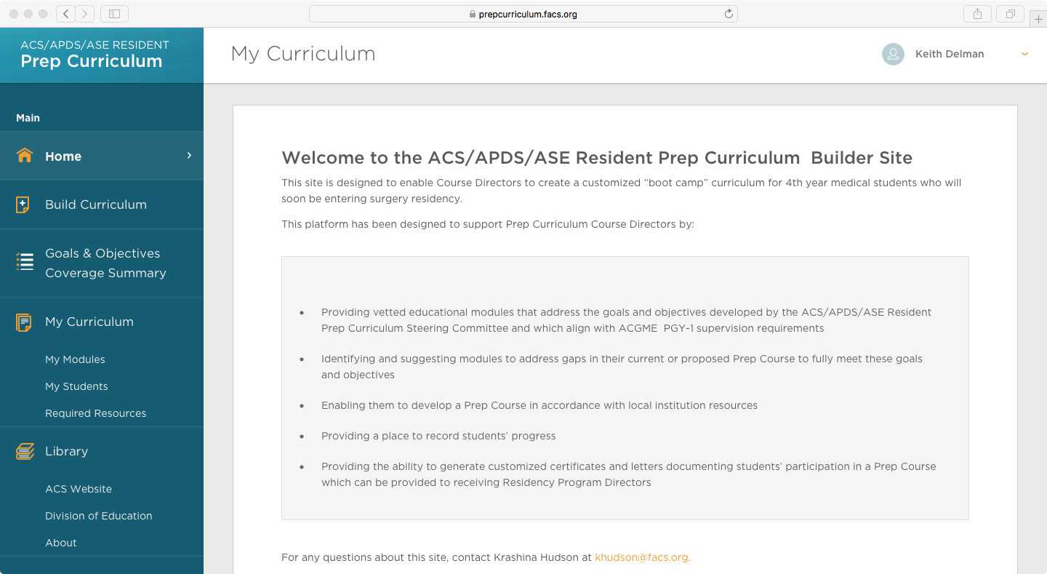
Landing Page

Slide 3
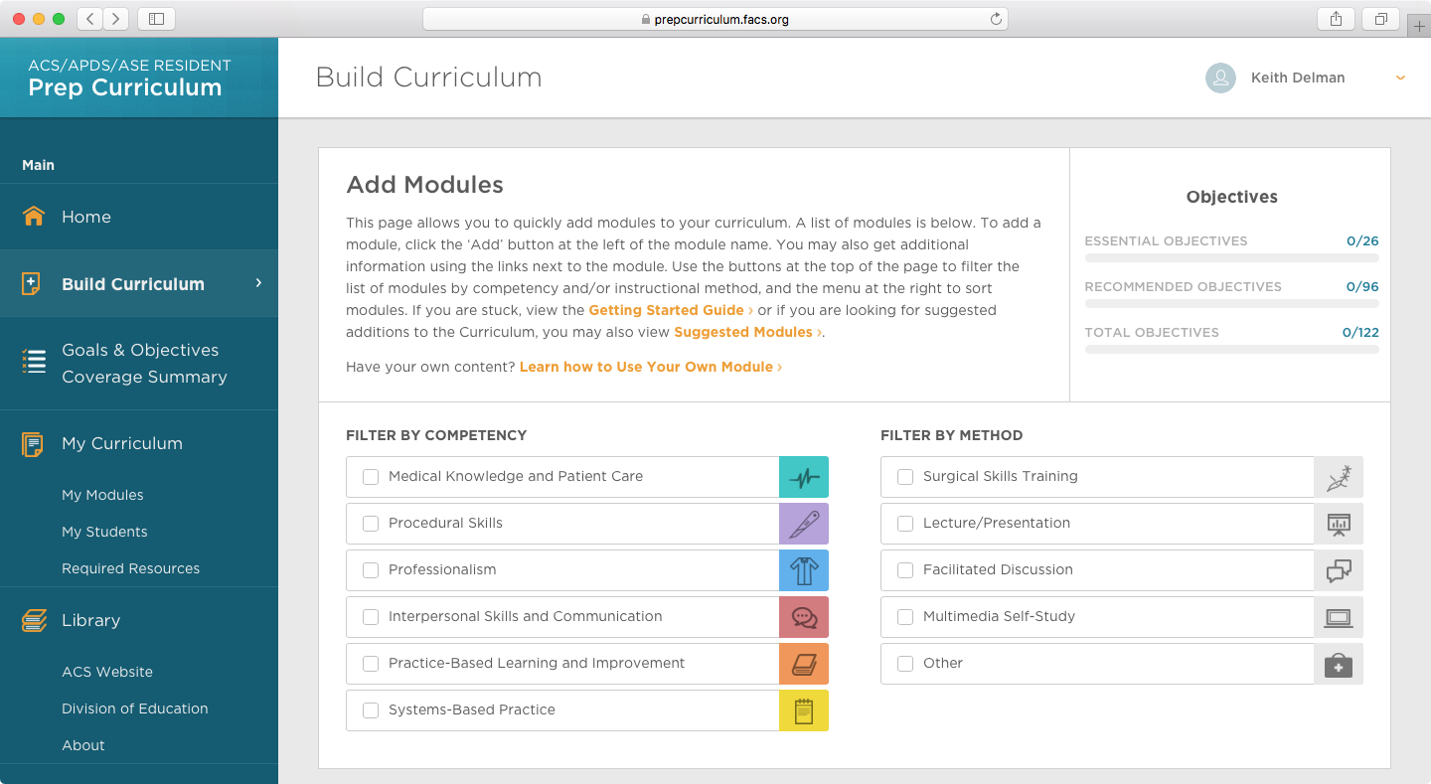
Curriculum Builder Page

Slide 4
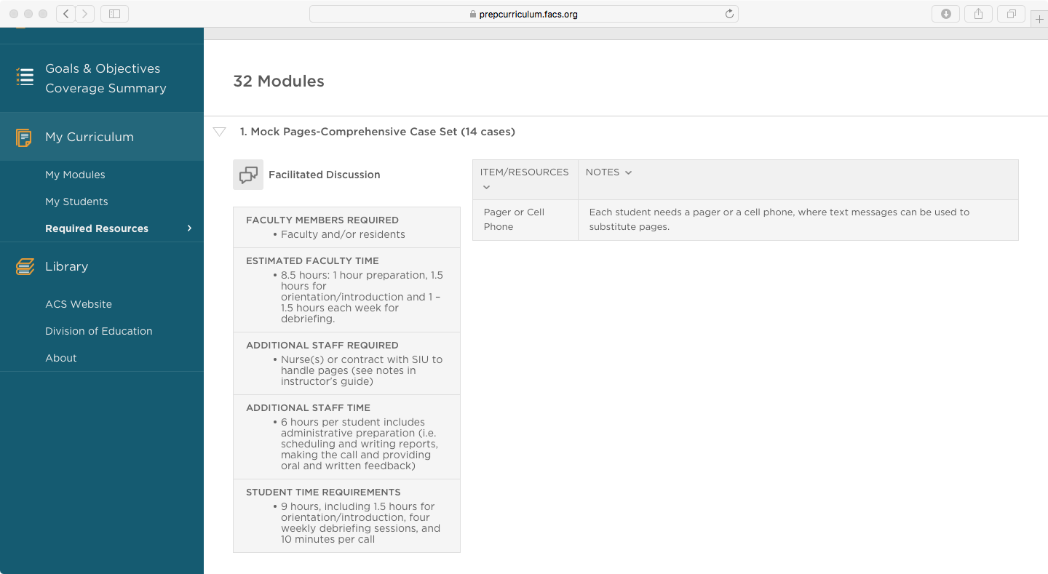
What do I need?

Slide 5
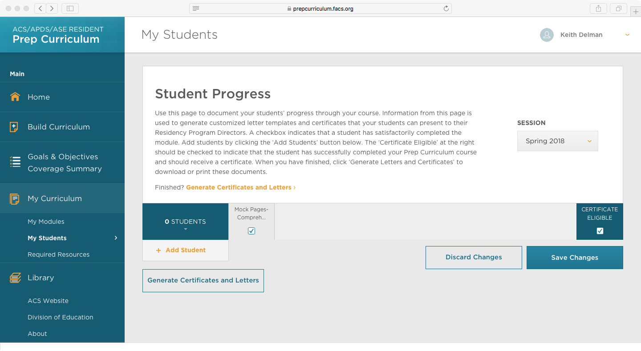
Course Completion and Grades

Slide 6
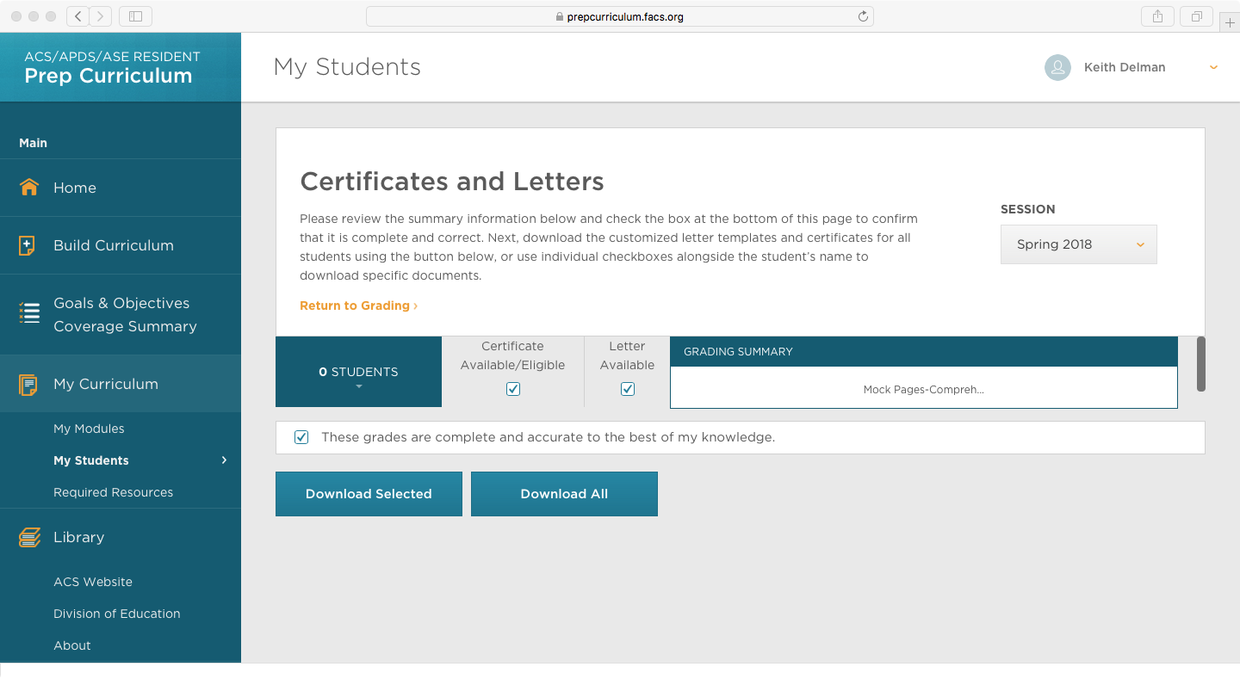
Certificate Generation

Slide 7
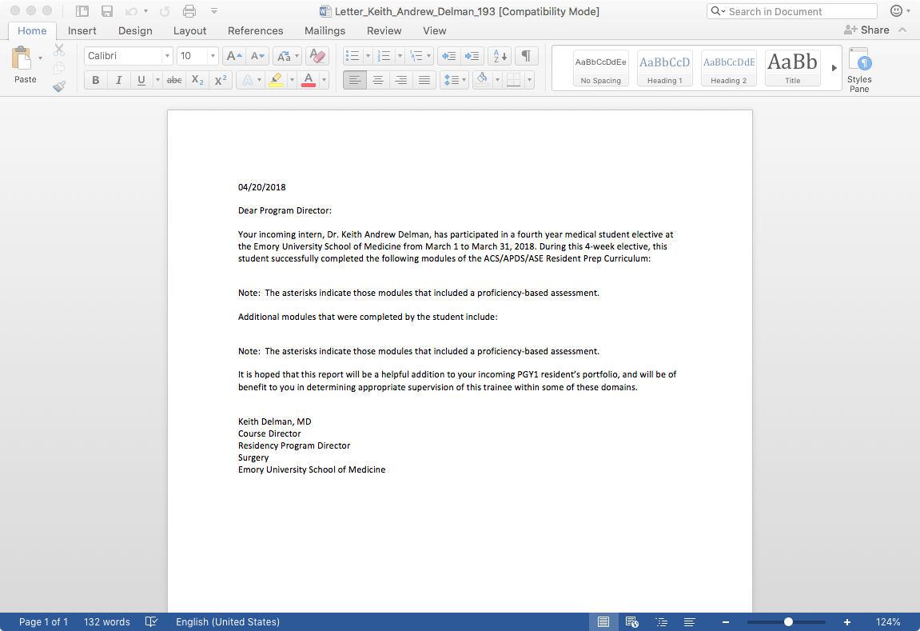
Letters

Slide 8
Certificate

Slide 9
What it includes
30 goals
6 competencies
122 individual objectives
Hands-on and cognitive modules
Resources needed
Instructors guides and assessments

Slide 10
“Stop trying to reinvent the wheel”
ACS 4th year Prep Curriculum Update
Surgical Education Week
30 April 2018

