Slide 1
TULANE HONORS SURGERY SENIOR ELECTIVE

Slide 2
GOAL
To Prepare Highly Qualified Final Year (T4) Graduating Medical Students for Careers in General Surgery

Slide 3
PROPERTIES
Competitive- Up to 16 Students/Year Based on Clerkship Grade
4 Weeks (August), Full-Time, Intensive
Lots of Direct Faculty Mentoring
Results in Letter of Support for Residency
Professionalism, Communication Skills

Slide 4
PRIMARY OBJECTIVES
Research- Select faculty Mentor
Design
Carry Out
Publish Results of OriginaI Project

Slide 5
PRIMARY OBJECTIVES
Teaching- Teach T3’s Material for Shelf Exam with Faculty Observation, Guidance
Aid in Knot Tying/Suturing in Sim Center
Teach Each Other Technical Details of Operations Overseen by Faculty

Slide 6
PRIMARY OBJECTIVES
Operative Skills- Study, Present, Technical Details of 22 Major Operations
Perform Operations on Anesthetized Pigs
2 Days, 4 Students/Pig
Reps Bring Advanced Equipment
Faculty First Assist and Teach

Slide 7
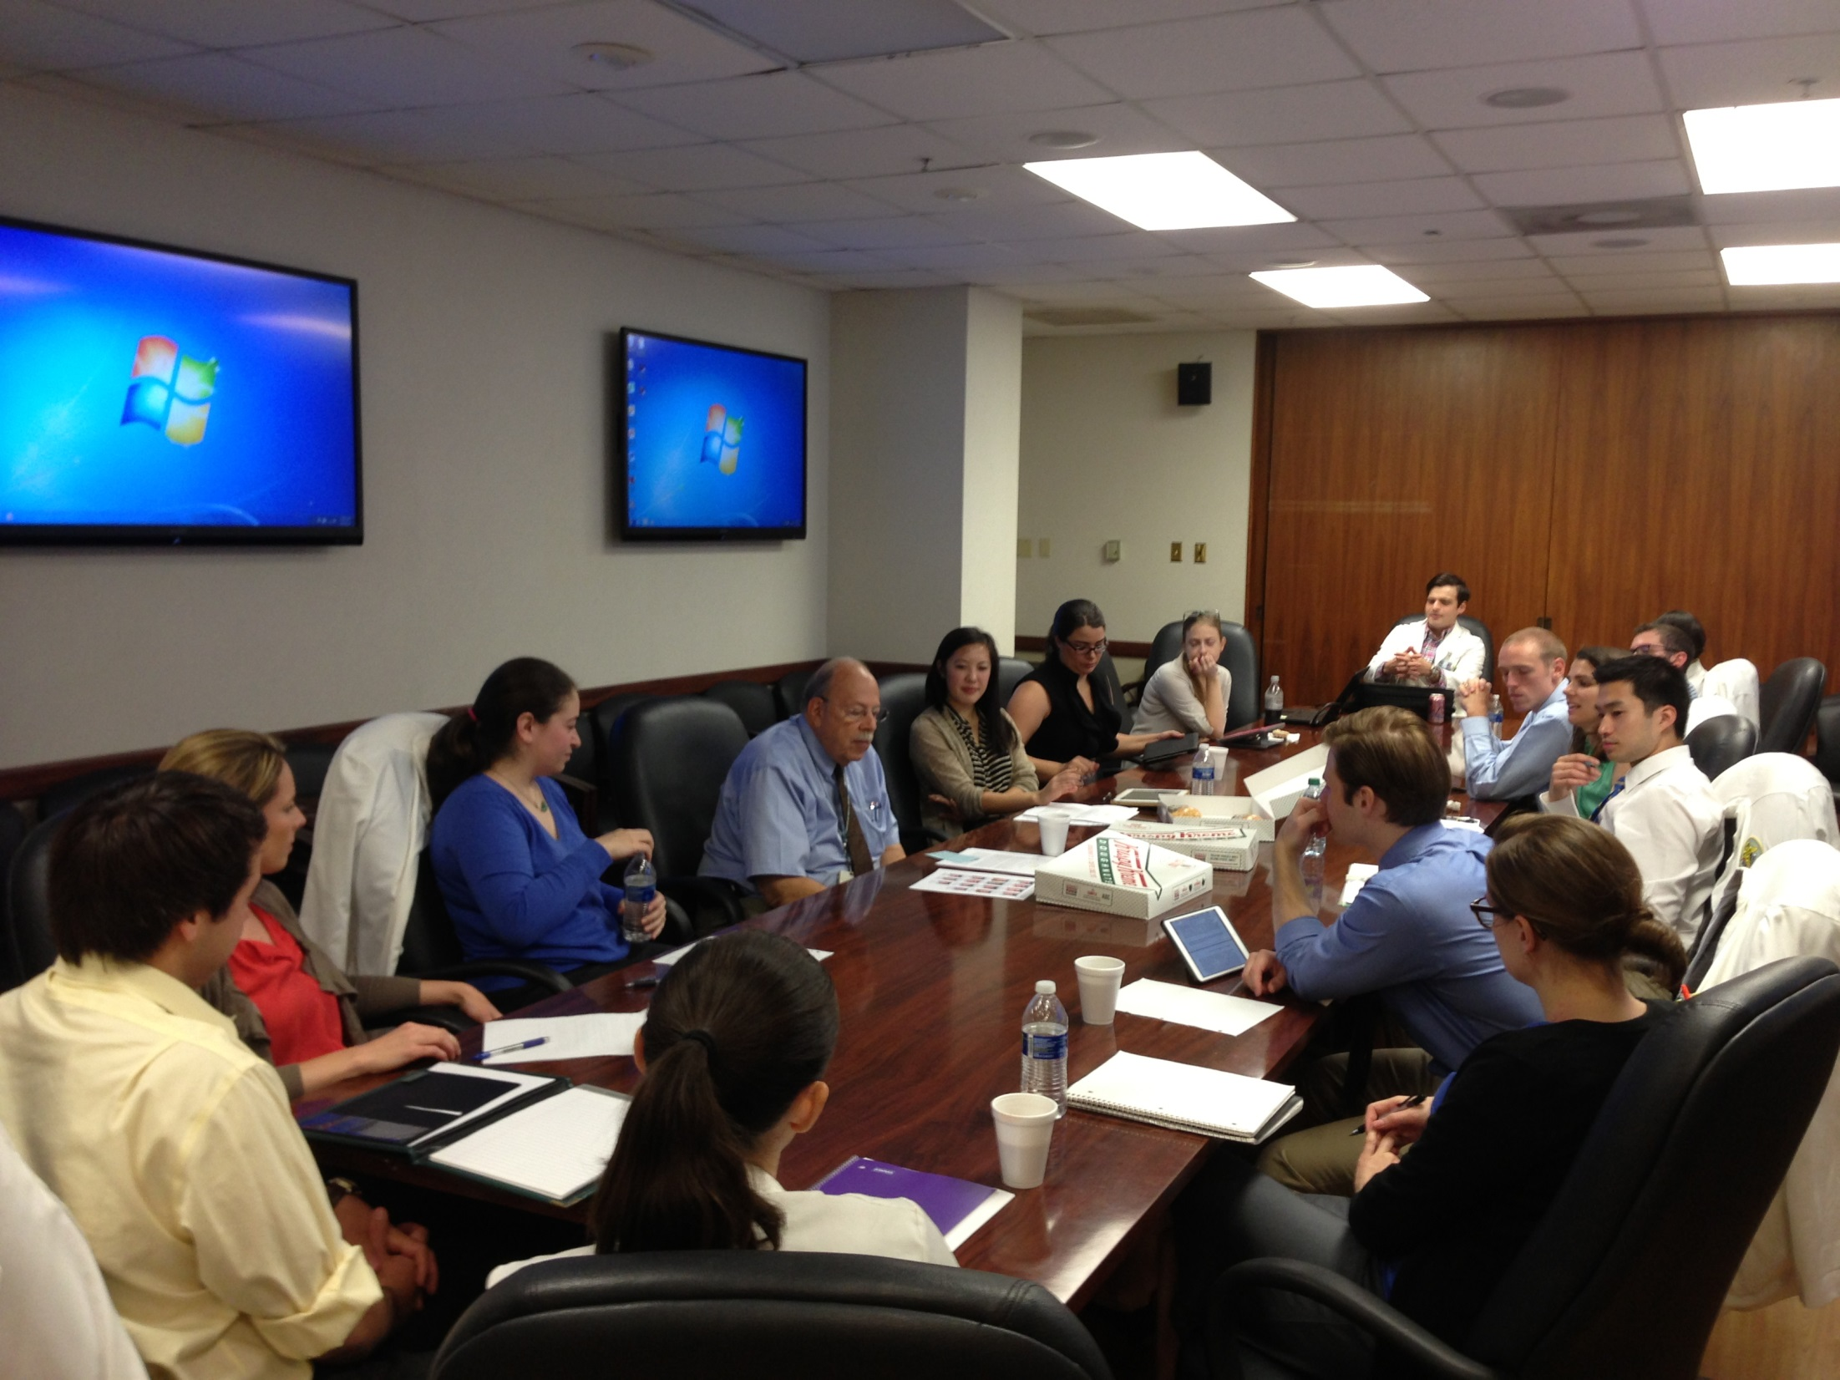

Slide 8
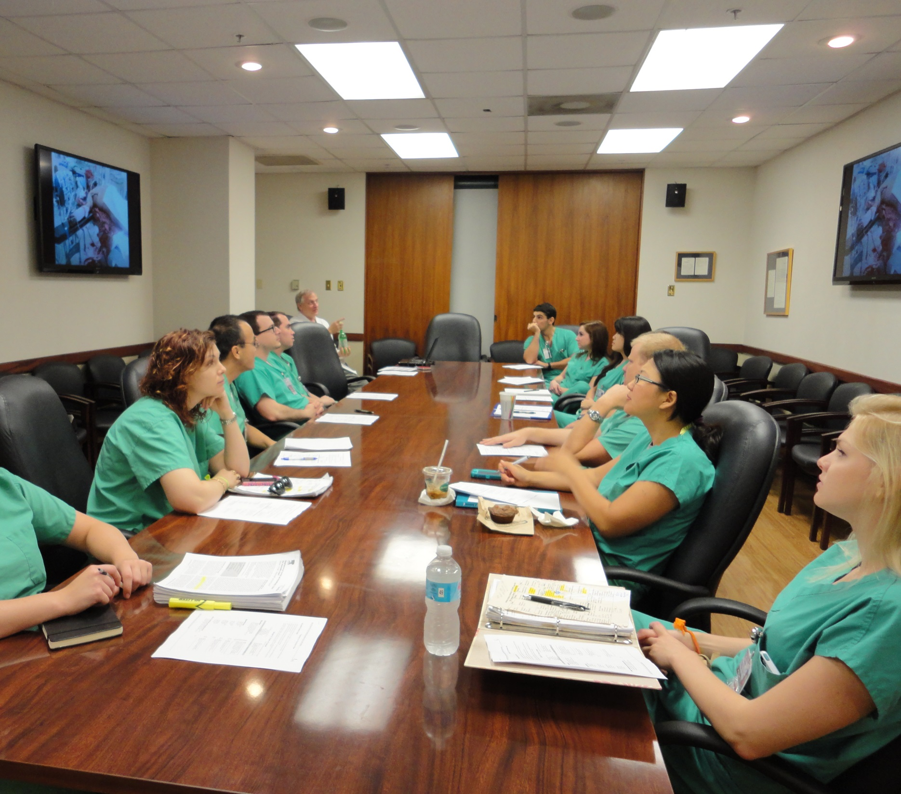

Slide 9
OPERATIONS
Diagnostic Peritoneal Lavage
Repair Inferior Vena Cava, Heart Injuries
Tube Thoracostomy
Thoracotomy, Pericardiotomy
Partial, Complete Nephrectomies
Tracheostomy, Cystostomy, Gastrostomy
Truncal vagotomy

Slide 10
OPERATIONS
Truncal Vagotomy, Nissen Fundoplication
Partial gastrectomy, Roux-en-Y
“Appendectomy”, Feeding Jejunostomy
Low Anterior Resection, EEA Anastamosis
Colon Small Bowel Resections, Colostomy
Splenectomy, Cholecystectomy
Wedge Resection of Liver

Slide 11
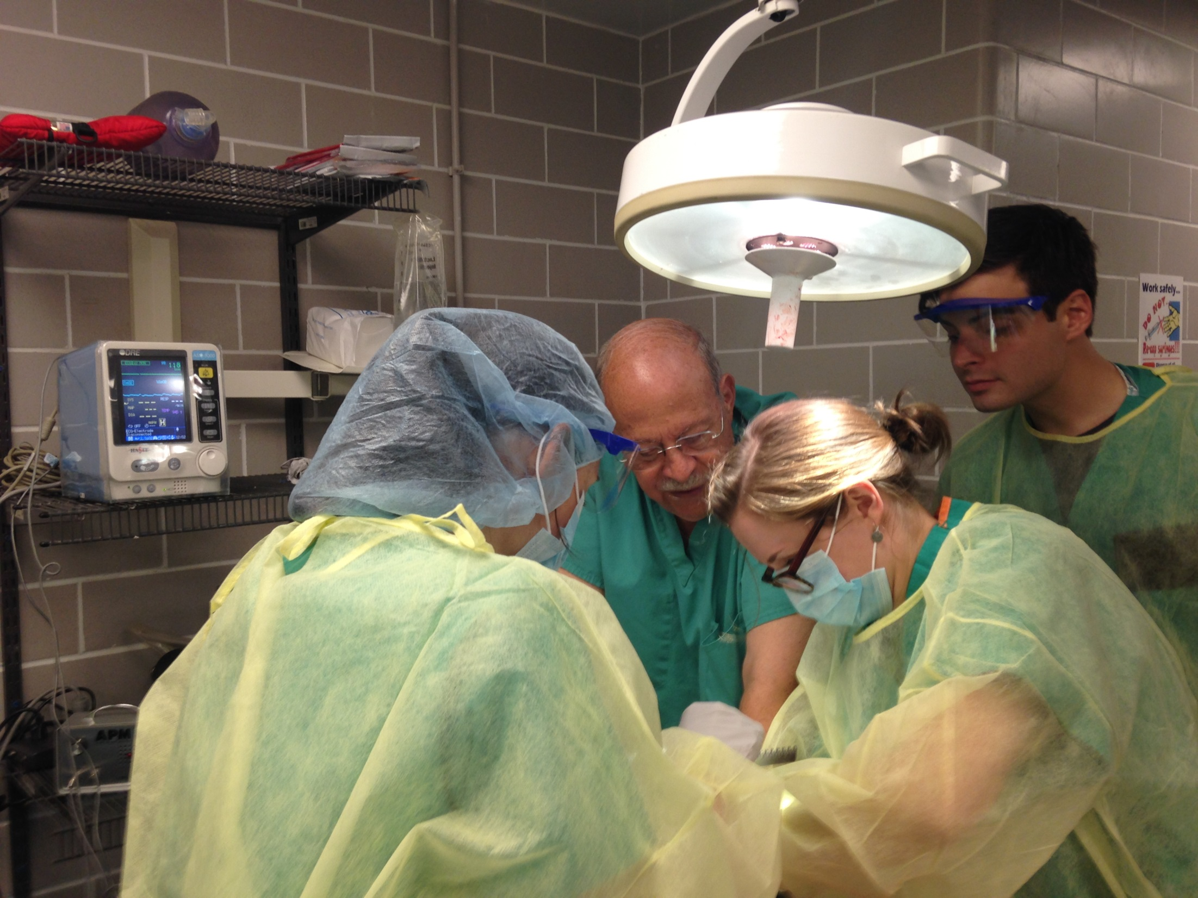

Slide 12
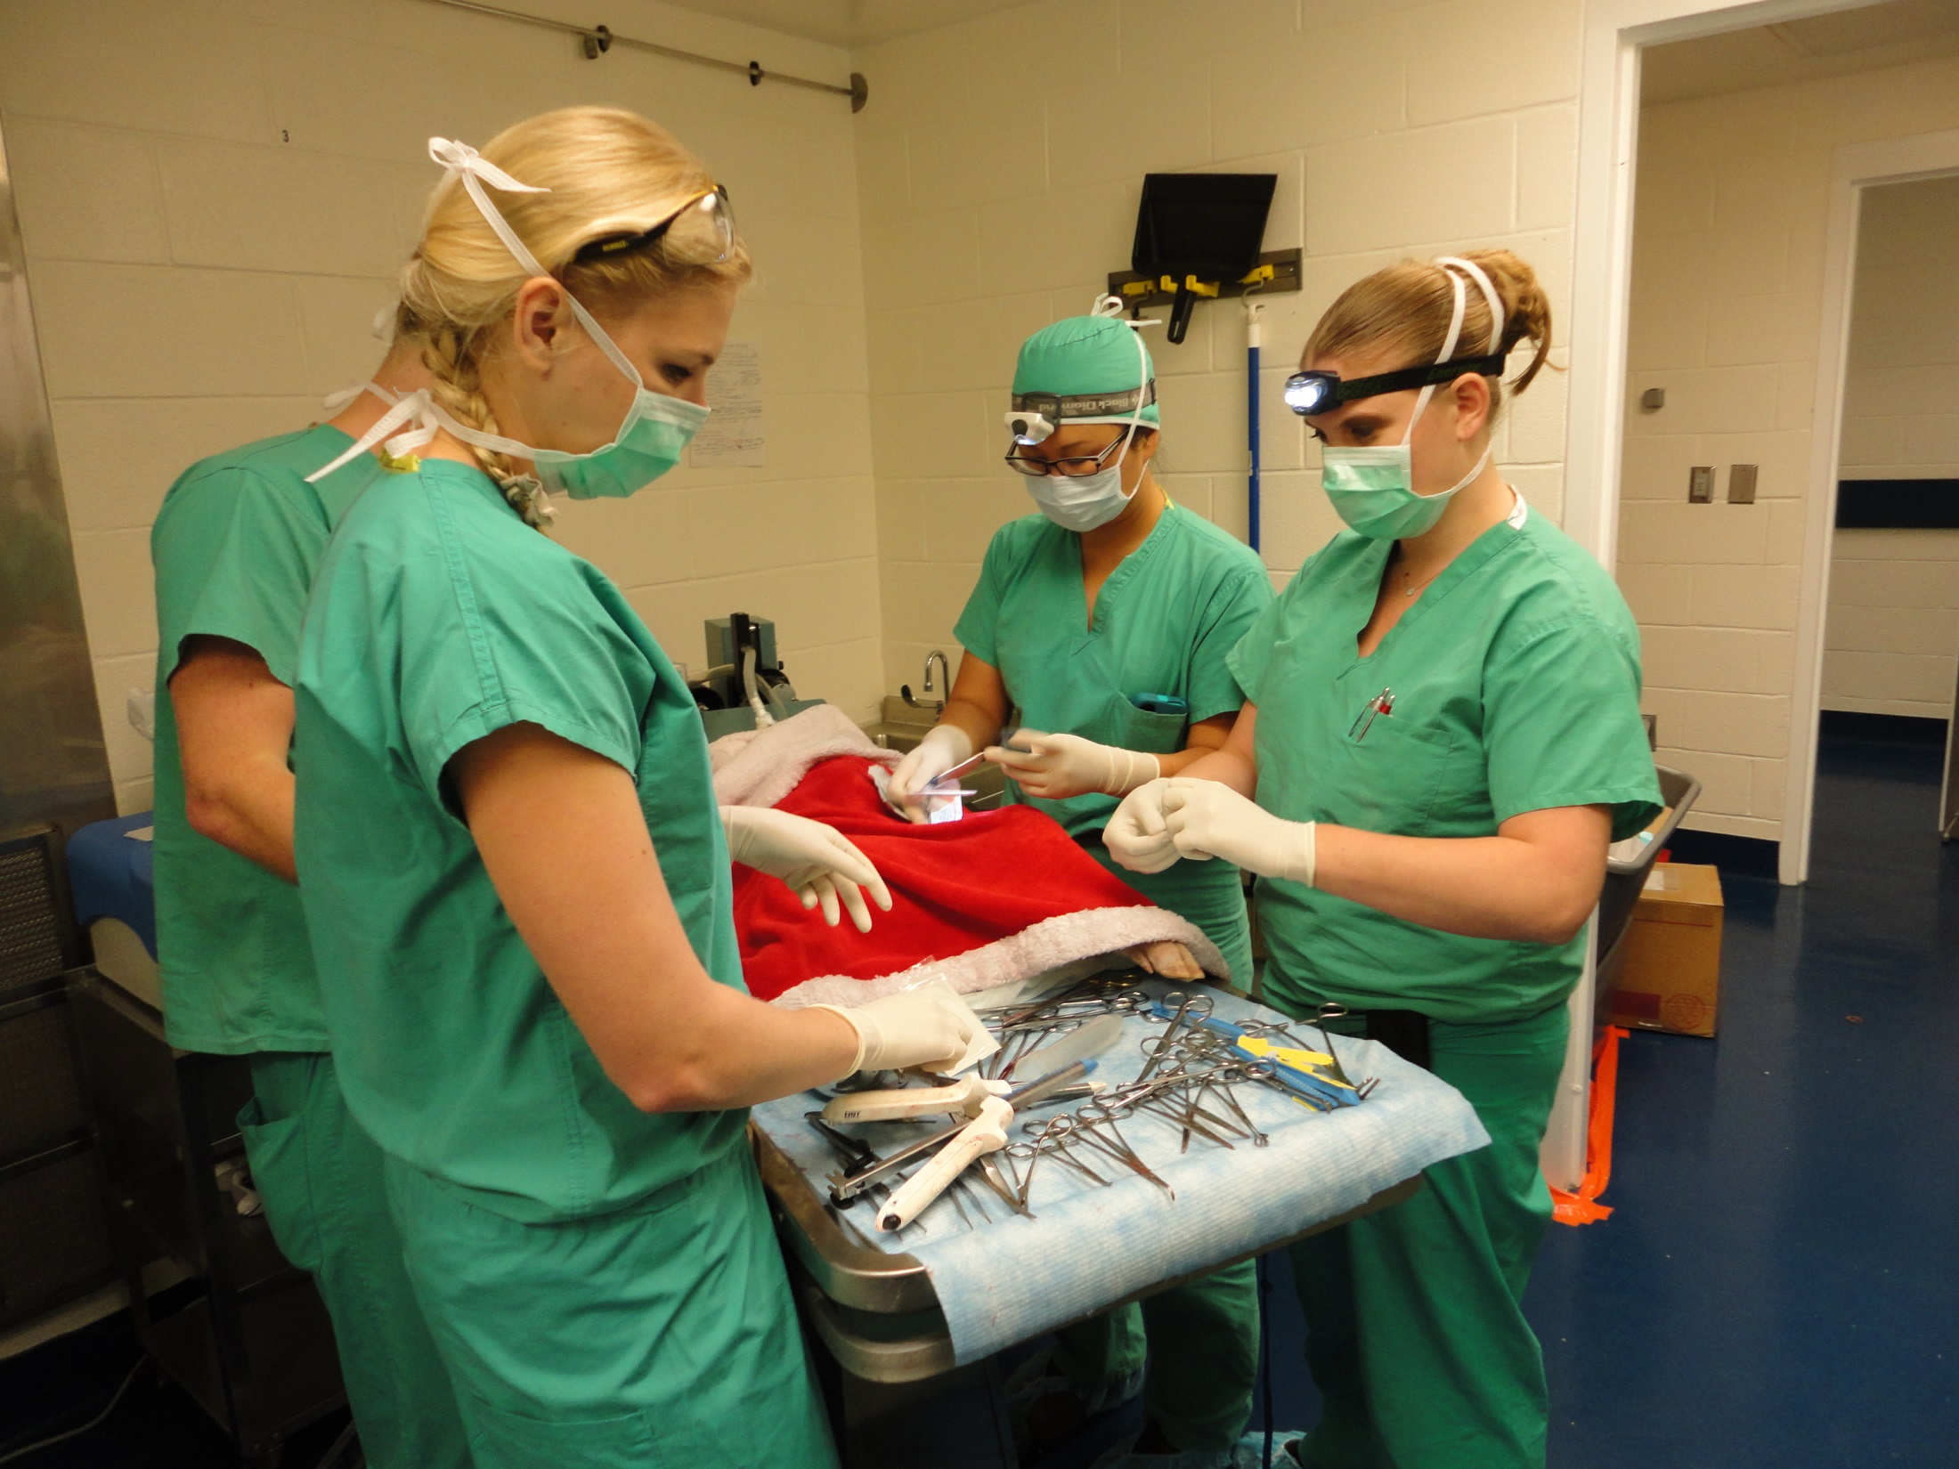

Slide 13
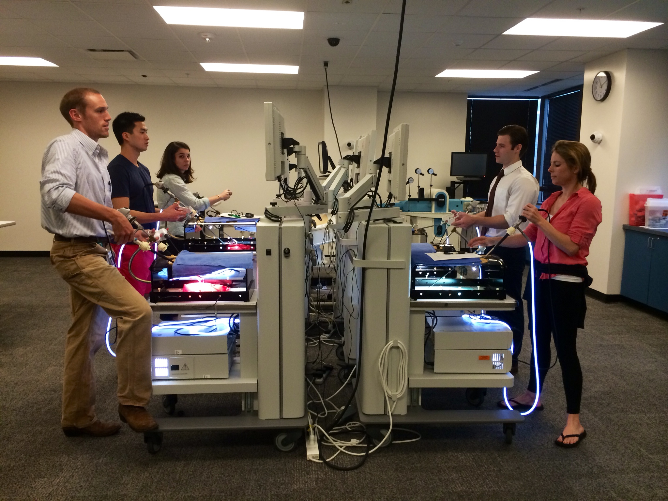

Slide 14
PRIMARY OBJECTIVES
Practice- Specialists Teach Info Vital for Careers
Malpractice Avoidance, Legal Defense
Billing and Collecting
Mechanics of Running a Practice
Ethics, Professionalism
Credentialing, Medical Staff Requirements

Slide 15
Practice (2)
Pharmaceutical Regulations
Safe Prescription Practices
Blood, Blood Product Use
Imaging Techniques and Use
Computerized Medical Record Use
Clinical Communication Skills

Slide 16
OUTSIDE SPEAKERS
Malpractice Attorney
Billing Service Director
Busy Practitioner, Practice Manager
Medical Staff Coordinator
Pharmacy, Blood Bank Directors
Radiologists

Slide 17
RESIDENCY ADVICE
Discussions with Chair
Program Director
Elective Director, Other Faculty
Group Sessions, One on One
Review of CV
Personal Statement

Slide 18
ADVANTAGES
Group Dynamics- Students Work in Groups of 4, Have to Interact to Complete Tasks
Close Relations with Faculty- Supervision, Evaluation, Guidance
Role Modeling
Total Commitment of Department

Slide 19
RESULTS
Very Popular Unique Elective
Other Depts Considering Similar Programs
Follow-Up with Prior Student’s Residency Directors Documents Success
Partly Responsible for Tulane’s Rate of Producing General Surgeons (More Than Twice National Average)

