Slide 1

Surviving the LCME VISIT
Lessons Learned
Laszlo Kiraly MD FACS
Associate Professor of Surgery
Oregon Health & Science University

Slide 2
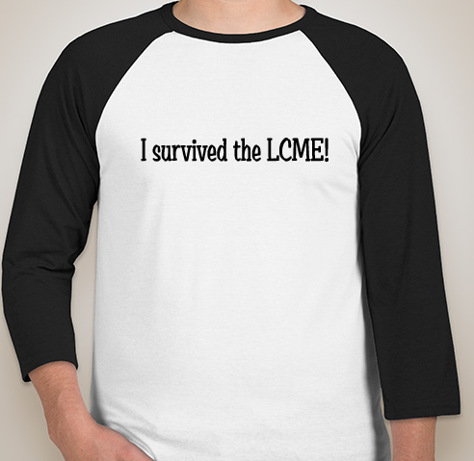

Slide 3
Surviving the LCME VISIT
Lessons Learned
Last visit -- 2004
Self Study – 2010/2011
LCME Visit -- 2012 (Accreditation with warnings)
LCME Survey Visit –2014 Full Accreditation
Next Cycle – 2019/2020

Slide 4

Clerkship Challenges
~120 students per class
5 week clerkship
7 clerkship hospitals in large physical area
  5 different services at University Hospital
Expanding classes
Assessment challenges
Curriculum challenges

Slide 5

Self Study
Remarkable Scale
Summer 2010
Dean of UME
Stakeholders
October 2010 Conference
  Chairs
  LCME Committee
  Deans
  Consultants
  President

Slide 6
Self Study Process
Complete responses on all clerkship relevant evaluation standards.
Environment, Resources, Policies, etc.
Policy vs. execution.

Slide 7
Standard 3: Academic & Learning Environments
3.1 Resident participation in student education
3.5 Professionalism
3.6 Student Mistreatment

Slide 8
Standard 8 Curricular Management, Evaluation and Enhancement
8.2 Use of Program Objectives
8.5 Medical Student Feedback
8.7 Comparability of Education/Assessment
8.8 Monitoring Student Time

Slide 9
Standard 9: Teaching, Supervision, Assessment, and Student and Patient Safety
9.1 Preparation of Resident and NF Instructors
9.2 Faculty Appointments
9.3 Clinical Supervision of Medical Students
Quality, quantity, and timeliness of assessments
9.6 Standard Setting

Slide 10
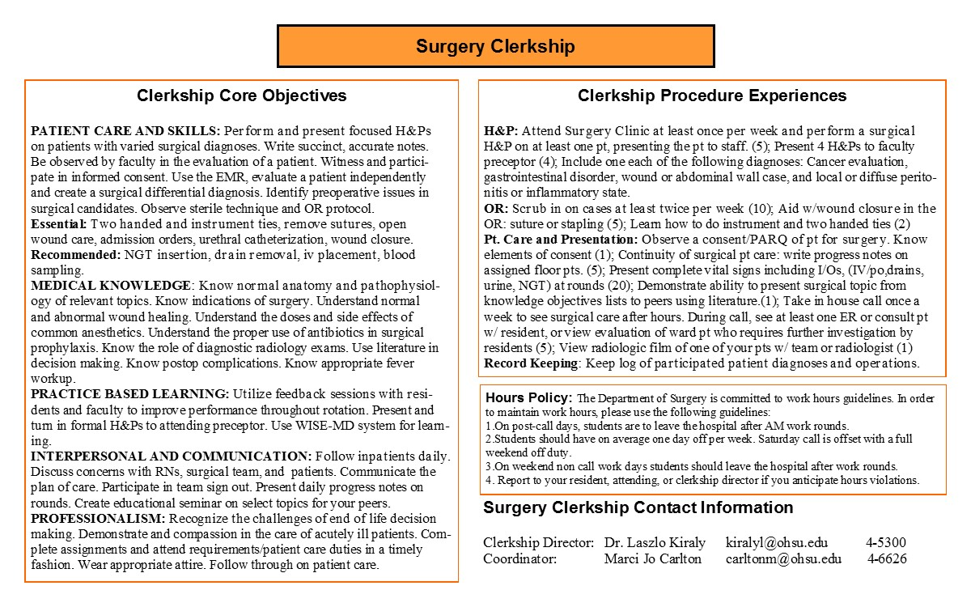
Self Study Improvements

Slide 11
Self Study Improvements
Shelf Exam
WISE-MD cases
Best practices of grade timeliness

Slide 12
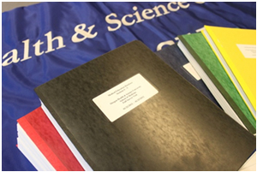
Outcome of Self Study
Encourage active participation
Starting Point?
What were the conclusions?

Slide 13
Self Study
Quantified Criteria for Numbers and Kinds of Patients
Observations of Clinical Performance
Mid-Clerkship Feedback and Timeliness of Grading

Slide 14
Self Study
Course Clerkships and Program Objectives Linkage
Teaching development for faculty and residents

Slide 15
Other Important Areas, but..
Student Debt
Faculty Diversity
Educational Resources
Call Rooms
Study/Relaxation Space
Affiliation Agreements

Slide 16
Self Study Lessons
Take full advantage of the self-study process.
Leverage the findings to garner resources and motivations to improve your clerkship.
Proactively consider changes before LCME conclusions.
Use collaborative time to get best practices from other clerkships.

Slide 17
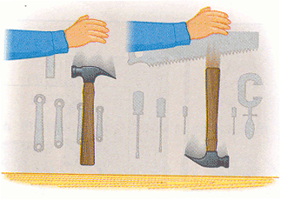
LCME Conclusions

Slide 18
LCME Non-compliance
1. Diversity
2. Observation by an attending physician of students
3. Fair and timely assessment of students
4. Financial aid and debt management counseling
5. Impact of direct expenses on indebtedness

Slide 19
Areas of Concern/Non-compliance
Observation of Clinical Performance

Slide 20
Areas of Concern/Non-compliance
Mid-Clerkship Feedback and Timeliness of Grading Reporting

Slide 21
Summer after LCME visit
Just implemented new curricular changes
LCME non-compliance “citations” arrive
Follow-up visit in winter
What do we do?

Slide 22
Implement Changes

Slide 23
Implement Changes
Just implemented new curricular changes
LCME non-compliance “citations” arrive
Follow-up visit in winter
What do we do?

Slide 24
Lessons Learned
Don’t just plan, implement early.
Consider adding changes during self study.
Each step represents an opportunity to gather “buy in” for a positive change.

