Slide 1


Slide 2

Troubleshooting Your Clerkship 105
LCME: Updates and Challenges
Robert R. Nesbit, Jr., MD
(disclaimer)

Slide 3



Slide 4
Objectives
Identify recent changes in LCME Standards that impact accreditation
Discuss successful strategies for meeting curricular standards
Recognize curricular development needs at own institution to meet LCME standards
My actual objective……………..
DISCLAIMER - Don’t shoot the messenger!

Slide 5
The LCME
Founded 1942 – AMA and AAMC
Accredits medical education programs leading to the MD degree in the U.S. (and with CACMS)
19 members – 8 AMA – 8 AAMC – 2 public – CACMS
Two co-secretaries – two offices – “The Secretariat”

Slide 6
The LCME
Standards reformatted in 2002
  From prose to numbered list
Increased clarity, specificity and transparency
Database questions to schools linked to standards
Easier to see if standards met
Increased number of “severe action decisions”
  “The Unintended Consequences of Clarity” -Hunt et al Acad Med. 2012:87;560-566

Slide 7
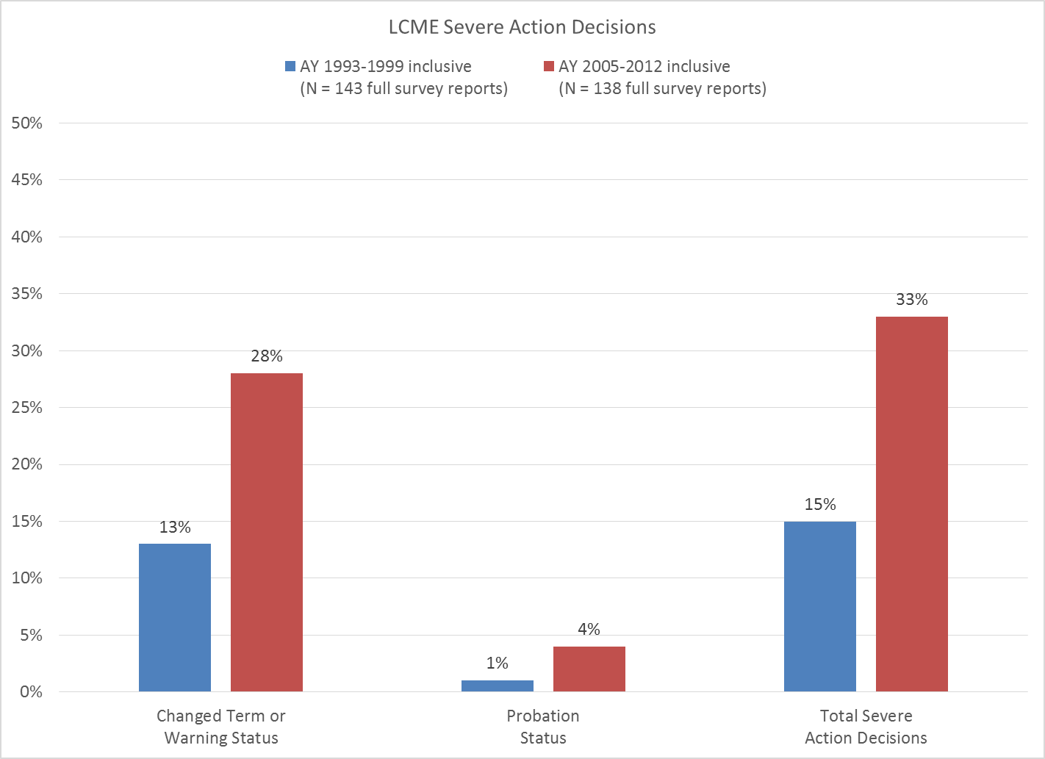

Slide 8
The LCME
“Functions and Structure of a Medical School”
  Standards for Accreditation of Medical Education
  Programs Leading to the MD Degree
By 2012 - 132 standards
  Plus annotations, notes, not orderly
2014 - another revision

Slide 9
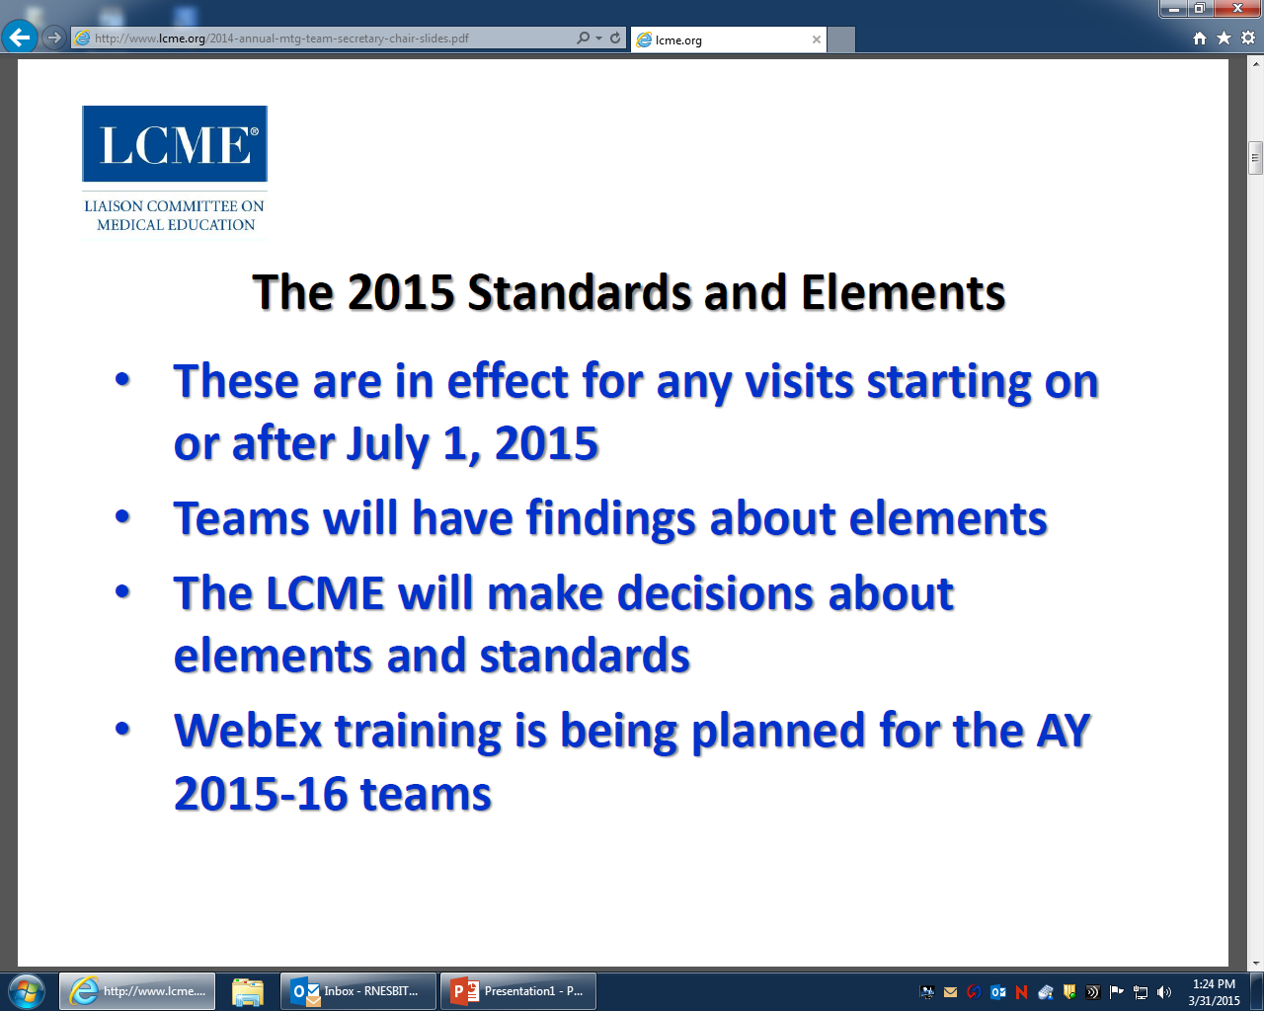

Slide 10
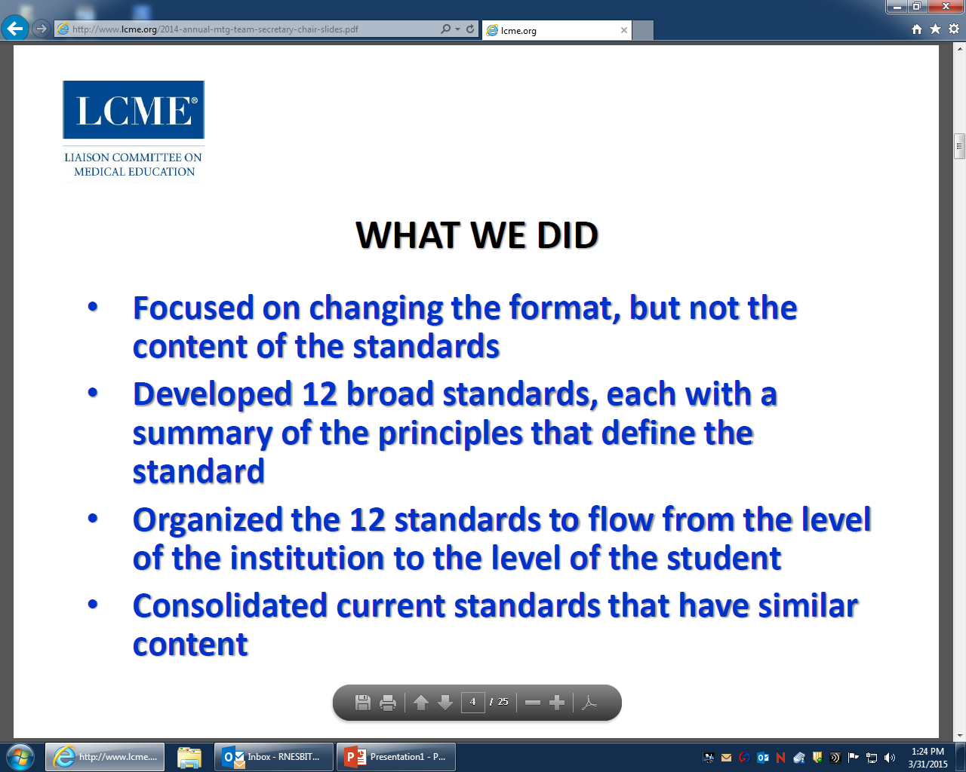

Slide 11
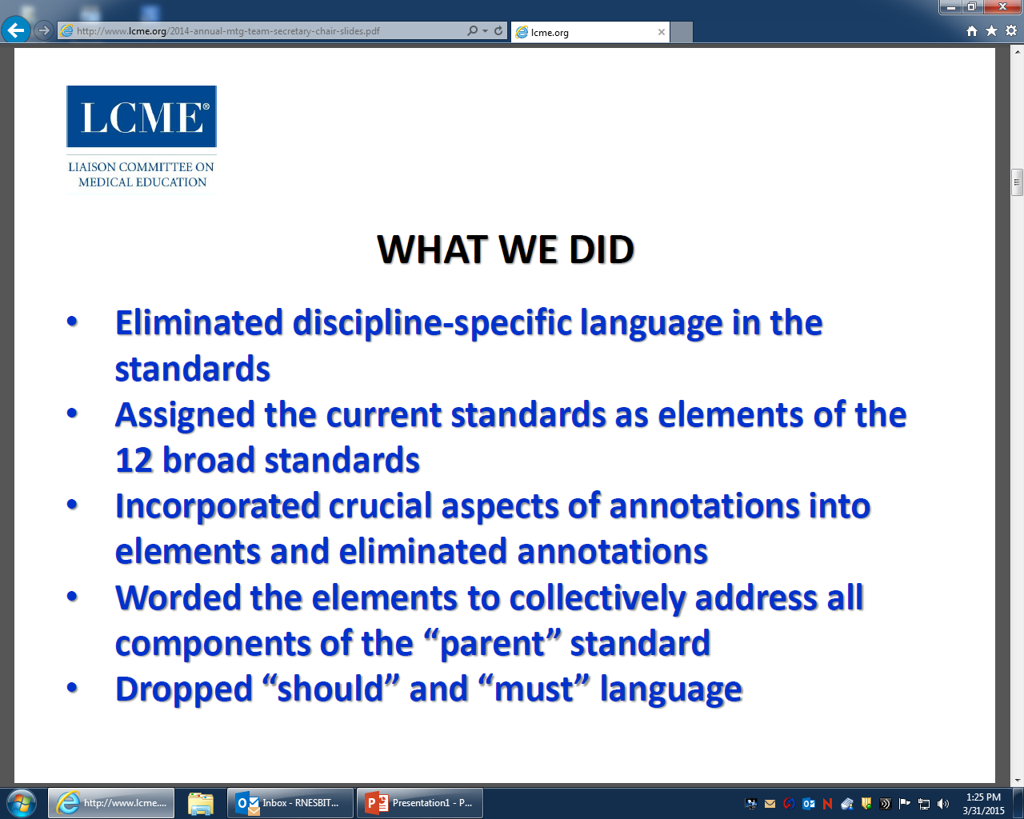

Slide 12
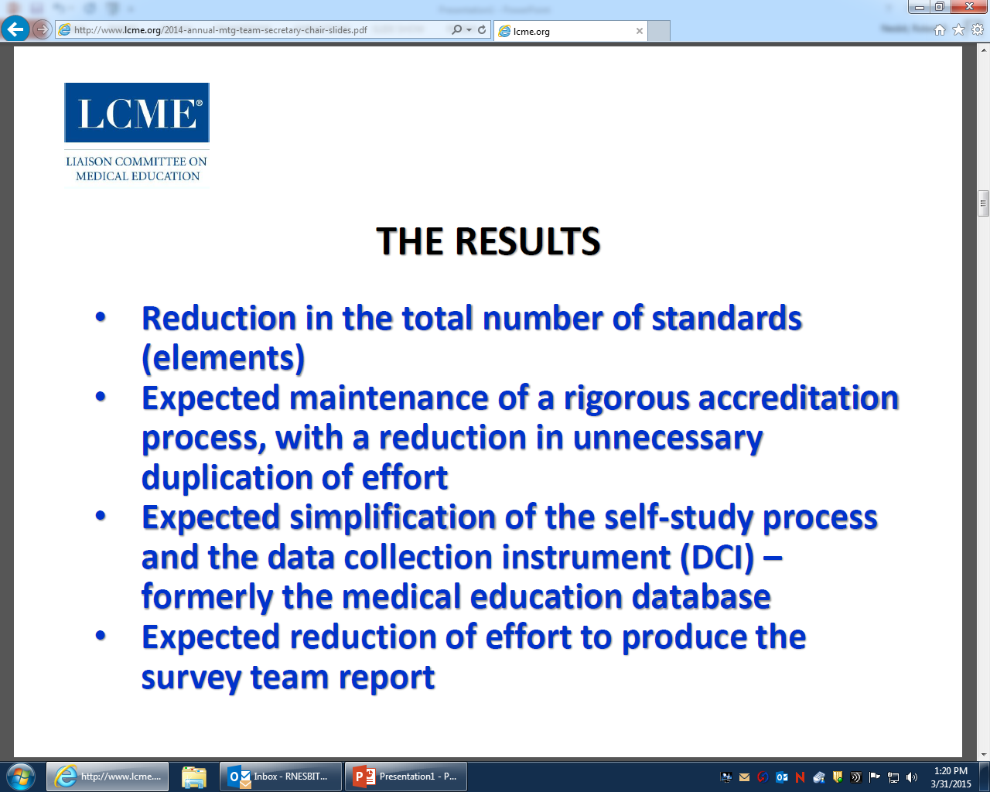

Slide 13
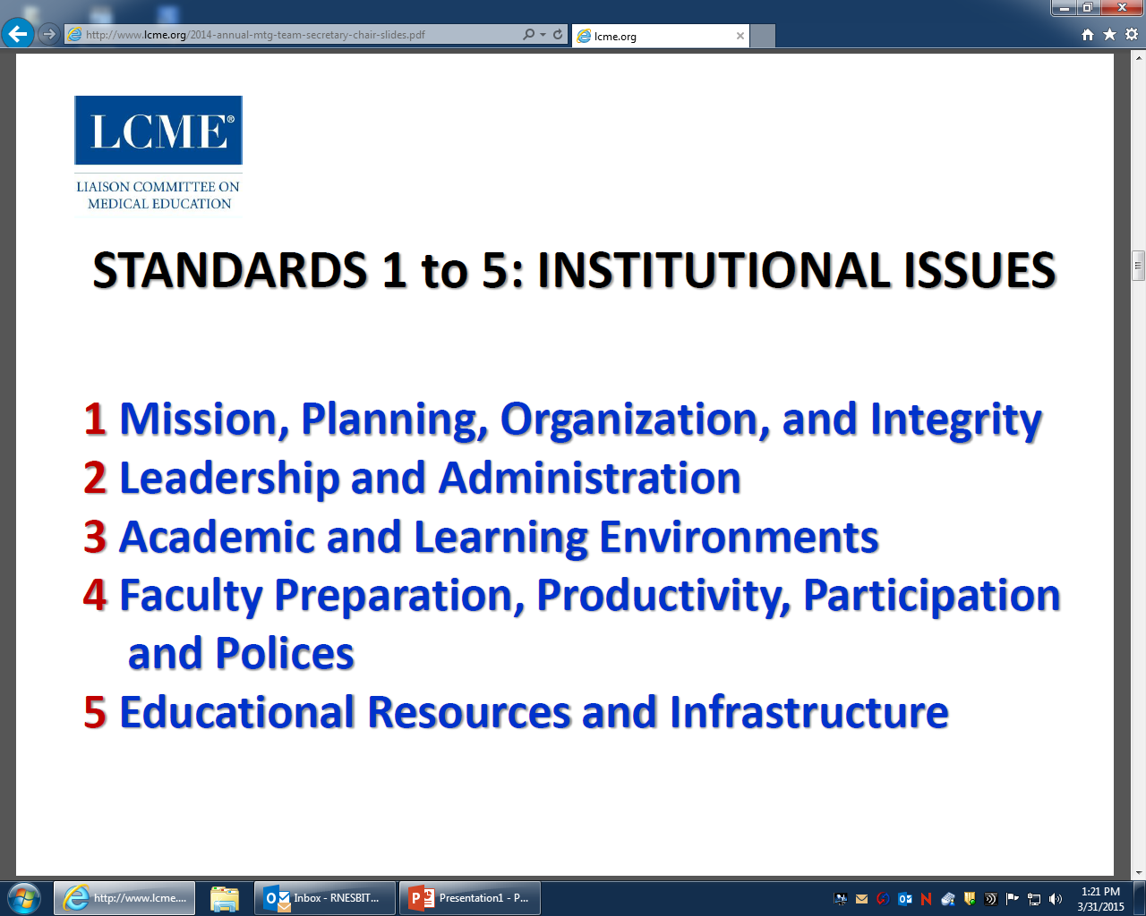

Slide 14
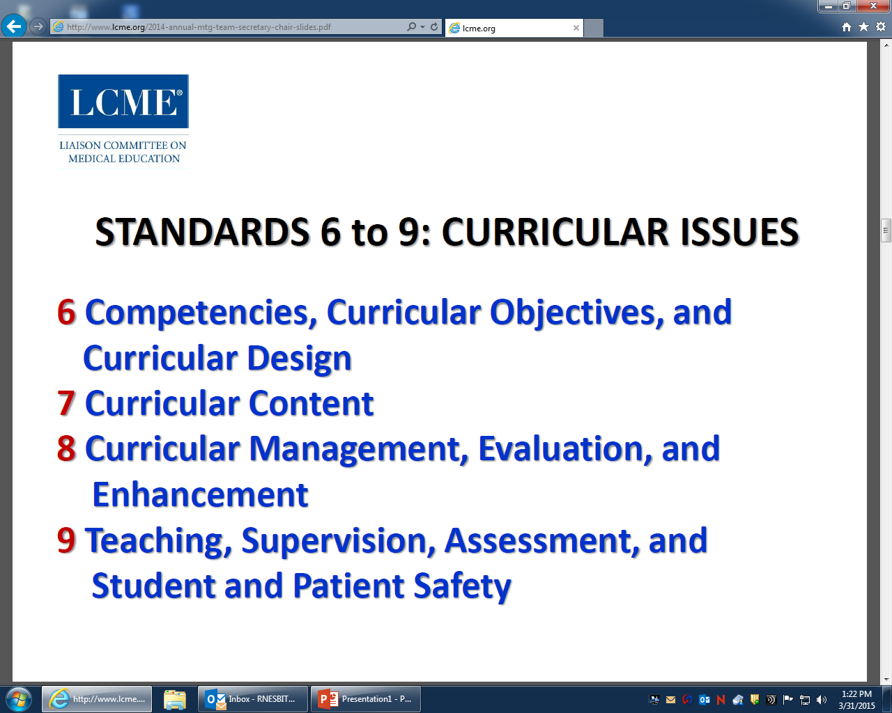

Slide 15
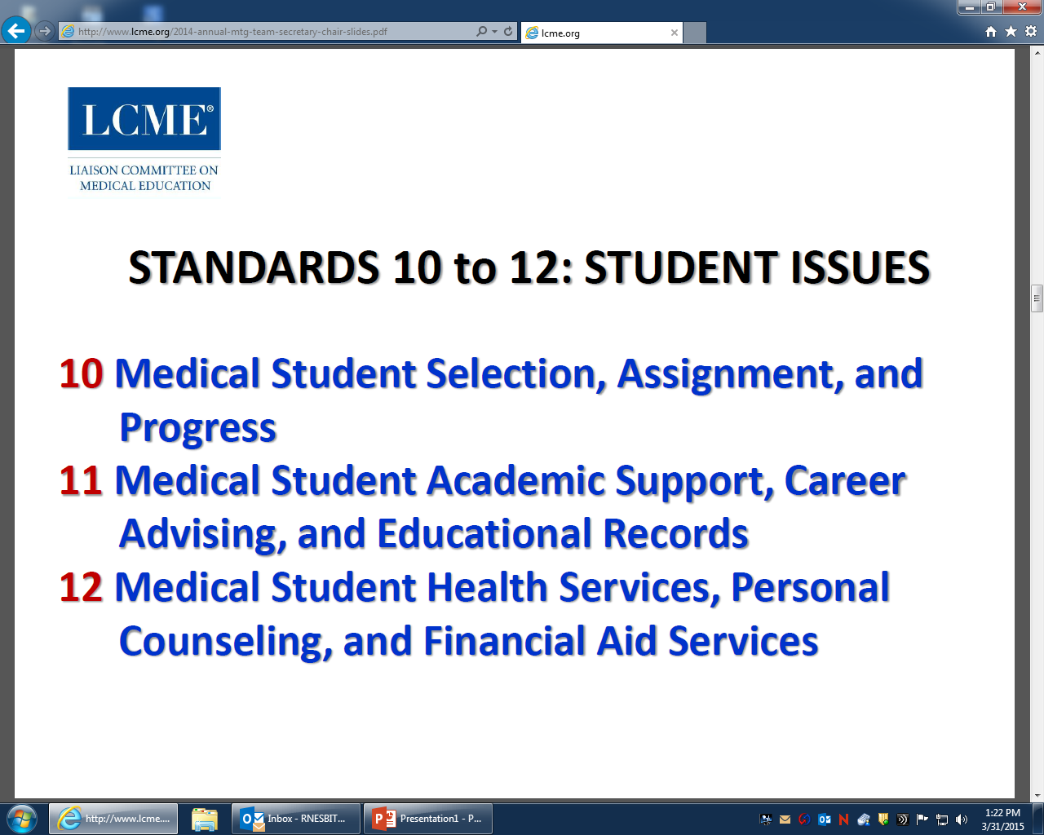

Slide 16
LCME Site Visit 2016
Paul M. Wallach, MD
Vice Dean

Slide 17
The LCME is Coming!
The LCME is Coming!
Surgery Clerkship Directors
Association for Surgical Education
March 21, 2011
Boston, Massachusetts
Robert F. Sabalis, PhD
LCME Assistant Secretary
AAMC

Slide 18
IN SUMMARY:
WHAT HAS CHANGED
New standards (12) and elements (95)
  Only one substantive addition (Element 1.1 asks for a CQI process for compliance with standards and elements)
No annotations; relevant substance incorporated in elements
Revised documents (DCI/Self-study Guide/Role of Students)
Eliminated duplication and redundancy in elements and in requests for information (i.e., DCI – was )
New way to enter and submit information (ASSET)

Slide 19
WHAT HAPPENS IN AN
ACCREDITATION REVIEW?
LCME Guide to the Institutional Self-Study
The DCI
  Data Collection Instrument (Database)
The ISA
  Independent Student Analysis
The GQ
  Graduation Questionnaire
    50 Q’s – 11 directly address mistreatment

Slide 20
WHAT HAPPENS IN AN
ACCREDITATION REVIEW?
School submits its data and self-study
3 to 4-day visit by a specially-selected survey team (typically 5-6 members)
  Team reviews written information and meets with faculty, administrators, students
Team prepares a report, including strengths, noncompliance areas, areas in compliance that need follow-up
LCME reviews the report and takes an accreditation action

Slide 21
WHAT HAS NOT CHANGED:
OVERVIEW OF THE PROCESS
Schedule of steps and timing leading to a survey visit and an ultimate LCME decision
Expectation that schools engage in a careful and broad-based process of data gathering and self-reflection
Process for preparing for a survey visit on the part of the LCME, the survey team, and the school

Slide 22
Goals of the Self-study
Self-study allows an institutional assessment of compliance with accreditation standards
  Schools are expected to identify strengths and challenges/areas needing improvement
This allows schools to develop plans and strategies to address problem areas before the visit and, if possible, implement change
A good self-study is when the findings of the school and the survey team are consistent
[teams are asked to comment on the consistency]

Slide 23
Predictors of Adverse Decisions
Significant predictors of severe action decisions based on binary logistic regression. A severe action decision becomes increasingly likely with more predictors present.
Total non-compliances
Element 8.7: Comparability of Education/Assessment (Formerly ED-8)
Element 8.1: Curricular Management
(Formerly ED-33)
Chronic noncompliance
Insufficient response to the requirements of the Data Collection Instrument/Self-study

Slide 24
Frequently Cited Standards / Elements
Wallach, Sebalis, Nesbit
DISCLAIMER!

Slide 25
6.1 (ED-3) Format/Dissemination of Medical Education Program Objectives and Learning Objectives
The faculty of a medical school defines its medical program objectives in outcomes based terms………………………
The medical school ensures that the learning objectives for each required learning experiences (e.g., course, clerkship, etc.) are made known to all medical students and to those faculty, residents, and others with teaching responsibilities in those required experiences.

Slide 26
6.1 (ED-3) RFS
  How are students, faculty (full-time and volunteer), residents, and other teachers at all educational sites made aware of the programmatic and clerkship learning objectives?
  If students from other schools are present in the clinical setting, which school’s objectives determine the clerkship content and assessments?
  (our card)

Slide 27
Curricular Management (Formerly ED-33)
8.1 Curricular Management
A medical school has in place an institutional body (e.g., a faculty committee) that oversees the medical education program as a whole and has responsibility for the overall design, management, integration, evaluation, and enhancement of a coherent and coordinated medical curriculum.

Slide 28
Comparability (Formerly ED-8)
8.7 Comparability of Education/Assessment
A medical school ensures that the medical curriculum includes comparable educational experiences and equivalent methods of assessment across all locations within a given course and clerkship to ensure that all medical students achieve the same medical education program objectives.

Slide 29
8.7 (ED-8) RFS
  Does each clerkship at all sites address same objectives?
  Provision of clerkship didactics: Central location by one faculty member or at various sites by site-specific faculty?
  Clerkship grade components same across sites: Preceptor ratings, NBME subject exam, OSCE, oral exam, etc.?
  How is faculty development provided to all faculty?
  Who determines final clerkship grade for all students in a given clerkship rotation?
  How/how often does clerkship director communicate with site personnel about clerkship planning/implementation?
  Who sees students’ evaluations of clerkship?

Slide 30
Curriculum Committee Charge (Formerly ED-37)
8.3 Curricular Design, Review, Revision/Content Monitoring
The faculty of a medical school are responsible for the detailed development, design, and implementation of all components of the medical education program, including the medical education program objectives, the learning objectives for each required curricular segment, instructional and assessment methods appropriate for the achievement of those objectives, content and content sequencing, ongoing review and updating of content, and evaluation of course, clerkship, and teacher quality. These medical education program objectives, learning objectives, content, and instructional and assessment methods are subject to ongoing monitoring, review, and revision by the faculty to ensure that the curriculum functions effectively as a whole to achieve medical education program objectives.

Slide 31
Self-Directed Learning (Formerly ED-5-A)
6.3 Self-Directed and Life-Long Learning
The faculty of a medical school ensure that the medical curriculum includes self-directed learning experiences and time for independent study to allow medical students to develop the skills of lifelong learning. Self-directed learning involves medical students’ self-assessment of learning needs; independent identification, analysis, and synthesis of relevant information; and appraisal of the credibility of information sources.

Slide 32
Define Clinical Experiences (Formerly ED-2)
6.2 Required Clinical Experiences
The faculty of a medical school define the types of patients and clinical conditions that medical students are required to encounter, the skills to be performed by medical students, the appropriate clinical settings for these experiences, and the expected levels of medical student responsibility.
8.6 Monitoring Of Completion of Required Clinical Experiences
A medical school has in place a system with central oversight that monitors and ensures completion by all medical students of required clinical experiences in the medical education program and remedies any identified gaps.

Slide 33
6.2 – 8.6 (ED-2) RFS
  List been established? Date of last review/update?
  Source of list and linkage to institutional/clerkship objectives and competencies?
  All three areas addressed?
  Students aware of requirements?
  How is completion monitored?
  Alternate experiences available?
  Mid-clerkship review of student logs?

Slide 34
Resident Preparation for Teaching (Formerly ED-24)
9.1 Preparation of Resident and Non-Faculty Instructors
In a medical school, residents, graduate students, postdoctoral fellows, and other non-faculty instructors in the medical education program who supervise or teach medical students are familiar with the learning objectives of the course or clerkship and are prepared for their roles in teaching and assessment. The medical school provides resources to enhance residents’ and non-faculty instructors’ teaching and assessment skills, with central monitoring of their participation in those opportunities provided.

Slide 35
9.1 (ED-24) RFS
  How are clerkship objectives made known to residents?
  Who supervises resident teaching/assessment of students?
  Resident preparation: Central or department programs or both?
  Is resident participation monitored?
  Type of preparation? Same or different from that of faculty?

Slide 36
9.2 (ED-25) RFS
“Supervision of medical student learning experiences at an institution that offers a medical education program must be provided throughout required clerkships…by members of the institution’s faculty.”

Slide 37
9.2 (ED-25) RFS
  Do all individuals (other than residents/fellows) who teach medical students have a faculty appointment?
  If not, are steps being taken to provide faculty appointments to those persons?
  Are there barriers to faculty appointments?
  Who is responsible for the faculty appointment process?
  How does the school ensure that students in the clinical environment are appropriately supervised?

Slide 38
9.4 (ED-27) RFS
“A medical education program must include ongoing assessment activities that ensure that medical students have acquired and can demonstrate on direct observation the core clinical skills, behaviors, and attitudes that have been specified in the program's educational objectives.”

Slide 39
9.4 (ED-27) RFS
  Core list of clinical skills, behaviors, and attitudes that students must demonstrate?
  Awareness of students’ perceptions of whether they are being observed performing medical histories and physical examinations during clinical clerkships from GQ data, school survey data, independent student analysis?
  Are there required formative or summative end-of-clerkship, end-of-year, or graduation OSCEs?
    If yes, what occurs if a student fails a required OSCE?

Slide 40
Give Feedback (Formerly ED-31)
9.7 Formative Assessment and Feedback
A medical school ensures that each medical student is assessed and provided with formal formative feedback early enough during each required course or clerkship four or more weeks in length to allow sufficient time for remediation. Formal feedback typically occurs at least at the midpoint of the course or clerkship. A course or clerkship less than four weeks in length provides alternate means by which a medical student can measure his or her progress in learning.

Slide 41
Timely Grades (Formerly ED-30)
9.8 Fair and Timely Summative Assessment
A medical school has in place a system of fair and timely summative assessment of medical student achievement in each course and clerkship of the medical education program. Final grades are available within six weeks of the end of a course or clerkship.

Slide 42
Narrative on Summative Evaluation
(Formerly ED-32)
9.5 Narrative Assessment
A medical school ensures that a narrative description of a medical student’s performance, including his or her non-cognitive achievement, is included as a component of the assessment in each required course and clerkship of the medical education program whenever teacher-student interaction permits this form of assessment.

Slide 43
Academic Environment
(Formerly MS-31-A & MS-32)
3.5 Learning Environment/Professionalism
A medical school ensures that the learning environment of its medical education program is conducive to the ongoing development of explicit and appropriate professional behaviors in its medical students, faculty, and staff at all locations and is one in which all individuals are treated with respect. The medical school and its clinical affiliates share the responsibility for periodic evaluation of the learning environment in order to identify positive and negative influences on the maintenance of professional standards, develop and conduct appropriate strategies to enhance positive and mitigate negative influences, and identify and promptly correct violations of professional standards.

Slide 44
Academic Environment
(Formerly MS-31-A & MS-32)
3.6 Student Mistreatment
A medical school defines and publicizes its code of professional conduct for faculty-student relationships in its medical education program, develops effective written policies that address violations of the code, has effective mechanisms in place for a prompt response to any complaints, and supports educational activities aimed at preventing inappropriate behavior. Mechanisms for reporting violations of the code of professional conduct (e.g., incidents of harassment or abuse) are well understood by students and ensure that any violations can be registered and investigated without fear of retaliation.
Respect?
Prior professional contact?

Slide 45
The AAMC Graduation Questionnaire
2011
“Mistreatment either intentional or unintentional occurs when behavior shows disrespect for the dignity of others and unreasonably interferes with the learning process. Examples of mistreatment include sexual harassment; discrimination based on race, religion, ethnicity, gender, or sexual orientation; humiliation; psychological or physical punishment; and the use of grading and other forms of assessment in a punitive manner.”

Slide 46
The AAMC Graduation Questionnaire
2001 - 2011
12-20% reported mistreatment
Average 17% per medical school
Range 4 - 41 % depending on school

Slide 47
Diversity (Formerly IS-16)
3.3 Diversity/Pipeline Programs and Partnerships
A medical school has effective policies and practices in place, and engages in ongoing, systematic, and focused recruitment and retention activities, to achieve mission-appropriate diversity outcomes among its students, faculty, senior administrative staff, and other relevant members of its academic community. These activities include the use of programs and/or partnerships aimed at achieving diversity among qualified applicants for medical school admission and the evaluation of program and partnership outcomes.

Slide 48
Diversity (Formerly IS-16)
7.6 Cultural Competence/Health Care Disparities/Personal Bias
The faculty of a medical school ensure that the medical curriculum provides opportunities for medical students to learn to recognize and appropriately address gender and cultural biases in themselves, in others, and in the health care delivery process. The medical curriculum includes instruction regarding:
The manner in which people of diverse cultures and belief systems perceive health and illness and respond to various symptoms, diseases, and treatments.
The basic principles of culturally competent health care.
The recognition and development of solutions for health care disparities.
The importance of meeting the health care needs of medically underserved populations.
The development of core professional attributes (e.g., altruism, accountability)
needed to provide effective care in a multidimensionally diverse society.

Slide 49
Affiliations (Formerly ER-9)
1.4 Affiliation Agreements
In the relationship between a medical school and its clinical affiliates, the educational program for all medical students remains under the control of the medical school’s faculty, as specified in written affiliation agreements that define the responsibilities of each party related to the medical education program. Written agreements are necessary with clinical affiliates that are used regularly for required clinical experiences; such agreements may also be warranted with other clinical facilities that have a significant role in the clinical education program. Such agreements provide for, at a minimum:
The assurance of medical student and faculty access to appropriate resources for medical student education.
The primacy of the medical education program’s authority over academic affairs and the education/assessment of medical students.
The role of the medical school in the appointment and assignment of faculty members with responsibility for medical student teaching.
Specification of the responsibility for treatment and follow-up when a medical student is exposed to an infectious or environmental hazard or other occupational injury.
The shared responsibility of the clinical affiliate and the medical school for creating and maintaining an appropriate learning environment.
Confirmation of the authority of the department heads of the medical school to ensure faculty and medical student access to appropriate resources for medical student education when those department heads are not also the clinical service chiefs at affiliated institutions.

Slide 50
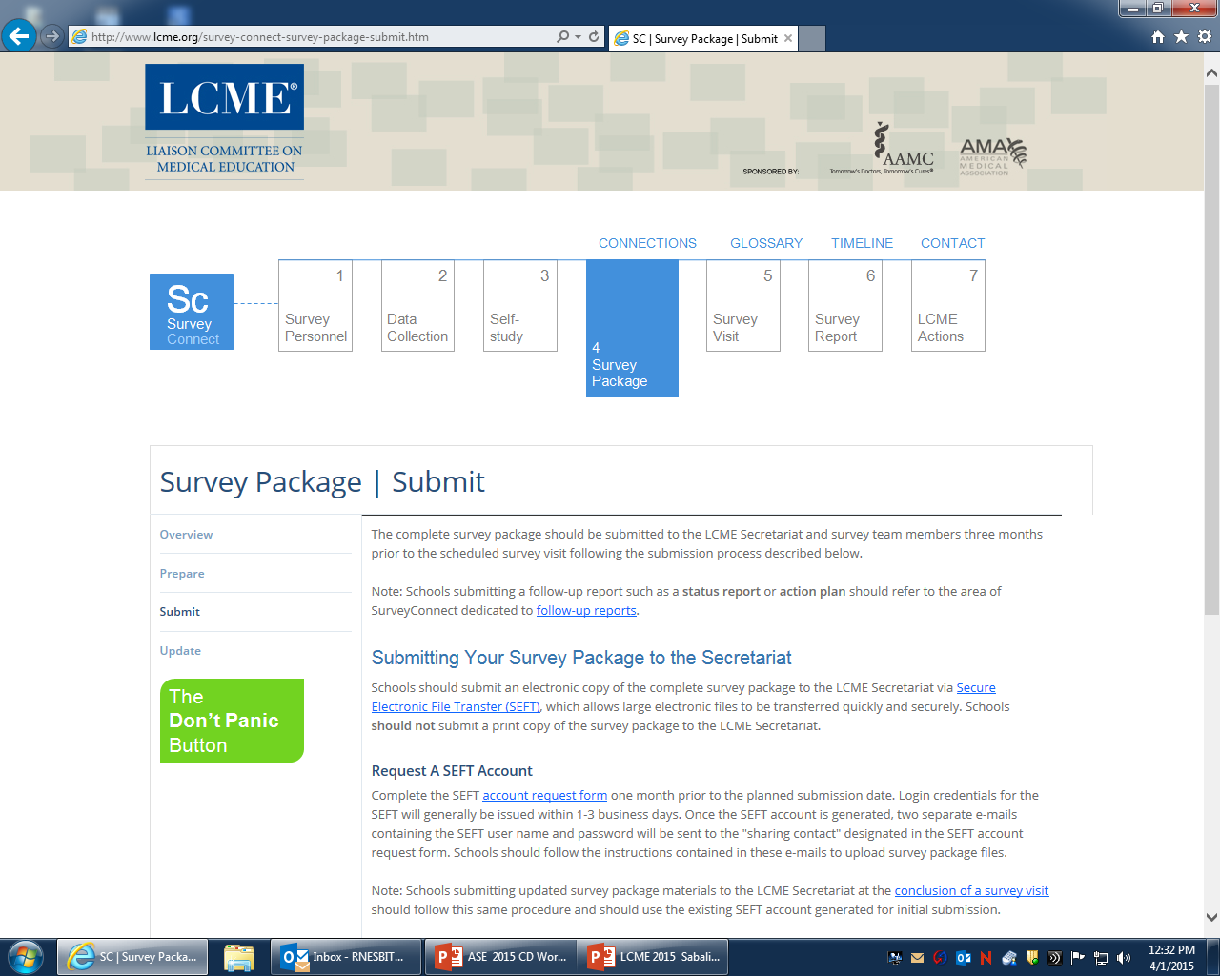

Slide 51
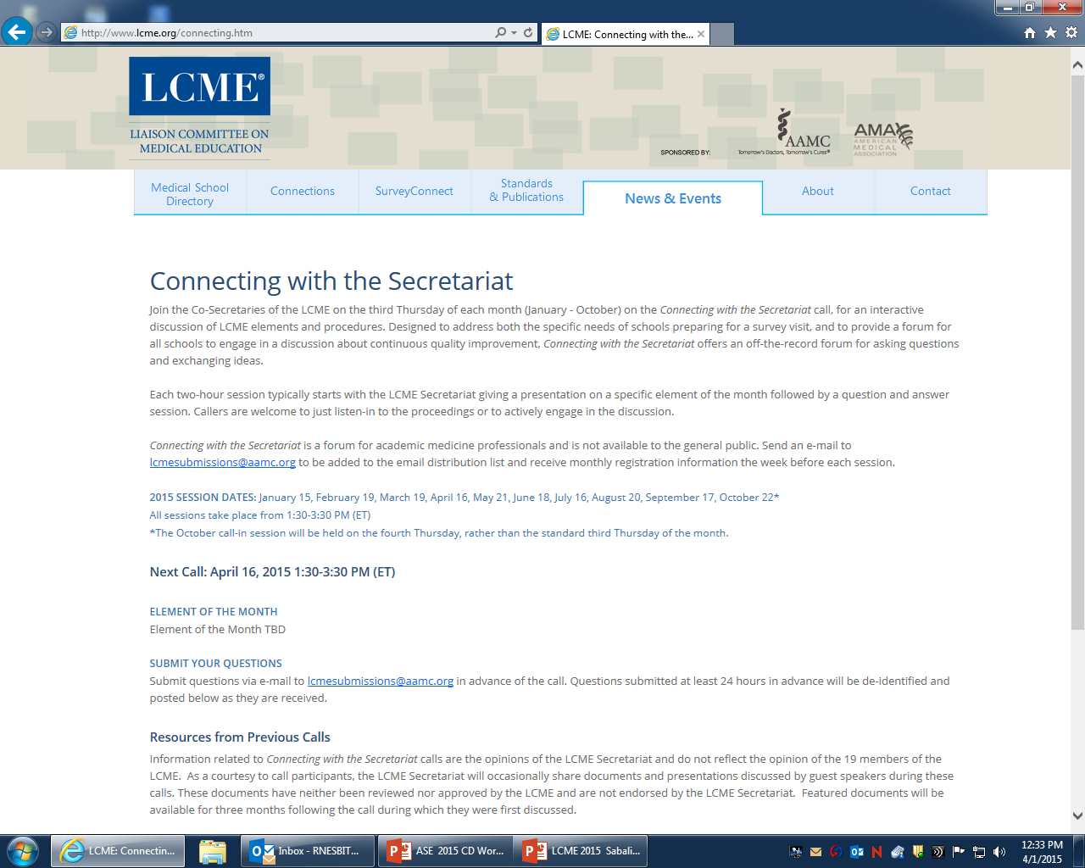

Slide 52
Be prepared!
Read the last LCME report/actions
Read the latest GQ (old news?)
Call in to “Connecting with the Secretariat”
See the Guide to the Institutional Self-Study
Ask others
Don’t wait

Slide 53
?’s
EXPERIENCES? - HORROR STORIES?

Slide 54

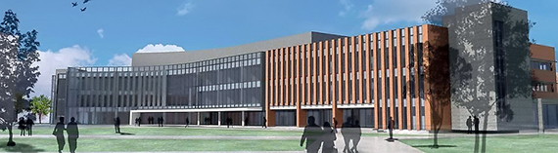
The Medical College of Georgia at GRU-Augusta rnesbit@gru.edu

