Slide 1


Slide 2

Surviving the LCME VISIT
Lessons Learned
Robert R. Nesbit, Jr.
Medical College of Georgia
Augusta University

Slide 3
Surviving the LCME VISIT
Lessons Learned
Our visit – January 24-27, 2016
Our report – June 2016

Slide 4



Slide 5
Surviving the LCME VISIT
Lessons Learned
It’s not your grandfather’s LCME
  Or even your father’s
Major schools have been put on probation
  You don’t want that!

Slide 6
We started the Self- Study 18 mos in advance
12 Standards, 95 Elements
The DCI
The ISA
The GQ
Consultant
Mock Visit

Slide 7


Slide 8
Curriculum Development?
  Competencies
  Oversight
  Review
  NOT a national curriculum

Slide 9
The Medical College of Georgia
Augusta University
240 students per class
Two 4 year campuses
  Augusta 190 / Athens 40
Three additional clinical campuses
  One with an LIC
  (all new since last visit)

Slide 10
Comparability
At all sites the same:
Goals and Objectives
Curriculum
Required Clinical Experiences
Evaluation and Grading
Final grade assigned by Clerkship Director
(and all that applies to the LIC too)

Slide 11
Prior citations
How are residents prepared to teach?
Policies – for everything!
  How is that centrally monitored?

Slide 12
  Our Dashboard – for everything every month – by site
  And what do you do about outliers?
    Grade delinquencies
    Required experiences
    Grades / scores
    Duty hours
    Mistreatment

Slide 13
Amenities
Study space
Lockers
Computer access

Slide 14
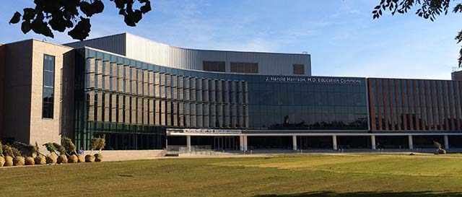

Slide 15
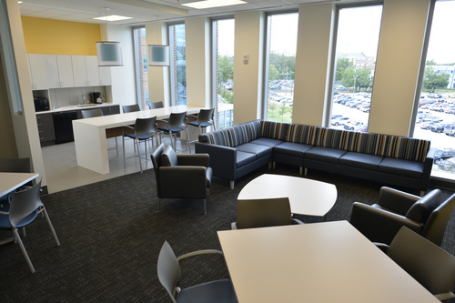

Slide 16
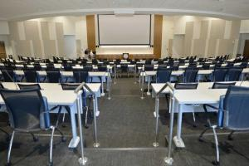

Slide 17
Other major interests
  CQI
  Cultural Competency
  Interprofessional Education
  Societal Problems

Slide 18


Slide 19


Slide 20

Still!

