Slide 1

Surviving the LCME Site Visit:
Lessons Learned
Association for Surgical Education- Trouble Shooting Your Clerkship Workshop
Nicole A. Stassen, MD, FACS, FCCM (@NAJSW)
President Eastern Association for the Surgery of Trauma
Associate Professor of Surgery
University of Rochester
Rochester, NY

Slide 2

The Preparation
LCME preparation discussed at every third and fourth year instruction committee meeting for over a year prior to the site visit
All people that would be interacting with the site visitors had multiple preparation meetings
  Department Chairs
    I met with our chair several times outside of these
  Residents
  Medical students

Slide 3
The Self Study
Self study started in August 2014
26 member LCME task force formed
  Dean of the school of nursing
  Department chairs
  Senior and junior faculty
  Clinical and basic science departments
  Administrators
  Alumni
  Residents
  Medical students
Multiple sub-committees
  All clerkship directors served on at least one

Slide 4
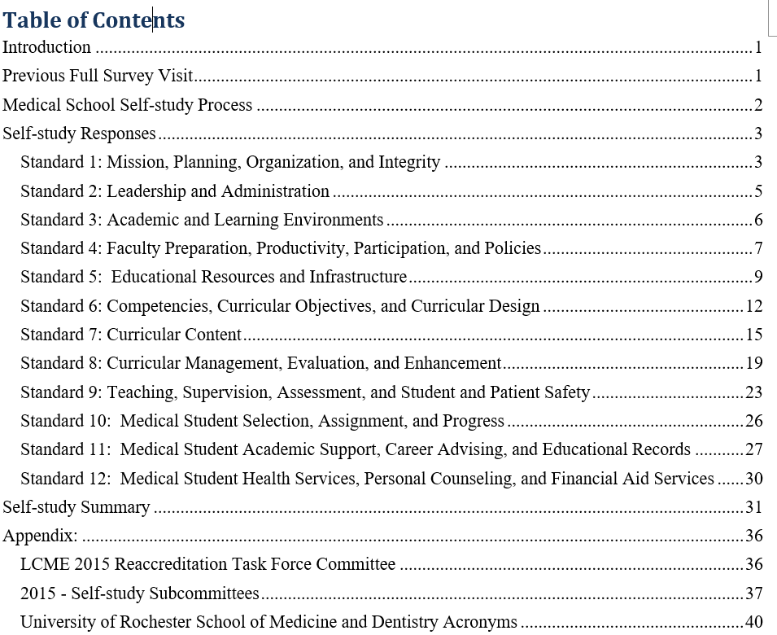
The Self Study

Slide 5

Focus Areas for the Self Study

Slide 6
Mapping of Program Objectives
Mapping of program objectives with learning objectives of each course and clerkship
  All school objectives mapped to at least one ACGME competency
  All ACGME competencies linked to at least one school objective
  Each clerkship learning objective has to link to an overall educational objective

Slide 7
Determination of Student Expectations
Defined patient types and clinical conditions the school expects students to encounter and the clinical skills they are expected to perform were first defined by each clerkship
  Determined by clerkship directors and faculty
    Based on national organization recommendations
  Each requirement is associated with a patient type, clinical setting and level of responsibility
  The levels of responsibility defined and reviewed with students at class meetings and by individual clerkship directors.
  Reviewed annually by instruction committee
Students record completion of these requirements so it can be monitored by the clerkship and centrally by the Office of Curriculum and Assessment.

Slide 8
Direct Observation of Students
Clerkships with lower compliance directly addressed in self study
  Surgery clerkship was behind others (60-70%)
    Some of the issue was with sign posting
  Methods of improvement written into the self study
    Standardized patient encounters
    Addition of an abdominal exam skills lab
    Abdominal exam observation skills sheet
      Signed by faculty and student at completion

Slide 9
Mid-Clerkship Feedback and Final Grades
Clerkships with lower compliance directly addressed in self study
  Surgery clerkship was behind others (60-70%)
    Some of the issue was with sign posting
  Methods of improvement written into the self study
    Addition of “Afternoon of mid-clerkship feedback with the CD”
      Written schedule with times
      Student sign in
    Addition of mid-clerkship feedback to passport
      Signed by faculty preceptor

Slide 10
Self Study Strengths
The medical school has a clear and effective governance structure that is well integrated into the medical center with the School of Nursing, Eastman Institute for Oral Health, and Strong Memorial Hospital. The relationship between Strong Memorial Hospital and the medical school is excellent. (Element 2.1)
The role of CEO that Dean that Dr. Mark Taubman assumed in January 2015 and the strengthened/new positions of the Vice Dean for Research Dr. Stephen Dewhurst and Vice Dean for Clinical Affairs Dr. Michael Rotondo have led to highly effective leadership with clarity in initiatives and timely decision making. (Element 2.4)
The student research opportunities with funding are numerous with a high level of participation with 73% of students participating in a research project with a faculty member and 12% of students conducting a year out research project. The Academic Research Track fosters student interest and participation in research. (Element 3.2)
The highly engaged and committed medical school student body is diverse across all measures including race, gender and geographic origin. Accepted applicants are of a high caliber with a wide variety of outstanding qualifications. (Elements 3.3 and 10.4)
There is a very supportive and collaborative culture at the medical school which fosters student education and contributes to a positive learning environment (Elements 3.5, 11.0)
The faculty are highly productive in their fields and their scholarly productivity contributes to the academic excellence of the medical school. The enthusiasm and engagement in teaching enriches the learning environment and the educational experience. (Element 4.2)
Faculty career development is supported by broad, deep, and increased programs and resources at the level of the school, department, center, and divisions. (Element 4.5)
The restructuring of the University of Rochester Medical Faculty Group (URMFG) has resulted in the performance based compensation plan to acknowledge and provide support for teaching, research, scholarly productivity as well as clinical productivity. This plan and timeframe for implementation are being finalized. (Element 5.3)

Slide 11
Self Study Strengths
Facilities for education, PBL rooms, flexible classrooms are excellent (Element 5.4)
The Double Helix Curriculum successfully integrates basic science and clinical medicine throughout four years. The curriculum fosters self-directed life-long learning through its problem based learning (PBL) instructional methods, team based learning, journal club, translational research group project, and other activities. Self-directed life-long learning is further emphasized with the student created Individualized Learning Plan (ILP). (Elements 6.0, 6.3, 7.0)
The school offers many volunteer community service and international health opportunities for medical students which enrich the educational experience of students and the global community. Curricular content emphasizes service learning and public health throughout four years. (Elements 6.6, 7.5, 7.6)
There are inter-professional learning experiences at different points in the program and inter-professional volunteer opportunities available. The collaboration across the medical center has emphasized and supported inter-professional education and collaborative practice. Student participation in IPE at the medical school was noted in the AAMC GQ to be 96.9% versus 78.5% nationally. (Elements 6.7 and 7.9)
Student evaluation data is used to improve the overall educational program. Changes including lecture time reduction, enhanced physical examination assessment, and course leadership that emerged from student feedback is well documented and demonstrates the school’s priority in soliciting and acting upon student feedback. (Element 8.5)
‘Assessment Days’ concurrently assess student’s knowledge of scientific foundations of medicine with knowledge and skills in clinical care in a unique format. An array of formative and summative assessment tools are integrated throughout the curriculum that provide feedback, facilitate growth, and also determine overall student performance while ensuring that the overall educational objectives of the M.D. program are met. (Elements 9.0, 9.4, 9.5)
Through weekly small group and individual meetings, the Advisory Dean program provides students personalized guidance assisting the student in accessing the academic, personal, and career counseling resources in the medical school. (Elements 1.1, 11.2, 12.3)
Student educational debt has gone down and remains below the national average for all schools and private schools ($140,620 in 2014 for URSMD versus $167,466 nationally for all schools and $190,053 for private schools). (Element 12.1)

Slide 12
Self Study Areas for Attention
The institution has expanded efforts to increase the diversity of faculty and senior administration with the recent position of Associate Vice President and Senior Associate Dean for Inclusion and Culture Development. Compared with other institutions the percentage of our faculty who are underrepresented in medicine as defined by the AAMC are at the 33rd percentile and women faculty at our school are at the 46th percentile compared with medical schools nationally. The school has a strong commitment to diversity. There are new initiatives and plans to further increase the diversity of faculty and senior administration. (Element 3.3)
A recently developed template to facilitate providing faculty with annual feedback has been accepted and implemented however there is no information yet on the impact of this initiative to increase the frequency and quality of feedback to faculty. (Element 4.4)

Slide 13
Self Study Areas for Attention
The integration of technology into the curriculum for learning, assessment and curricular and outcome mapping should continue to be monitored (Element 5.9, 8.3)
In the Obstetrics and Gynecology Clerkship student satisfaction is the lowest of all clerkships at URSMD and the ISA indicated the clerkship environment is unwelcoming. (Element 6.2)
A small number of faculty in the Primary Care Clerkship do not yet have faculty appointments. (Element 9.2)
Observation of students taking a history or doing a physical examination needs to be improved. Faculty observation in the Surgery Clerkship and the Obstetrics and Gynecology Clerkship are below national levels. (Element 9.4)
Medical school tuition remains high and while debt numbers are favorable, continued efforts are necessary to further grow scholarship dollars. (Element 12.1)

Slide 14
The Visit Itself
Survey team composition
  Two main visitors
  An intern/trainee visitor
Significant focus on the “Areas for Attention” in the self study
Some surprises as well

Slide 15
The Interview with Clerkship Directors
Group interview
  Some questions were directed, others just put to the group
  “Treat it like a deposition”
Met with AD just prior to review what had come up in the visit to date

Slide 16
The Interview with Clerkship Directors
Honed in on “areas for Attention in the self study
  Student observation
  Tracking of task completion
  Educational alternatives
Significant stress on policies and procedures for contesting a grade or evaluation
Curriculum searching ability
  Can you search the entire formal curriculum on any topic?

Slide 17
The Interview with Clerkship Directors
Residents as teachers education
  How are visiting residents handled
  How do they get feedback
Faculty as teachers education
  How do they get feedback
  Do our students work with any “non-faculty” physicians

Slide 18
The Unofficial Results
Brief comments when site visitors left Several strengths of the institution which
    CEO and Dean Mark Taubman
    Faculty as a whole
    Research opportunities for students
    The dean’s staff
    The quality of the materials submitted to the survey team
  Identified a number of areas for the school to address
    A perception of faculty not having a voice in the educational program and governance
    Some clerkship issues we identified in our self-study and others
    There were no concerns related to URMC residents

Slide 19

The Final Results
Full report in February 2016 - Full 8-year accreditation
LCME requested several specific areas where the school needs to provide follow up by 1 December 2016
  An update on the percentage of students who are observed in each clerkships
    Specific comment was about the Ob/Gyn, Surgery and Emergency Medicine clerkships
  Currently each clerkship asks students if they were observed and also there are specific physical examination maneuvers that each student must complete and sign off for each clerkship
  This data and data from the AAMC GQ 2016 will be submitted
Concerns with the Clerkship Director sitting on an ad hoc grade appeals committee for their clerkships

Slide 20
