Slide 1



Troubleshooting Your Clerkship 2018
Managing Multiple Clinical Sites
and Ensuring Equivalence
AJ Copeland, MD FACS
Core Surgery Clerkship Director
Uniformed Services University of the Health Sciences
Bethesda, MD

Slide 2
LCME Standards

Slide 3
Standard 8:
Curricular Management

Slide 4
Standard 8:
Curricular Management

Slide 5
USUHS Core Clerkship Structure
Five weeks of General Surgery
Two Surgical Subspecialty electives (2-1/2 weeks each)
Five weeks of OB-GYN
All at the same clinical site
6-12 students per site
In any order
End-of-clerkship assessments (NBME and OSCE) done at USUHS week 16

Slide 6
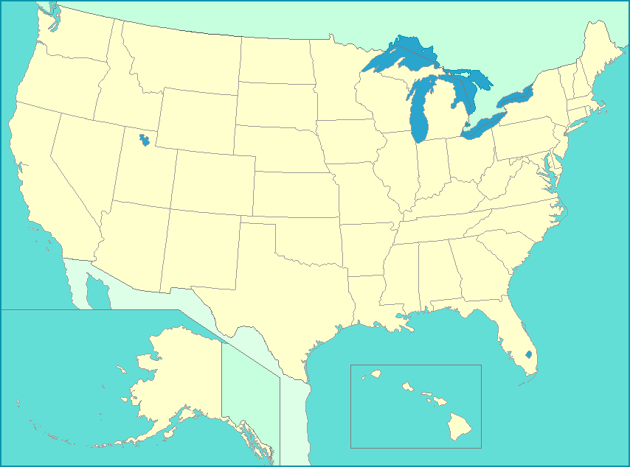
USU Core Surgery Clerkship Sites
Walter Reed NMMC
Bethesda, MD

Slide 7

USU Core Surgery Clerkship Sites
Walter Reed NMMC
Bethesda, MD
NMCP
Portsmouth, VA

Slide 8

USU Core Surgery Clerkship Sites
Walter Reed NMMC
Bethesda, MD
NMCP
Portsmouth, VA
Eisenhower AMC
Augusta, GA

Slide 9
USU Core Surgery Clerkship Sites
Walter Reed NMMC
Bethesda, MD
NMCP
Portsmouth, VA
Eisenhower AMC
Augusta, GA
SAMMC
San Antonio, TX

Slide 10
USU Core Surgery Clerkship Sites
Walter Reed NMMC
Bethesda, MD
NMCP
Portsmouth, VA
NMCSD
San Diego, CA
Eisenhower AMC
Augusta, GA
SAMMC
San Antonio, TX

Slide 11
USU Core Surgery Clerkship Sites
Madigan AMC
Takoma, WA
Walter Reed NMMC
Bethesda, MD
NMCP
Portsmouth, VA
NMCSD
San Diego, CA
Eisenhower AMC
Augusta, GA
SAMMC
San Antonio, TX

Slide 12
USU Core Surgery Clerkship Sites
Madigan AMC
Takoma, WA
Walter Reed NMMC
Bethesda, MD
NMCP
Portsmouth, VA
NMCSD
San Diego, CA
Eisenhower AMC
Augusta, GA
SAMMC
San Antonio, TX
Tripler AMC
Honolulu, HI

Slide 13
Keys to Ensuring Comparable Clinical Experiences Across Sites
Defined educational objectives
A system to ensure those objectives are met
Active monitoring of clinical experiences
Frequent communication
Regular site visits
Annual faculty retreat

Slide 14
Keys to Ensuring Comparable Clinical Experiences Across Sites
Defined educational objectives
A system to ensure those objectives are met
Active monitoring of clinical experiences
Frequent communication
Regular site visits
Annual faculty retreat

Slide 15
Lecture Series
Daily
One hour
Problem-based
Given by faculty or chief residents
21 lectures on General Surgery
20 lectures on Surgical Subspecialties
Published objectives

Slide 16
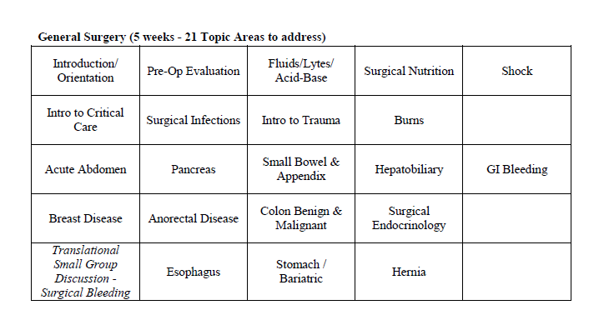
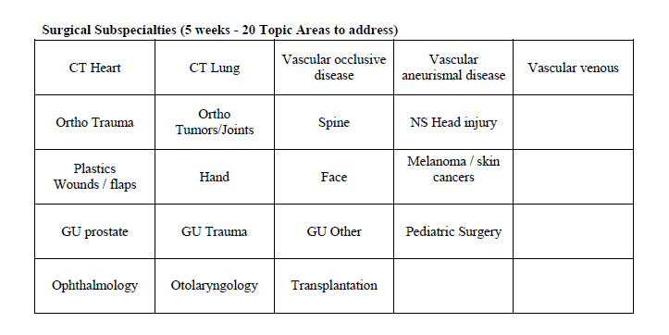
Lecture Series

Slide 17
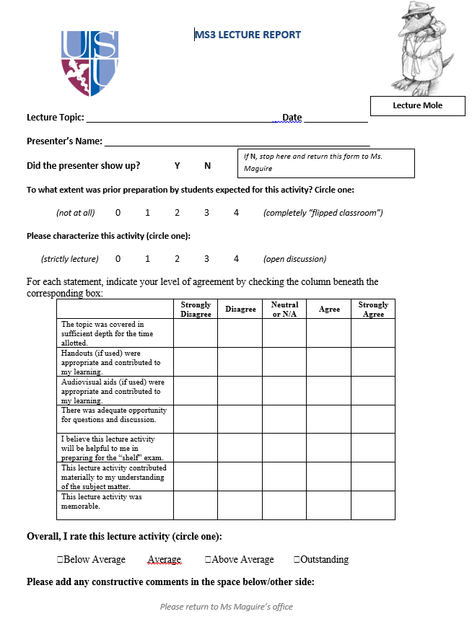
Lecture Series
Feedback to lecturers (“Lecture Mole”) collected daily, and collated and distributed to faculty each trimester

Slide 18
Keys to Ensuring Comparable Clinical Experiences Across Sites
Defined educational objectives
A system to ensure those objectives are met
Active monitoring of clinical experiences
Frequent communication
Regular site visits
Annual faculty retreat

Slide 19
Active Monitoring of
Clinical Experiences
Field Journal
Clerkship Tracker
Mid-rotation feedback
Final rotation feedback
End-of-clerkship surveys

Slide 20
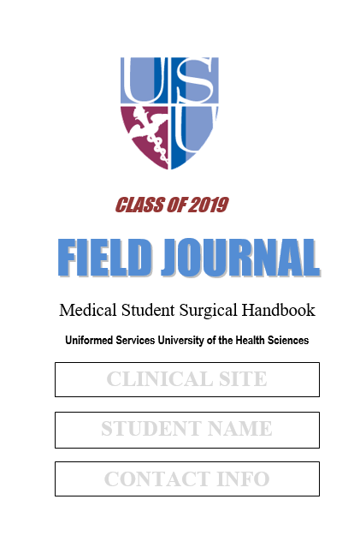
Active Monitoring of
Clinical Experiences
Field Journal
Clerkship Tracker
Mid-rotation feedback
Final rotation feedback
End-of-clerkship surveys

Slide 21
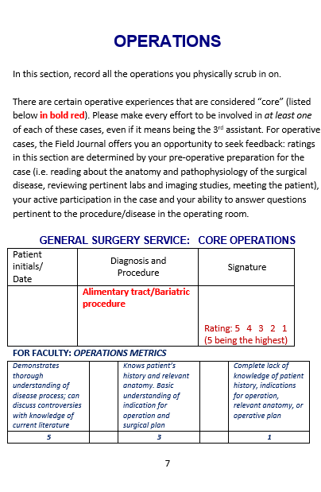
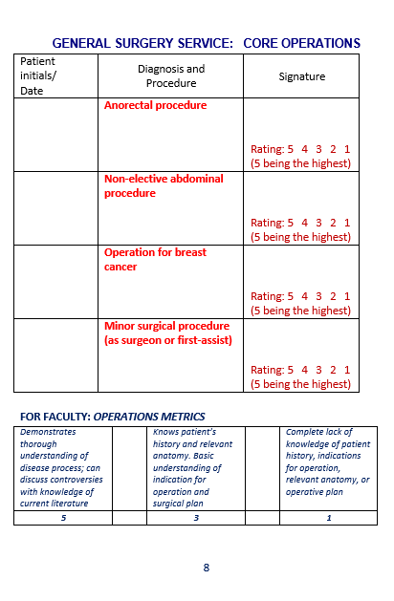
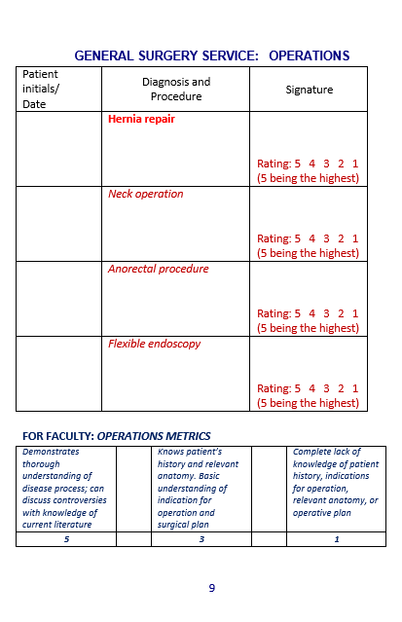
Active Monitoring of
Clinical Experiences: Field Journal

Slide 22
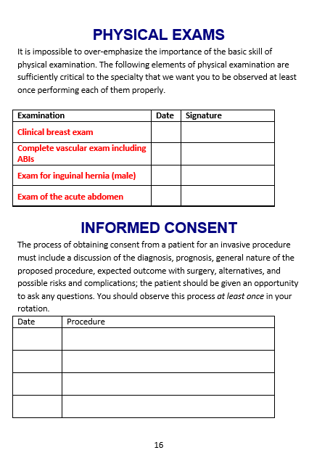
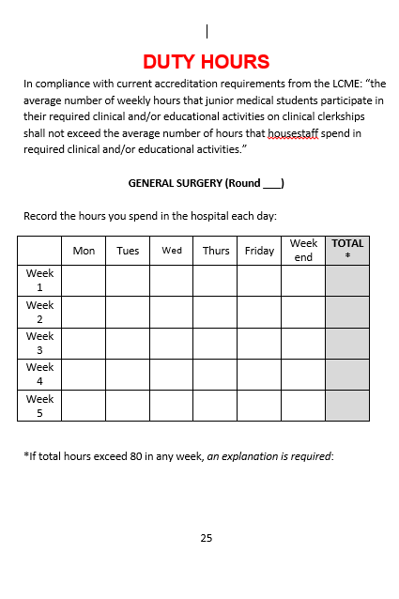
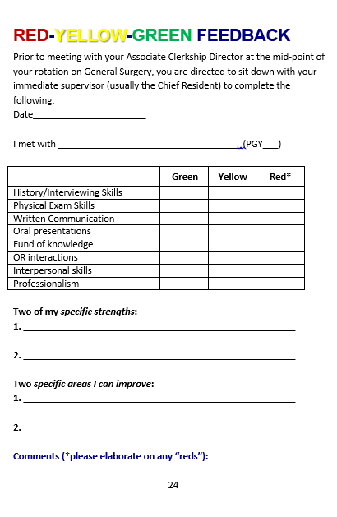
Active Monitoring of
Clinical Experiences: Field Journal

Slide 23
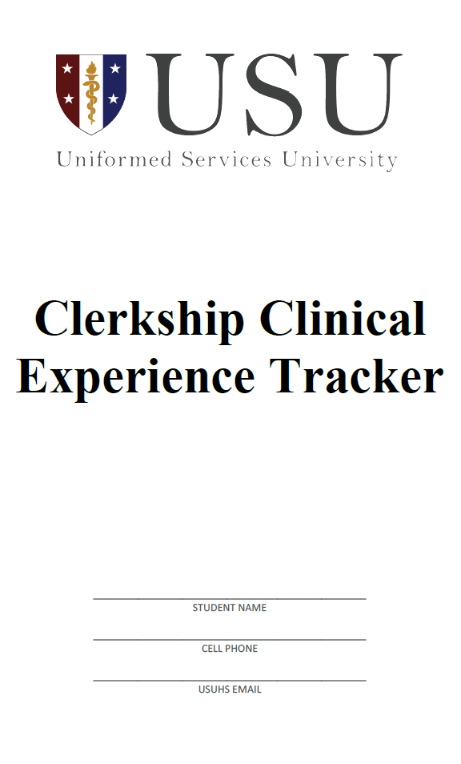
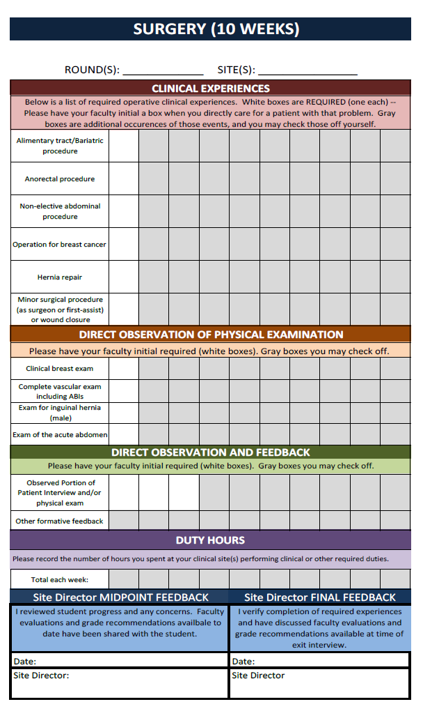
Active Monitoring of
Clinical Experiences: Clerkship Tracker

Slide 24
Keys to Ensuring Comparable Clinical Experiences Across Sites
Defined educational objectives
A system to ensure those objectives are met
Active monitoring of clinical experiences
Frequent communication
Regular site visits
Annual faculty retreat

Slide 25

Frequent Communication
Teleconferences monthly and PRN
Bidirectional communication between the CD and ACDs

Slide 26
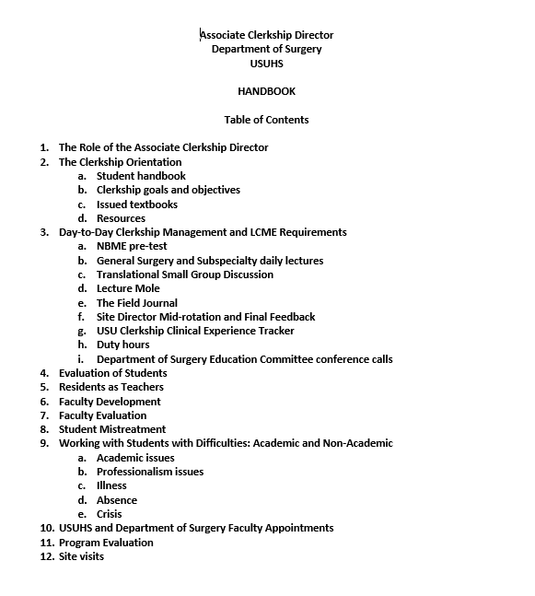
Communication with ACDs:
ACD Handbook

Slide 27

Keys to Ensuring Comparable Clinical Experiences Across Sites
Defined educational objectives
A system to ensure those objectives are met
Active monitoring of clinical experiences
Frequent communication
Regular site visits
Annual faculty retreat

Slide 28
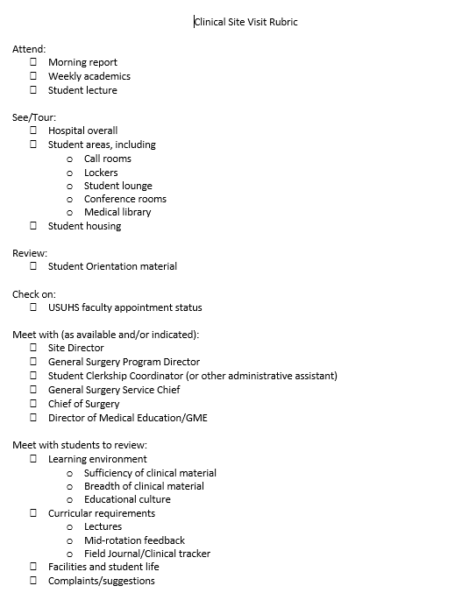
Regular Site Visits
Every two years on a rotating basis and PRN
Follows a defined site visit template
Includes meeting with students, ACDs, administrative support personnel, senior leadership

Slide 29
Keys to Ensuring Comparable Clinical Experiences Across Sites
Defined educational objectives
A system to ensure those objectives are met
Active monitoring of clinical experiences
Frequent communication
Regular site visits
Annual faculty retreat

Slide 30
Annual Faculty Retreat
Supported by the office of the Associate Dean for Faculty Development
1-1/2 days each September
Includes all required clerkships
Extra half day for “new site directors”
All required clerkships participate

Slide 31
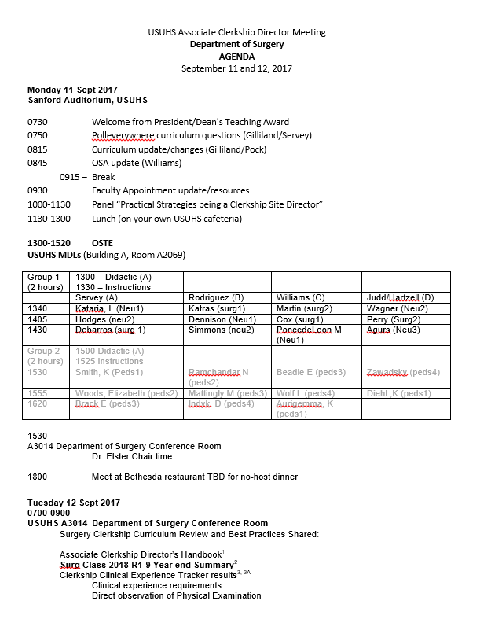
Annual Faculty Retreat
½ day of common material
  faculty appointments
Breakout by clerkship
  take the NBME exam
  review the curriculum
  specific faculty development as requested

Slide 32
Standard 8:
Curricular Management

Slide 33
Troubleshooting Your Clerkship 2018
Managing Multiple Clinical Sites
and Ensuring Equivalence
AJ Copeland, MD FACS
Core Surgery Clerkship Director
Uniformed Services University of the Health Sciences
Bethesda, MD

Slide 34
Troubleshooting Your Clerkship 2018
Managing Multiple Clinical Sites
and Ensuring Equivalence
Comparability
AJ Copeland, MD FACS
Core Surgery Clerkship Director
Uniformed Services University of the Health Sciences
Bethesda, MD

Slide 35
Troubleshooting Your Clerkship 2018
Questions?
AJ Copeland, MD FACS
Core Surgery Clerkship Director
Uniformed Services University of the Health Sciences
Bethesda, MD

