Slide 1
Devashish J Anjaria, MD, FACS Rutgers – New Jersey Medical School
Capstone Courses
What, How and Why It is Important for You

Slide 2
Getting Involved in Education Beyond the Clerkship
In prior “Troubleshooting” – need to be involved in preclinical education
Understand student foundation
Mentor and role model
You need to be involved in your medical school capstone!

Slide 3
Capstones
Capstones
A finishing stone of a structure
The crowning achievement, point, element, or event.
Capstone Projects
Capstone Courses

Slide 4
Capstone Projects
Academic or service based
“Excellence” “Distinction” “Honors”
At NJMS – Distinction Programs
Service, Global Health, Urban Health, Entrepreneurship and Innovation in Medicine or Medical Education
Potential for mentorship

Slide 5
Capstone Course = Transition to Residency Specialty Specific Capstone = Boot Camp

Slide 6
Capstone Courses – Why?
Medical Students
Decreasing structure and increasing non-clinical time in 4th year
Not prepared for internship
For surgery – residency programs are requesting them
Indirectly asked in the AAMC GQ

Slide 7
What do our students say?
AAMC 2017 and 2015 Graduation Questionnaires

Slide 8
Capstone Courses – Why?
Medical Schools
Prepare for internship (make us look good!)
Final documentation of EPA’s
Directly asked by the LCME

Slide 9
Capstone Courses - Proliferation
In 2010, 16 programs had a transition course
For the 2014 – 2015 academic year, 76 out of 141 medical schools reported having a transitions course
For the 2015 – 2016 academic year, 83 out of 142 medical schools reported having a transitions course
Teo AR, et al. Acad Med. 2011. 86:860-5
AAMC Website - LCME Annual Medical School Questionnaire Part II

Slide 10
Duration of the Capstone
AAMC Website - LCME Annual Medical School Questionnaire Part II

Slide 11
Capstone – Topics Covered
AAMC Website - LCME Annual Medical School Questionnaire Part II

Slide 12
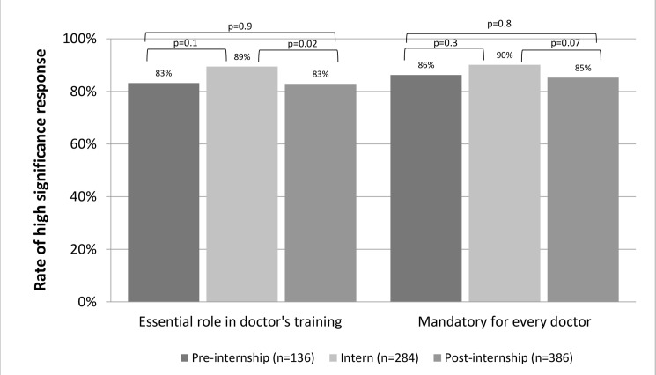
Capstones – Do they help?
Minha S, et al. Plos One. 2016. 11(3).

Slide 13
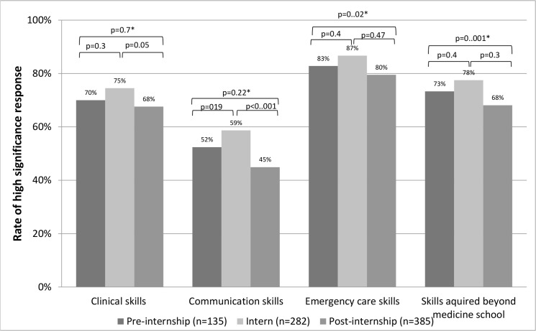
Capstones – Do they help?
Minha S, et al. Plos One. 2016. 11(3).

Slide 14
Models for Capstones
Required capstone for all student regardless of specialty
No required capstone, only specialty specific boot camp type courses
Hybrid model – core required capstone for all students with option for specific boot camp if offered

Slide 15
Specialty Specific or General Capstone
AAMC Website - LCME Annual Medical School Questionnaire Part II

Slide 16
Capstone at NJMS?
We have been running a boot camp for the past 5 years
More recently, EM and Neurosurgery/ENT have boot camps?
Spring 2019 will be the first medical school wide graduation capstone

Slide 17
My Boot Camp
Succeeding at internship
Pronouncing death
Residents as educators
Pain management
Prepping and draping
Instrument identification
Ultrasound basics
Ultrasound simulator
Emergency surgical procedures
Ventilators – didactic and practical
Shock
Central line placement
Financial literacy
Ultrasound practical
Surgical procedures – Trauma-man
Nutrition (surgical)
Professional development
Airway management
Studying as a resident
EMR and order writing
Roundsmanship
Professionalism
Wound care
Communication – informed consent
Communication – breaking bad news
Cadaver lab – surgical skills
Laparoscopic skills - FLS
EKG analysis
“Critical” patient simulation – trauma and post op
Suturing/knot tying
Suture and needle selection
IV placement
Writing operative notes
Mock pages
Radiology – CXR, CT

Slide 18
My Boot Camp
Succeeding at internship
Pronouncing death
Residents as educators
Pain management
Prepping and draping
Instrument identification
Ultrasound basics
Ultrasound simulator
Emergency surgical procedures
Ventilators – didactic and practical
Shock
Central line placement
Financial literacy
Ultrasound practical
Surgical procedures – Trauma-man
Nutrition (surgical)
Professional development
Airway management
Studying as a resident
EMR and order writing
Roundsmanship
Professionalism
Wound care
Communication – informed consent
Communication – breaking bad news
Cadaver lab – surgical skills
Laparoscopic skills - FLS
EKG analysis
“Critical” patient simulation – trauma and post op
Suturing/knot tying
Suture and needle selection
IV placement
Writing operative notes
Mock pages
Radiology – CXR, CT
Applicable to all graduating students Applicable to all students but surgery specific may benefit Surgery Specific

Slide 19
NJMS Hybrid Capstone/Boot Camp
4 weeks – 2 week core and optional 2 week specialty specific
Distribute the burden of teaching
Gives the potential for development of new curricula for the boot camp since now not responsible for teaching all transition skills
Guarantees students going into surgery will have the time “protected” to take boot camp

Slide 20
Capstones – Making a better clerkship?
Are you teaching what you think?
Are they learning what you think?
Allow you to evaluate your clerkship learning outcomes – to allow improvement to your clerkship…

Slide 21
What did I find out?
Blood draw and IV placement?
Order writing?
Informed Consent?
Difficult Conversations?

Slide 22
Capstones are Fun!
Boot camps students
Your mentees
Last chance to work with them before graduation
Easiest “teaching” activity to get faculty for
Other than acting/sub internships – this is the most engaged you will see your students
FEAR!!!!!!

Slide 23
Conclusions
If you don’t have a capstone – get in on the ground floor so you can help model the curriculum
If you have a capstone – be involved.
Are they learning what you think you are teaching?
Help guide curricular development

