Slide 1
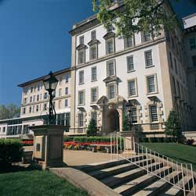
“Stop trying to reinvent the wheel” ACS 4th year Prep Curriculum Update
Surgical Education Week
30 April 2018

Slide 2
Landing Page

Slide 3
Curriculum Builder Page

Slide 4
What do I need?

Slide 5
Course Completion and Grades

Slide 6
Certificate Generation

Slide 7
Letters

Slide 8
Certificate

Slide 9
What it includes
30 goals
6 competencies
122 individual objectives
Hands-on and cognitive modules
Resources needed
Instructors guides and assessments

Slide 10
“Stop trying to reinvent the wheel” ACS 4th year Prep Curriculum Update
Surgical Education Week
30 April 2018

